Slide 1
Postgraduate Course MSFP101 Systems for Food Risk Management
Prof. Eng. Stefan G. Dragoev DSc.
Corresponding Member of Bulgarian Academy of Sciences

Slide 2
Chapter 2 Hazard Analysis and Critical Control Points - A Mandatory System for Food Safety in the EU
Prof. Eng. Stefan G. Dragoev DSc.
Corresponding Member of Bulgarian Academy of Sciences

Slide 3
Content
2.1. History of HACCP. Basic concepts and principles.
2.2. The HACCP system structure. HACCP plans.
2.3. Operational prerequisite programs and CCP records.

Slide 4
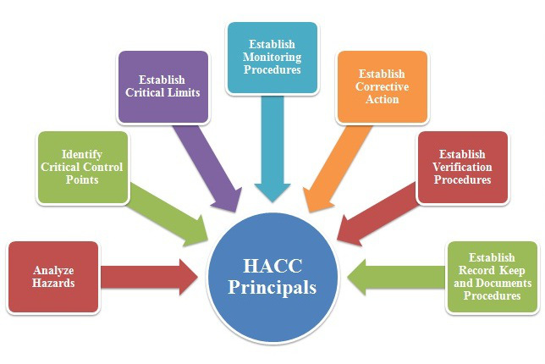
2.1. History of HACCP.
Basic concepts and principles

Slide 5
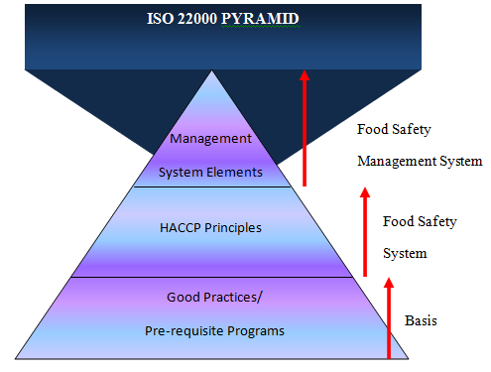
2.1.1. Preface
HACCP is an internationally recognized system that enables companies in the food and feed industry to draw up the framework for the production of safe food / feed and minimize the hazard of food incidents.
The introduction of a food safety management system based on HACCP principles and training on good manufacturing/ hygiene practices GMP-s is regarded as a major step towards ensuring the production of safe food / feed, which is a key element in the Food Act and the Feed Law in the context of protection the health of humans / slaughtering animals and birds. In addition to ensuring significantly the production of safe food / feed, HACCP system has the following advantages:
- Protects the company on conflict of interest;
- Increased consumer confidence in food / feed;
- Expand market position;
- Reduced production losses;
- Commits all staff of the company with production problems safe food / feed.
The implementation of HACCP system is a response to the challenge of producing safe food / feed.

Slide 6
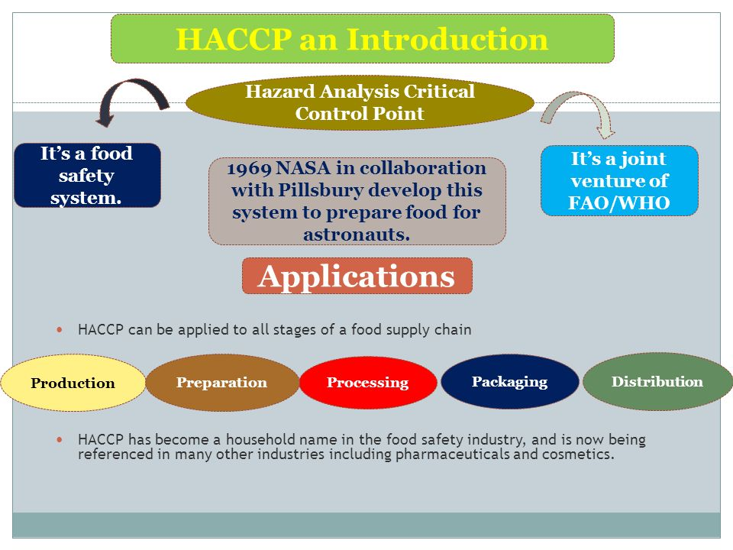
2.1.2. Introduction
Food and feed industries must meet modern requirements for production of safe food / feed. Consumers are increasingly demanding quality and safety of marketed food / feed. An important point in this respect is mandatory harmonization of national legislations in European countries with the acquits in the field of food / feed. Responsibility for the quality and safety of food / feed borne by producers. This leads to a change in the state system for the inspection and control of food / feed. The introduction of HACCP system is one way to implement these requirements.
HACCP is the most easily accessible way for the industry to produce safe food / feed. To be effective, the HACCP system should be applied in each unit along the food chain from the farm to the table. There are opinions that the production and marketing of safe food / feed does not depend on state inspection programs, regardless of whether they are modern and efficient.
Food / feed are safe when used quality materials and technologies for their production - subject to systematic control by the owners of agricultural and livestock farms, businesses and shops.

Slide 7
Who benefits from the introduction and implementation of the HACCP system?
Firstly - those are the manufacturers who will save considerable funds on an ongoing preventive control during the process. Thus preventing the ability to produce finished goods, harmful to human / animal health.
Secondly - those are consumers because through the HACCP system to ensure the production of safe food / feed.
The entire production food / feed chain - farmers, processors, traders and consumers benefit from the introduction of HACCP system, as in every link in the chain will rely that the processes are under control, including critical control points which may hazard the food / feed safety.
The application of HACCP system throughout the food chain ensuring product safety at every stage of production (from primary production to the end product).
Cost that was made for the development, implementation and maintenance of HACCP system may seem high, but the benefits are realized both the business of food and feed industry and the state far outweigh this cost.

Slide 8
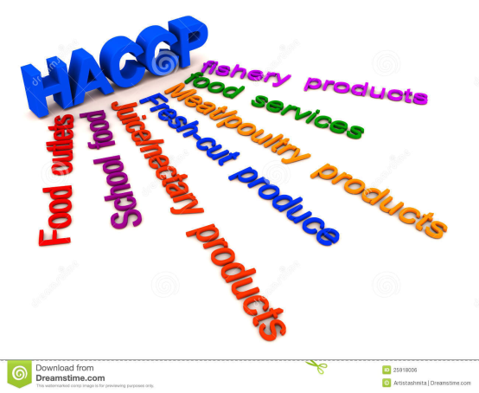
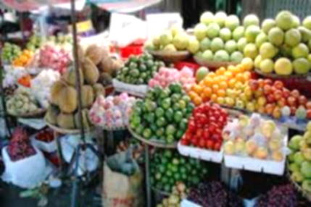
2.1.3. Brief history of HACCP system
The first reports on the use of elements of the food production hazard analysis system dating back to the 40s of XX century. During World War II in the US Army was registered food poisoning with Clostridium botulinum after eating the canned spinach. Analyzing data for its occurrence has been studied and the first systematic analysis of the hazard of food contamination.
In 1959, in a space project of NASA (National Administration of Aeronautics and Space) company, "Pillsbury“ Ltd. (USA) firstly adapts HACCP system to food processing industry. This system was used as a guarantee that food for astronauts in the space program should be completely safe.
At the end of the 60s of the XX century the use of HACCP system in food processing industry for wider use began.
In the early 70s of the XX century in the United States the authorities governing food production and food manufacturers were highly interested in HACCP system as a way to prevent the disease botulism after eating of improperly canned foods with low acidity.

Slide 9
The reasons for this are that it provides a more effective and systematic approach to the control of microbiological hazards than traditional inspection procedures and quality control.
For the processing of healthy food in 1993 Codex Alimentarius (Codex for food) recommends seven principles of HACCP.
HACCP system was established in the feed and food of many countries. Codex Alimentarius apply HACCP system as the international standard.
United States, member states of the European Union and other countries apply HACCP system as a basis for development of regulations governing the food and feed industry.

Slide 10
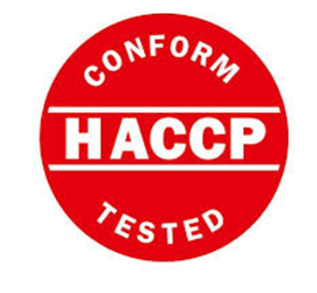
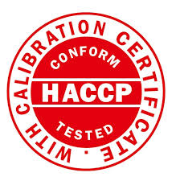
By the middle-70s of the XX century the principles of HACCP remains very limited. Many sectors of the food industry continue to rely on traditional methods of examining the samples of end products and by this way to determine their safety.
This analysis "post factum" are the antithesis of the approach in the HACCP system - for preventive control in the production process aimed at preventing various contamination risks.
Gradually HACCP is recognized as a reliable system for ensuring the safety of food and feed. This situation is also some scientific reports that recommend HACCP system for the production of safe food / feed and for more effective state control.
In 1980, some government agencies of the US, insist the National Academy of Sciences (NAS) and the National Research Council (NRC) to establish a subcommittee to formulate general principles for the application of microbiological criteria for foodstuffs.
In 1985, the Subcommittee on NAS / NRC recommends the implementation of HACCP programs to protect food and training of staff in the food industry, including controllers.

Slide 11
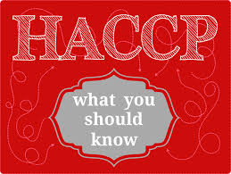
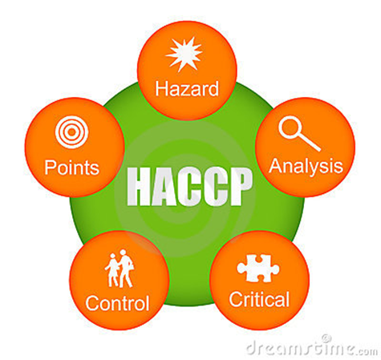
2.1.4. Introduction to HACCP
2.1.4.1. What is HACCP?
The safety of food / feed is the actual problem of great importance both for consumers and other parts of the food chain. Many standards, regulations and various control methods have been introduced to ensure the production of safe food / feed. So far the most effective method to control potential hazards concerning the food / feed safety is HACCP.
HACCP from English (Hazard Analysis and Critical Control Points) is a modern, preventive system for continuous production of safe food / feed. This is a systematic scientific approach for the identification, analysis and control of biological, chemical and physical hazards in each production stage.
HACCP is an active, dynamic system based on thorough scientific knowledge. It has an advantage over traditional methods of inspection of the end product as aimed at identifying of the potential hazards and their elimination or reduction to an acceptable level so as not to provoke unsafe food.

Slide 12
In addition, the HACCP is a management system for food / feed safety through the analysis and control of biological, chemical and physical hazards.
The HACCP system does not focus on the end product but on the preventive control, i.e. control of the whole technological process. The preventive control allows to be made intervention of the corrective actions in case of discrepancies in various processing stages.
HACCP is a system to control the food / feed safety which may be introduced alone or integrated with other quality management systems such as ISO 9001: 2015, BRC, ІFS, etc.
HACCP is most effective when is used in the food / feed processing throughout the food chain "from the farm to the table". This means that HACCP can be used in farms, in feed factories, in primary and secondary food production, storage and in distribution network processors, commercial wholesalers and food / feed retailers.
The successful introduction and implementation of HACCP system is closely linked and depends on effective action of operational prerequisites programs (OPR) and prerequisites programs (PRP-s) of good manufacturing practices (GMP-s).
HACCP analyzes cover of all potential hazards, their risk and determination (identification) of "critical control points" (CCPs) in the process.
Organizations have to continuously monitor the safety by CCP establishment, in order to be able to control them at any time. For this purpose the records for tracking and documenting the food / feed manufacturing have to be kept. These records can be inspected by the state control authorities, in order to verify the adequate control of the technological processes in organization.

Slide 13
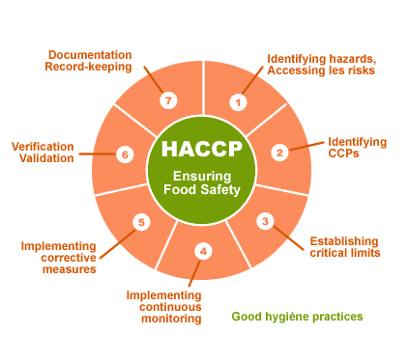
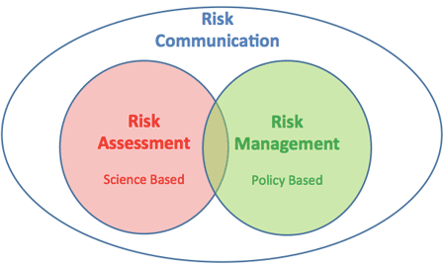
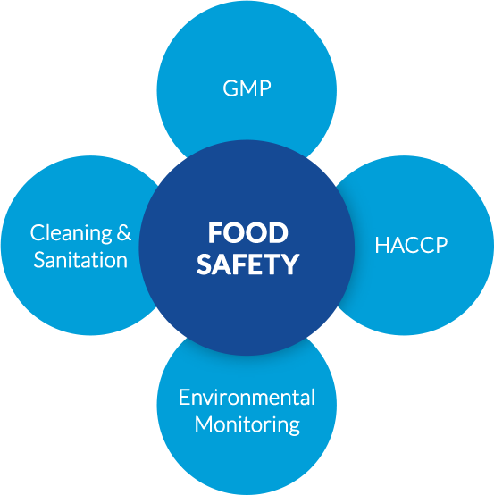
Focusing the attention on the CCP, who are the most important for product safety, the government inspectors, manufacturers and consumers can be confident that the desired safety levels have been achieved.
One very important part from the HACCP introduction is connected with motivation of business owners. In this way will be possible to realize the positive aspects of this system, namely:
This is a control over the entire technological process, which may defended against possible hazards that may occur during production.
The identification of critical control points, in the manufacturing process, influences on the product safety, and put the attention on the creation the conditions for a proper location of technical resources and facilities.
Without to reduce the production losses, the traditional systems of quality control of the end product can lead to large losses for the manufacturer in a result of the product scrapping. In contrast, the HACCP allows for impact during the various phases of the technological process and to be made timely intervention with preventive measures and corrective actions to prevent nonconformity of all or part of production.
The HACCP system is a complementary to any other system of quality control, recognized internationally as the most effective control over the safety of food and feed. Its implementation contributes to raising the prestige of the Organization and its strengthening in both domestic and international market.

Slide 14
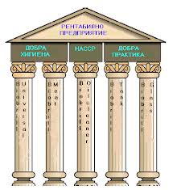
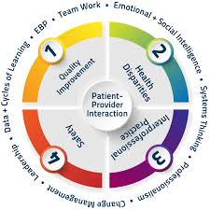
With the aim to improve the hygiene conditions, the staff has a personal responsibility for product safety.
In developing the strategy for the implementation of the HACCP system should take into account both benefits and difficulties, particularly in the small and medium-sized enterprises, namely:
Insufficient readiness and expertise of the management team;
Insufficient financial and human resources;
Unspecified infrastructure and modern technological equipment;
Lack of practical experience, skills and knowledge of different production levels.
Basic prerequisites for implementation and effective functioning of the HACCP system in an enterprise are introduced good manufacturing practices and commitment of the company top management.

Slide 15
2.1.4.2. Responsibilities for the implementation of the HACCP system!
The implementation of the HACCP system leads to a change of the different responsibilities of producers, processors, distributors, retailers, government control and consumers.
Responsibility for the food / feed safety is taken entirely by producers, processors, distributors and retailers.
The role of the state control changes, too. Instead of detecting certain failures, control authorities should assess the effective implementation of HACCP.
The state inspectors have to be familiar with the responsible tasks set by the enterprise to minimize the risk factors for the production of safe food and feed.
The users have great responsibilities in HACCP also. Very often, despite the existence of a functioning system in enterprises, the user can manipulate or improperly stored foodstuff. Subsequently, this can cause damage to the health of consumers. This requires commitment on the part of consumers to act in accordance with HACCP requirements and information from manufacturers for product handling in user.
When HACCP is applied correctly, it is sufficiently effective method for ensuring food safety.
HACCP requirements are not achieved easily. Its implementation is associated with collecting and analyzing large amounts of information, training of workers and HACCP team properly developing specific HACCP plans for each product or group of products.
The successful implementation of HACCP requires high corporate culture and depends on the human factor.

Slide 16
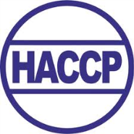
HACCP will be effective only if the staff of every levels has been involved. Of particular importance is the staff to understand their responsibilities under the HACCP system and the importance of their immediate work that they do.
The development, implementation and maintenance of HACCP requires time and commitment from every employee and worker in the company.
The system engages the whole team.
The top management of the organization must have a vision and a policy at all levels to produce safe food / feed.
Operational management must also take maximum responsibility for the safety of the company's products, which is provided by HACCP system.
Every worker should be familiar with the advantages of HACCP and to has concrete obligations to produce safe products.
To ensure success, the employees need to be educated, skilled and retrained.
Staff turnover makes necessary to provide continuous training so that HACCP can be understood by all.

Slide 17
2.2. The HACCP system structure.
HACCP plans

Slide 18
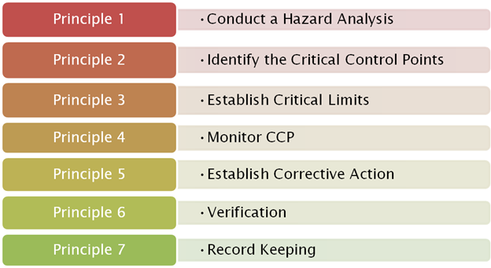
2.2.1. HACCP principles
HACCP is based on seven internationally accepted principles:
Principle 1. Hazard analysis
Identifying potential hazards associated with food / feed in all stages of the process, assess the risk of any hazard and prescribing specific preventive control measures.
Principle 2. Identify the critical control points (CCPs) in the process
Determination of points, procedures or technological steps that are indispensable for prevention, avoidance or elimination to an acceptable level of food / feed contamination or reduce that hazard to an acceptable level.
Principle 3. Define and implement critical limits for each CCP
Determination of critical limits (and if you want the operational limits in addition) that have to be followed to ensure that CCP is under control.
Principle 4. Establish a monitoring system for identified CCP
The monitoring system of CCP is performed by conducting planned observations and examinations.
Principle 5. Determination of corrective actions
Such actions shall be taken in case of nonconformity, i.e. when monitoring indicates that a CCP is out of control.
Principle 6. Enter the verification procedure of the HACCP system
These procedures are performed to confirm that the HACCP system is working effectively.
Principle 7. Documentation and keeping the records of the HACCP system
This principle requires procedures and records consistent with the principles of the HACCP system.

Slide 19
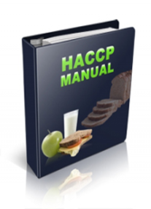
2.2.2. Steps to develop a HACCP plan
According with Codex Alimentarius, in a logical sequence should be implemented 12 steps when the HACCP plan is developing.
Five of them are introductory and 7 are required under the Codex Alimentarius. They correspond to the 7 HACCP principles.
Before the HACCP introduction is important to determine how the company deals with issues of processing the safety products? This includes a review of existing programs to ensure the quality, hygiene programs and good manufacturing practices. With the proviso that these programs are effective, they can become the basis for HACCP plan.
Indicators that should be considered include: maintenance of buildings and premises, processing and storage of raw materials and ingredients, equipment maintenance, compliance with good hygienic and good manufacturing practices, effectiveness of the sanitation program and adequacy of programs for download product from the market in any crisis situation.
When HACCP is implemented it supports the management. The top management of the enterprise have to be aware of the benefits of HACCP regarding product safety.
It should identify a team for the introduction of HACCP, and Coordinator of the team which will be responsible for the entire HACCP plan. This person have to have extensive knowledge and experience on FSMS.
The HACCP team coordinator have to have rights to make decisions and an economic power for implementation of appropriate corrective actions and corrections.
HACCP team appointed by written order from the owner of the enterprise.

Slide 20
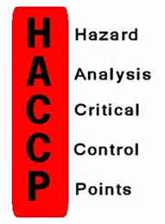
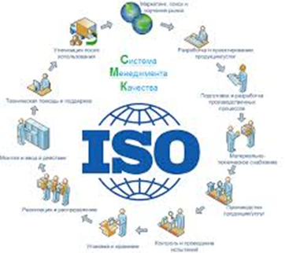
Steps should be taken when a HACCP plan is developing and implementing are as follows:
1. Formation of a HACCP team
2. Description the manufactured food / feed
3. The product designation
4. Development of flow diagram of each products’ group
5. Checking the flow diagram on site
6. Conduct the hazard analysis
7. Identify the critical control points (CCPs)
8. Establishing of critical limits for each CCP
9. Establishing a monitoring system for every one CCP
10. Establishing of corrective actions
11. Enter the verification procedure of the HACCP system
12. Documentation of the HACCP system and record keeping

Slide 21
Step 1. Formation of a HACCP team
In order to define the obligations of the team - they are usually limited to the study of one or a group of products manufactured in uniform technology.
The same team or part of it can be assigned study groups and other products and technologies in the same establishment.
The HACCP team have to be composed from different type of specialists. It is desirable to include experts in various fields - technology, machinery and equipment, hygiene of food / feed production, food microbiology, food chemistry, food quality control etc. Team members have to have excellent knowledge about the technology, and to understand the basic principles of manufacturing operations. They should have some knowledge of the principles and practical steps in developing and implementing the HACCP plan.
The top management the team determined by an order the coordinator of the HACCP team. He coordinates the overall work, convene and chair meetings, liaise with the company's management, defines the needs of tools and other conditions for the task, offers dismissal or appointment of new team members.
For an enterprise with industrial capacity is recommended the HACCP team to be composed of 6 -7 members. Team members are trained, to carry out an analysis of all potential hazards, to assess the degree of risk of any hazard, to prescribe appropriate corrective measures, to identify the hazards that can be brought under control, to offer adequate ways to control, to establish critical limits for each CCP, to develop procedures for monitoring, to introduce the corrective action in the occurrence of deviations from critical limits, to validate HACCP plan in case of relevant changes in technology, regulatory framework and etc.

Slide 22
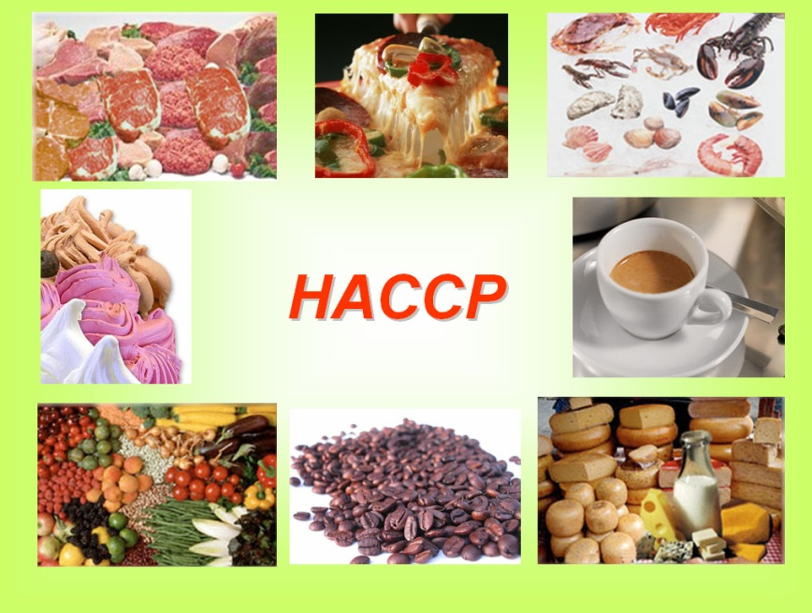
Step 2. Product description
1. Name of the product
2. Important product characteristics
3. How will the product be consumed?
4. Type of product packaging
5. Product storage
6. Shelf life
7. Where the product will be sold?
8. Requirements for product labeling
9. Other requirements to the distribution conditions

Slide 23
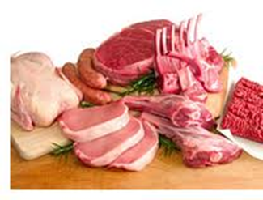
Step 3. Intended use of the product
HACCP team defines the typical or expected use of the product.
It should be assessed whether the product will be targeted in general use or will be used by a specific group of people / animals. It should be described this target groups of people / animals.
If the group of people / animals involves risk subgroups (such as lactating mothers, the sick and elderly people), it should be noted.

Slide 24
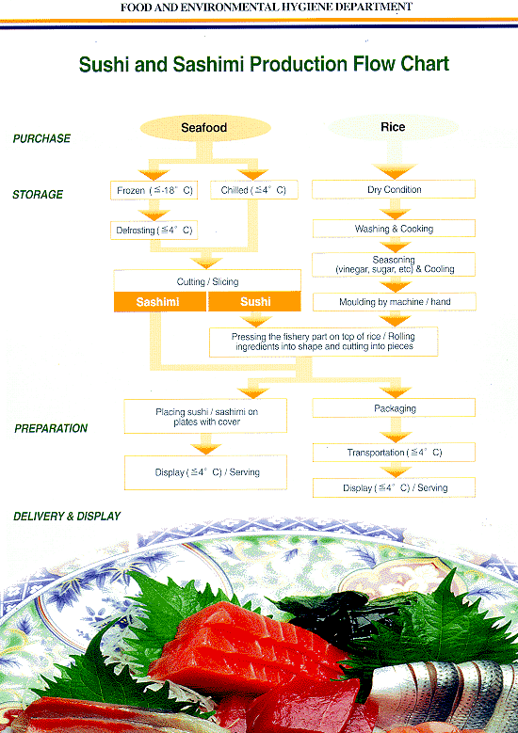
Step 4. Development of flow diagram for each group of products
Once the products have already been described, must be submitted to the processes of production. The flow diagram represents an overview of the rank-order description of the process for manufacturing the product. Compilation of technological schemes (flow diagrams) can be done in different ways.
In this case it is important to get a real idea of ​​the entire production process. In the flow diagram detailing all stages. They must be identical to those of the technological project.
When we drawing up the flow diagram is essential that the following requirements:
- to choose a final product or product group;
- to make a full description of the entire production process;
- to present a clear and simple process diagram;
- to work with templates to achieve clarity and;
- to use unambiguous symbols;
- to use unambiguous terminology.
Symbols
For drawing up the flow diagrams are applicable the international norms for the use of symbols, according to the norm of NEN 3283.

Slide 25
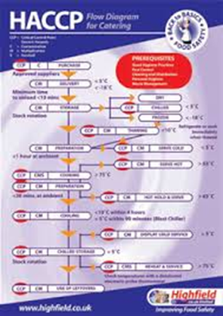
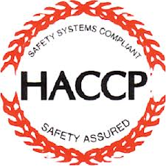
Step 5. Check the location of the flow diagrams
Once composed, the flow diagram of the process must be verified on-site enterprise.
What is the check?
The team must make sure that everything described in flow diagrams really reflect reality in the enterprise.
After the verification of the flow diagrams on site the HACCP team can do in these two ways:
- To alter the flow diagram, if in practice the process does not proceed in the manner described.
- Adjust the flow diagram as incomplete and / or if in practice the process takes place in a better way in those conditions.
The verification visit to discuss and offer all the additions and changes in the flow diagrams and placement of technological equipment.

Slide 26
Step 6. Hazard analysis – A first principle of HACCP
A description of all potential biological, chemical or physical hazards, the appearance of which can be expected in each stage of production (incl. harvesting and storage of raw materials and ingredients and their processing after that).
These hazards arise most often from:
- contaminated materials or components;
- technological gaps in different stages during processing, for example failure of mode and temperature during processing and storage, improper mixing or storage at the inappropriate temperature and relative humidity;
- technological gaps in different stages after processing - cross-contamination between raw materials and finished goods, between clean and unclean flows or between initial and end products;
- unsatisfactory hygienic practices, e.g. unsatisfactory hygiene of workers, ineffective cleaning, sweeping or disinfection of premises, inventory and technological equipment;
- improper storage, distribution and delivery to the consumer.

Slide 27
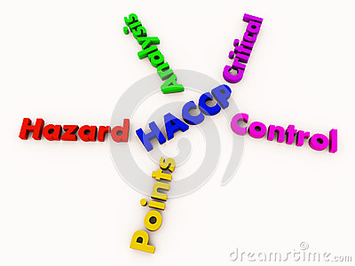
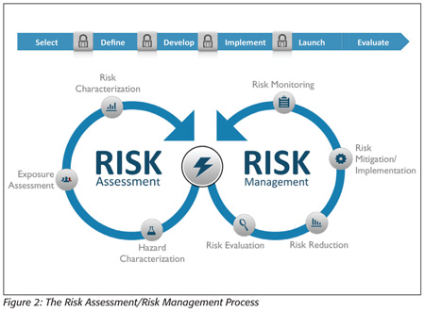
Conducting an analysis of all hazards (biological, chemical and physical) and determine the degree of risk in every one stage of the process.
Hazards, the risk of which is small and for which there is a low probability of occurrence should not be taken into account further.
Hazard analysis requires a thorough knowledge of microbiology and knowledge of microorganisms that may be present in food / feed and the factors conducive to their reproduction.
Discussion and description of the control measures that should be applied to any existing hazards.
Hazard analysis and determination of the related corrective measures aim to: detect significant hazards and appropriate preventive measures to control them; be used to change a phase of the process in order further to achieve or improve the food / feed safety; be the basis for CCP determination.
Hazard analysis requires asking a series of questions adapted to the particular process. In the current recommendations it is not possible to give a list of all matters that may relate to specific food / feed.
HACCP team has the responsibility to decide which risks are significant and should be recorded in the HACCP plan.
During the analysis of risk factors must be distinguished safety issues from these quality.
The hazards and the risks of biological, chemical or physical nature may be the cause of a food incident.

Slide 28
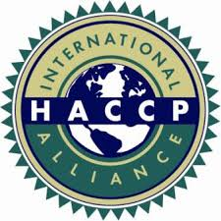
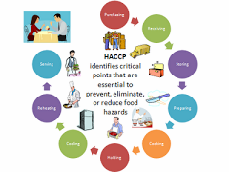
The HACCP team is the one who has to decide what is probability the safety problem to may arise and to what extent this problem is dangerous for the consumers health and life. A prerequisite and basis of the HACCP system are good manufacturing practices (GMP-s).
If GMP-s are not in place and aren't operating effectively, the hazard analysis will reveal many risks. The purpose of HACCP is to prevent real hazards. With GMP-s can prevent a number of hazards and therefore they have to be introduced.
After all hazards and possible measures for controlling have been analyzed, the HACCP identifies of concrete measures that will be implemented.
Management measures, which are part of a common procedure or instruction.
Management measures that are specific to one or more stages of the process.
Examples of measures for common procedures are:
. control of suppliers;
. procedures for cleaning and disinfection;
. instructions on personal hygiene.
Hazards can be divided into three categories: biological, physical and chemical.

Slide 29
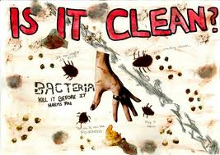
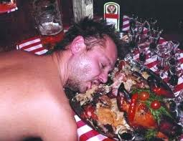
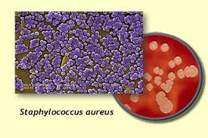
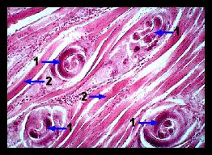
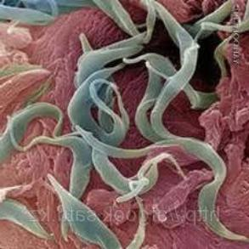
Biological hazards
Biohazards include: microorganisms – bacteria, viruses, fungi, etc., and parasites.
Microbiological hazards
Microorganisms are everywhere, incl. food / feed. Only certain types of microorganisms that are present in food / feed under certain conditions cause diseases. Many diseases in humans / livestock are due to consumption of food / feed contaminated or infected with primary microorganisms.
Toxicological infections occur when live pathogenic microorganisms fall into the human / animal after eating of the contaminated food / feed and find conditions for reproduction.
Acceptance of food containing toxins causing intoxication - these toxins can be natural substances, for example. toxins from poisonous plants, fungi, or toxic products of certain bacteria, i.e. Staphylococcus aureus.
Parasites
Trichinella - Trichinosis is a disease in humans associated with consumption of pork infected with Trichinella spiralis.
- Cysticercs in swine - the meat of pigs can be infected with the larvae of the pork tapeworm (Taenia solium);
- Cysticercs in cattle - meat of bovines may be infested with larvae of the beef tapeworm (Taenia saginata).

Slide 30
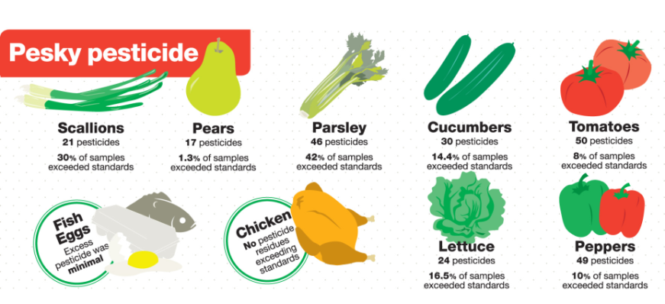
Chemical hazards
Chemical hazards can be divided into two categories: residual and chemical pollutants - substances that contaminate food / feed by the environment during the cultivation, transport or processing.
Residual chemical hazards are:
residues of veterinary medicines conducted after treatment of animals;
residues of antibiotics, sulfonamides, medicines, growth-promoting hormones, etc.;
food remains - of additives used in food / feed and water;
residues of mycotoxins in food / feed;
pesticide residues – such as insecticides, rodenticides and herbicides, and others pesticides;
residues of environmental contaminants - various chemicals for weed control, fertilizers, leaks from equipment and others.
Chemical pollutants are also: various acids, bases, ammonium compounds and others.
Surfactants used for disinfection; cleaning products and solutions for processing equipment and inventory; lubricating oils; paints and varnishes; lead from water supply connections; of aluminum containers; zinc, tin, lead from canned food / feed; some food / feed additives overdose; additives to the water used in production that are used to process it.
Chemical contaminants may enter both the raw materials and to be made during preparation, handling or storage of food / feed.

Slide 31
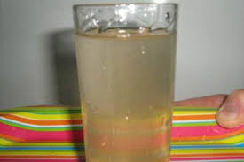
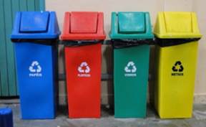
Physical hazards
Under physical threat means the presence of foreign bodies, which are not normally found in food / feed but fall in food / feed can cause illness or injury to humans / animals. Physical contamination of food / feed is usually limited to a single (isolated) cases. Foreign bodies can enter into food / feed of the raw materials or be introduced during the manufacturing process from the environment or workers.
They can be divided into two groups:
- typical physical contaminants:
bone fragments, fur, feathers, metal brackets, plastic, stones, lead shot in the game, parasites - caught or imported raw materials;
glass, nuts, bolts, screws, metal clips, cutting blades, pins, pieces of plastic crates, plastic, rodent excrement and others imported from the environment;
imported by the workers - jewelry, buttons, hair, pieces of nails, nail nails, cigarettes, matches, gloves and more.
- physical hazards occur when certain objects (e.g. - metal) within the product and it becomes dangerous for consumption.

Slide 32
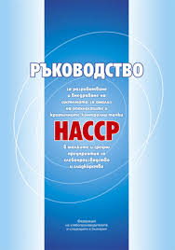
Step 7. Determination of CCP - A second principle of HACCP
CCPs are those points in the process that are essential to monitor the safety of the product and where the incorrect implementation of control would lead to an unacceptable risk to the safety of the food / feed. This could be operations or steps by which take preventive or control measures to eliminate, prevent or to minimize the risk arising prior to these points. In developing the HACCP plan CCP are identified for each product or group of products whose manufacturing process is identical.
It is in these critical points are set and monitor critical limits, sign up data and prescribe specific remedies in case there are deviations.
For each product is needed as well as a detailed analysis of all hazards and establishing a list of CCP. HACCP plans must be individualized for each product or group of products within each individual company to take into account the uniqueness of the different processes, equipment, production - governmental premises, suppliers, customers and employees.
It is necessary to pay attention to all significant hazards.
The establishment of each CCP can be facilitated through the use of the "decision tree". It must consider all hazards that might be expected to occur. Using a decision tree allows to determine whether a CCP to stage a prearranged danger. They can use other methods, according to the experience and knowledge of the team. Critical control points are all points where it is necessary to prevent, eliminate or minimize potential hazards to the safety of feed. CCPs should be carefully defined and documented.

Slide 33
A decision tree for identification of CCPs Answer to each question sequentially at each step and for each hazard!
Question 1: Do control preventive measures exist for the identified hazard?
Remake this step, the process or the product!
NO
Did the control at this stage guarantee product safety?
YES
NO
Question 2. Did this stage specially designed to eliminate or reduce the risk to an acceptable level?
YES
YES
NO
Question 3. Can contaminate to identify hazards or it can be increased over the permissible level?
NO
YES
Question 4: Would it be possible next step to eliminate or reduce the identifying danger to permissible level?
NO
YES
This step is a CCP
This step is not a CCP

Slide 34
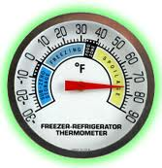
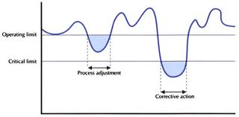
Step 8. Determination and introduction of critical limits for each CCP - A third principle of HACCP
After determining the CCP establish and monitor critical limits , showing that CCP is "under control" - the state when proper procedures are followed and criteria observed.
Critical limits are determined for each CCP to monitor deviations and take appropriate corrective action.
Deviations or discrepancies occurs when there are:
evidence of direct health risk to humans and animals
evidence that can develop direct risk to human health / animal signs that a product can not be produced under conditions which ensure its safety.
For critical limits should be used thresholds values ​​of the parameters of physical, chemical, biological nature that are scientifically justified.
Critical limits can be defined in regulations, standards, guidelines on GMP-s and experimental research.
Besides critical limits must be established and operational limits (OL) for each CCP. These are the limits within which the operator is taking action before they reached critical limits. Operating limits are much stricter and stricter than critical limits and are at levels that were reached before the critical limits. The reasons for defining and establishing operational limits are to be given the opportunity to respond return and normalization process before reaching the critical limits.

Slide 35
2.3. Operational prerequisite programs
and CCP records

Slide 36
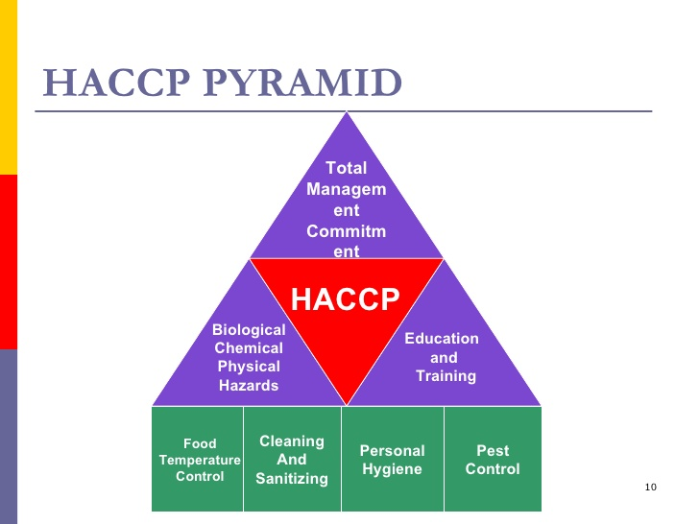
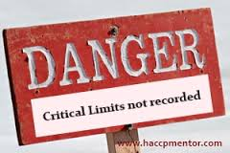
Step 9. Establish a CCP monitoring system – A fourth principle of HACCP
Monitoring is a planned sequence of observations or measurements to assess whether a CCPs is under control and to produce accurate documentation for verification. Monitoring has three main objectives:
First, monitoring is essential for ensuring the safety of food / feed that tracks the activities of the system. If monitoring is established that there is a trend towards loss of control, for example exceeding the specified limits, then can be taken to return the process under control before it has received deviation.
Second, monitoring is used to establish whether has a loss of control and variation in a specific CCPs, i.e. exceeded critical limits. In this case must initiate corrective action.
Third, surveillance document written and used in the test / verification of HACCP plan.
The main methods for monitoring critical control points are:
1) continuous recording of the controlled parameters.
2) visual observation.
3) physical measurements.
4) chemical measurements.
5) express microbiological and other biological assays.

Slide 37
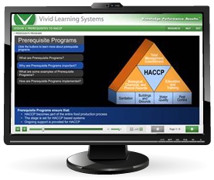
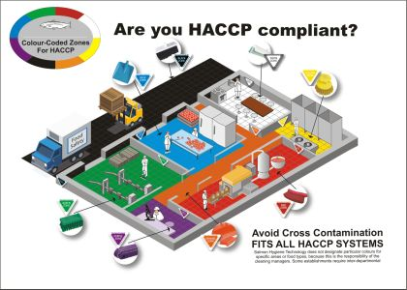
Step 10. Determination of corrective actions – A fifth principle of HACCP
Corrective actions must first be identified, conceptualized and recorded in the HACCP plan. When identifying critical control points define specific corrective actions for each CCP. When deviations occur, can take immediate action to eliminate the disparity in CCP. It is necessary to document corrective actions in the respective registers. Those who know the manufacturing process, product and HACCP should be responsible for the timely execution of corrective action.
Corrective actions are planned in advance by the HACCP team for each critical control point, so should be taken immediately when deviation is observed.
Corrective actions are intended to:
- to discover the causes of the problem;
- to exclude the appearance of new tolerances;
- modify the HACCP plan.
The procedure for corrective action include: precise definition of the person responsible for its implementation; how to perform corrective action; description of means and action required to correct the observed deviation; actions taken on product manufactured during the deviation; written record of the actions taken; follow-up - evaluation of the effectiveness of corrective action.
Deviations and procedures are documented, which is proof of the correctness or nonconformity of the measures taken.

Slide 38
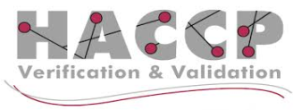
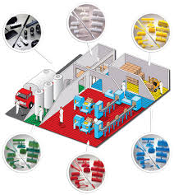
Step 11. Enter the verification procedure of the HACCP plan - A sixth principle of HACCP
Verification are all activities other than monitoring, which indicate whether the HACCP plan is valid and confirm that the HACCP system functions effectively, according to the HACCP plan.
Validation confirms that if the HACCP plan is executed correctly, can effectively control the identified hazards. This is achieved by collecting and evaluating scientific and technical information for each part of the plan HACCP analysis of hazards in each CCP.
Activities confirming that CCP are under control are:
- calibration of monitoring;
- review the records of calibration;
- making targeted samples for testing;
- review the records to determine the CCP.
Internal audits - a continuous process that requires effectively keeping the records. The system allows management to conduct a daily review of the records to determine whether they were observed KG and whether react immediately to problems. Management should also regularly check the health records and documentation for GMP.
External audits - certification and inspection bodies or clients are external auditors of the HACCP system. They perform their own audit to see if it functions successfully. The auditors submit a written report on their observations. If there are deviations give specific advice on corrective actions. These reports should be stored together with the HACCP plan.

Slide 39
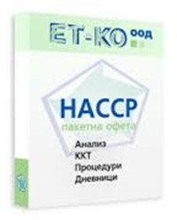
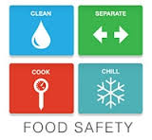
Step 12. Documentation and records of the HACCP system –A seventh principle of HACCP
The approved HACCP plan and related documentation should be kept in a designated place in the enterprise. Generally recordings used in the overall HACCP system have to contain the following:
- list with the members of the HACCP team and their responsibilities;
- description of the product and its intended use;
- the technological scheme of the entire production process, with listed CCP-s;
- risk factors associated with each CCP-s and preventive measures;
- critical limits;
- monitoring system.
- plans for corrective actions when critical limits are exceeded;
- procedures for checking the HACCP system effectiveness;
- registration procedures and documentations.
In addition to the list of members of the HACCP team, product description and usage, flow diagram and other information in the HACCP plans can be presented as a table with records.

Slide 40
References
HACCP: a system of "Evaluation of hazards and critical control points" in meat and poultry processing industry. (2003). Foundation of the American Institute of meat, Baltimore, Washington, USA.
Guidelines for the development and implementation of HACCP systems in food industry, according to national, European and international standards and legislation (2003). Moody International Training Division
Problems in implementing HACCP in enterprises for the production of feed National Conference (2002). "The international management standards - the basis for accelerated growth, competitiveness and investment capacity", FLAG, Sofia, 02.2002, the
Betts, G.T. et all. (1999). Food Spoilage yeasts: effect of pH, NaCl and temperature on growth, Food Control, 9: 27-33.
Codex Alimentarius Commission. (2002). Joint FAO/WHO food standard programme Codex Alimentarius commission Twenty-fifth session Rome, Italy 30 June - 5 July 2003. Report of the third session of the Codex ad hog intergovernmental task force on foods derived from biotechnology, Yokohama, Japan 4-8 March 2002.
Council Directive 93/43 / EEC of 14 June 1993 on the Hygiene of Foodstuffs.
Eiler, J. (1991). Confirms HACCP Performance, Food Processing, 6: 158-160.
Food Quality and Safety Systems (A Training Manual on Food Hygiene and the Hazard of the United Nations). (1998), FAO / UHO, Rome.
Hall, P. Et all. (1993). HACCP Implementation: A General Model for Chilled Foods, Journal of Food Protection, 12: 1072 - 1084.
Hathaway, St. (1999). Management of Food Safety in International Trade, Food Control, 10: 247-253.
Implementation of HACCP in a Food Processing Plant (1993), Journal of Food Protection, 6: 548-554.
Notermans, S. et all. (1995). Identification of CCP-s in HACCP system with a Quantitative Effect on the Safety of Food, Food Microbiology, 2: 93-96.
Notermans, S. et all. (1995). The HACCP Concepts: Specification of Criteria using Quantitative Risk Assessment, Food Microbiology, 12: 89-90.
Notermans, S. et all. (1995). Quantitative Risk Analysis and: Some Remarks, Food Microbiology, 12: 425-429.
O'Donnel, C. (1994). Laying the Groundwork for HACCP, Prepared Food, 4: 49-50.
Peri, C. (1991). HACCP, Italian Journal of Food Science, 1: 5-10.
Recommended International Code of Hygienic Practices of Food Hygiene CAC / RCP 1-1969, Rev. 3. SAS (1997).
Recommended International Code of Hygienic Practices for Dried Fruits CAC / RCP 3-1969, Rev. 3. SAS (1997).
Recommended International Code of Practice for the Processing and Handling of Quick Frozen Foods (1995). CAC / RCP, 8-1976, Rev. 8.
Sperber, W. (1991). The modern HACCP System. The IFT Quality Assurance Division Symposium. April, Anaheim.
Sara, M. (1994). HACCP - a Practical Approach, London.
Snydre, P. (1994). Achieving Successful Total Quality through Behavioral Management, Food Technology, 9: 146-151.

