Slide 1
Advanced Research Methods
Psychology Department
Doctoral Studies Program
Statistics:
Course Presentation

Slide 2
Lies, Damn Lies and Statistics
Cynics sarcastically say that you can prove anything with statistics. Others argue that you can't do anything with statistics. Some remind us that Statistics is a way of lying.
An example:
The vast majority of Greeks have a higher than average number of lower limbs.
Indeed: There are 500 of our compatriots who have no lower limbs (amputations, etc.) Two and a half thousand have one leg. The rest (10 997 000) have two legs.
Average lower limbs of Greeks = 500×0+2.500×1+10.997.000×2 / 11.000.000 = 1,999682.
The vast majority of Greeks have 2 legs, 2>1.999682
M. Manolopoulos

Slide 3
The Importance of Good Statistical Knowledge
Why Statistics is more important than mathematics
Why psychology students hate statistics:
Breaking News - Psychology Students Hate Statistics!
...and why you should not be afraid of it!

Slide 4
Variables and their measurement
Variable: Any quantity/property/attribute that can take variable values.
Any event or characteristic of phenomena, objects or organisms that can be changed and measured.
Different ways of categorising variables
Quantitative - Qualitative
Continuous - Discretre
Independent - Dependent
Importance of the measuring instrument

Slide 5
Independent and Dependent Variables
Independent Variable
The variable that the researcher changes in order to determine the effect of the change on another variable. In a cause-and-effect relationship, the independent variable plays the role of cause
Dependent Variable (Dependent Variable)
The variable affected by the changes the researcher makes to the independent variable. In a cause-effect relationship, the dependent variable plays the role of the outcome

Slide 6
IV or DV, depending on the type of problem under consideration.
Independent Variable |  | Dependent Variable
Student attitude towards school |  | Student's performance at school
Independent Variable |  | Dependent Variable
Educational level of parents |  | Student attitude towards school

Slide 7
4 levels of measurement
NON-PARAMETRIC - No Distribution Assumptions
Categorical or Nominal variables
Ordinal variables
Equal interval variables
Ratio variables
PARAMETERS - Normal Distribution

Slide 8
Test - Examples
The state of health of a patient (very serious, serious, moderate, normal)
The level of education (primary, secondary, tertiary, etc.)
The degree of one's satisfaction with a product (very much / much / a little / not at all)
Nationality (Greek, French, German, Finnish, French, Korean)
The finish time in a marathon race.
Age → RATIO
Age group (10-15, 15-20, 20-25, ...) → ORDINAL
The evaluation system for the university's courses (inadequate = 1, moderate = 2, good = 3, very good = 4, excellent = 5)

Slide 9
Measurement of dependent variable
Ideally:
Objective
Quantitative
Common ways of measuring reactions:
Reaction accuracy
Delay or reaction time: the time between the presentation of a stimulus and the beginning of the execution of a reaction
Reaction rate: time necessary to complete a reaction
Frequency of reaction: how many times in a given period of time
Reaction intensity

Slide 10
Types of Hypotheses
Declarative Hypothesis - H1
(Directional Hypothesis)
The researcher makes a prediction of the result he expects to find in the survey, according to the theoretical background
Examples:
There is a positive association between students' attitudes towards school and their performance
Children with medium anxiety compared to children with low or high anxiety have the highest performance in written tests
Null hypothesis - H0
This hypothesis indicates the absence of an effect or an association between the variables
Example:
There is no association between students' attitudes towards school and their performance

Slide 11
Useful Resources
A brief introduction - a reminder of important methodological and statistical points
http://www.jolley-mitchell.com/Appendix/Introduction%20to%20Statistics.pdf
Useful resources:
https://edge.sagepub.com/field5e
http://stackexchange.com/
Youtube tutorials (e.g. Psychology Research Hub)
Google searches...

Slide 12
Statistics
Sampling, Representativeness
Randomization

Slide 13
Structure (Parts) of Psychological Measurements - Noise Levels
"Actual score" of the quantity we want to measure
"Scores of other irrelevant quantities" intruding in our measurement
Systematic (non-accidental) bias [Problem if it affects some participants more than others, e.g. experimenter bias]
Random (non-systematic/occasional) error (e.g. fatigue, boredom, ambiguity of questions, external distractions, noises) - eliminated by a large number of participants
We want as much of 1 and as little of the rest → Critical role of sampling

Slide 14
SAMPLING: SAMPLE - POPULATION
Nature of the problem determines the type of participants
The ideal sample should be representative
Sample: The subset selected from a larger set of individuals of the same type (e.g. schizophrenia patients, schoolchildren, individuals with dyslexia, etc.) to represent it for the purposes of the research
Population: broadest set of individuals from which the sample is drawn
A basic requirement in any sample-based research is that empirical findings should only be generalised to populations that have the same characteristics as the sample (external validity).
Sample representativeness is determined by:
Samplinh method / selection of included participants
Sample size

Slide 15
Qualitative methods
Targeting wealth of information
Intentional sampling
Maximum Variance Sampling
Outlier sampling
Average / typical case sampling
Theoretical or conceptual sampling
Homogeneous sampling
Critical sampling
Opportunistic sampling (after initiation of the study)
Snowball sampling
Confirmation/rejection sampling
Sample/space size varies

Slide 16
Sampling Types
Non-random sampling (without probability)
Convenient sampling
Snowball sampling
Random sampling (with probability)
Simple random sampling
Stratified sampling
Multi-stage sampling
Cluster sampling

Slide 17
Random Sampling as Generalizability
Random sampling contributes to representativeness, and thus to generalisability
Every member of the population has the same chance of being included in the sample
With this assumption we can statistically calculate the accuracy of the research sample
The opposite is the biased sample, e.g. over-representation or under-representation (c.f. bias error)

Slide 18
Sampling and noise
Random sampling error: sampling inevitably leads to a difference between our measurement and the actual measurement of the population. It depends on
The degree of precision of the sampling we wish to have in our generalisations
The heterogeneity of the population
The magnitude of the difference between the sample value and the population value that is tolerable for the investigator
Relation: error inversely proportional to the square root of the sample size, e.g. ½ error = 4x sample
'Bias error': Biased sample selection (systematic error, fixed direction). Negligence/practical weakness of researcher.
Related to circumvention of random - unbiased sampling. E.g. children's IQ and self-selection
Increasing sample size primarily helps to reduce random error

Slide 19
Bias error and sample size
Example: the US presidential election, 1936. Literary Digest magazine.
10.000.000 voters
Sample selection through the telephone directory and car registration numbers
Systematic error: Not everyone had a phone/car
Non-representative sample: Differences in age, income, etc.

Slide 20
The importance of randomization
Measurement of a variable involves natural variation, e.g. repeated measurement of the same variable in the same individual or measurement of the same variable in several different individuals
Statistics s (or σ) → Standard deviation
Score = True Score + error = TS + e
e = Noise (Experimenter effects, Instrument measurement error, Variable definition error/validity, Reliability problems)
What we are interested in experimentally is whether our experimental manipulation causes a variation around the mean that is statistically more significant than this natural variation.
Randomization separates the TS from the e
Because e is random, the independent variable has an individual effect on the variance of the TS

Slide 21
10 Factors That Play a Role in Determining Sample Size
1) Number of subgroups of the population to be compared
If we move on to further group comparisons, e.g. gender, socio-economic status
Alternative approach: keeping these factors constant
pairwise equation (matching)
repeated measurements
2) *The size of the population*
Numerically small population can be represented by a smaller sample
But influence limited, required sample size does not increase proportionally to population size, but gradually, and up to a point

Slide 22
10 Factors That Play a Role in Determining Sample Size
3) Population heterogeneity with respect to the variable under study
The greater the heterogeneity, the larger the sample we need
Alternative approach: limiting the scope of the population/population of interest
E.g. IQ 50 - 200 vs. 100 - 120, left-handed vs. right-handed
Sample size depends not only on population size, but on how different the members are from each other
4) Are mediating factors controlled for?
The more the 3rd intervening factors, the greater the heterogeneity/dispersion of the population

Slide 23
10 Factors That Play a Role in Determining Sample Size
5) Desired degree of accuracy in our estimates (confidence intervals)
The narrower the desired range of the confidence interval (higher precision) [confidence level], the larger the sample required
6) Size of expected differences
The smaller the expected differences, the larger the sample size necessary to avoid being inconclusive, however small
7) How "novel" is the result of our research expected to be?
Previous research, theories vs. innovation

Slide 24
10 Factors That Play a Role in Determining Sample Size
8) The "leakage - loss" of participants
E.g. longitudinal study. Sample as large as possible.
Continuous representativeness check. Better 90% of a low initial sample than 30% of a large sample
9) Number of information we get from each participant
The less information - measurements, the more the sample.
E.g. case study vs. questionnaires
10) Degree of data reliability
The more accurate the measurements, the more "tidy" and controlled the data collection and analysis process, the fewer the necessary participants

Slide 25
Sample size calculation
Approximate estimate:
Sizes in similar studies by other researchers
The more people willing/available
Depending on the expected study costs
Statistical methods for estimating the necessary sample (e.g. power analysis)
** Must be determined prior to conducting the survey, based on the desired degree of accuracy of the results, and the maximum measurement error that would be tolerated
** Acceptable sampling error rate (p < .05; p < .01; p < .001)
Required size depends on:
Type of research (e.g. psychophysiology vs. personality)
Experimental design (e.g. independent samples vs. repeated measures)
Number of independent variables and their levels
Recommended 10-20% above minimum required size → losses (can also damage representativeness)

Slide 26
Ideal Sample - General Recommendations
Size sufficient to avoid:
Type I error: rejecting a null hypothesis when it is correct
Type II error: accepting a null hypothesis when it is false
Pilot survey for pre-testing both the sampling procedure and the sampling result
Calculation of correlation indicators (correlation): 100 participants, not less than 50, minimum 30 per variable
Comparison of means/standard deviations: 30-50 per group, minimum 15 per group
Comparison of percentages (e.g. control x² ): 10 (5) per facsimile - combined group
Sampling: fewer/more people for individual research questions (e.g. 350 questionnaires)
Parametric (30⁺ ) - Non-parametric (30 )⁻

Slide 27
3 Research objectives: reliability, validity, generalisability
Validity: Measuring what we were interested in measuring.
Reliability: Re-executability by us or someone else
Indicates the degree of stability of measurements/agreement between repeated measurements under the same conditions.
It is expressed by a numerical value - index: Reliability coefficient (0-1)
Generalisability (external validity): Applicability beyond the specific participants, under the specific circumstances
+Importance: Missing in the absence of all the above

Slide 28
Structure (Parts) of Psychological Measurements
"Actual score" of the quantity we want to measure
"Scores of other irrelevant quantities" intruding in our measurement
Systematic (non-accidental) bias [Problem if it affects some participants more than others, e.g. experimenter bias]
Random (non-systematic/occasional) error (e.g. fatigue, boredom, ambiguity of questions, external distractions, noises) - eliminated by a large number of participants
We want as much of 1 and as little of the rest (2 - validity, 4 - reliability)

Slide 29
Statistics
Types of research: Correlational, Experimental, Observational methods

Slide 30
Typical Quantitative Research Designs
Experimental designs
Comparison of interventions/practices or groups
Interference in one or more groups, no interference in another group
Correlational designs
Cases of difficulty of intervention / classification of people in the groups we want
Checking correlation (association or covariation) between variables
Survey designs
Description of trends in a population
Sample
Questionnaire/scale
Attitudes, opinions, behaviours, characteristics
E.g. gallop

Slide 31
Research methods
Correlational
Associations between variables
Observation methods (Questionnaire, Interview, Observation, Focus Groups)
No direct handling of variables
Systematic/comprehensive recording of behaviours to get the best generalisability (trends)
Quasi-experimental
Intermediate solution to problems that prevent us from performing a (fully) experimental study
Experimental
Handling one or more variables
Effective way of measuring them
Causality

Slide 32
Research Types I: The Experimental Method
Causality isolation, Direct variable handling, Random variable control
Distribution of participants in experimental and control groups (e.g. Clinical Psychology: placebo - no drug)
Experimental designs
Independent measurements design (Between-groups design)
2 or more groups for each condition
Each participant participates 1 time, in 1 of the conditions
Within-subjects / Repeated measures design
Each participant participates in all conditions
Mixed designs

Slide 33
Randomization
Between-groups design
Randomisation between experimental groups absolutely necessary
Avoids allocating participants in a biased way, which can lead to systematic differences
Within-subjects design
Randomization (or counterbalancing) of the order of participation in each experimental condition
One experimental condition can affect the next one/s!
Randomization Table/Computer Randomization Generator/Excel

Slide 34
Independent Measurements. Between-groups Design
+
Simplicity (e.g. counterbalancing)
Avoiding the possibility of carry-over effects
Practical difficulties of each participant's participation in all experimental conditions
-
Costly in terms of time, effort, number of subjects
Lack of sensitivity to experimental manipulations (statistical reasons - statistical power, noise, systematic differences between groups, etc.)
C.f. Group equation (matching)

Slide 35
Repeated Measures. Within-Subjects Design
+
Economy
Sensitivity - less "noise"
The ultimate equation (matching)!
Wherever possible, preferable to comparing different groups!!
-
Carry-over effects from participation in previous conditions, systematic differentiation
Fatigue, boredom, practice
Randomization of the order of conditions
Counterbalancing - can be a variable in statistical analysis e.g. A-B, B-A
Independence between belonging to each condition

Slide 36
Experimental Design
Experimental group VS control group
1 independent variable with 2 levels (presence - absence of experimental manipulation)
Frequently also covariate analysis
More complex experimental designs:
Multiple levels of independent variables
Latin square designs
Multi-factorial designs
Multi-factorial designs with repeated measurements

Slide 37
Multiple levels of independent variables
Example: drug dosage.
Important: Control of order effects
Latin square. Counterbalancing: each possible set of conditions is shown only once.
Weighted Latin square (when we have an even number of conditions, e.g. A before B more times than B before A)
2, 3 or more independent variables OK for correlation, difficult more than 3 for experimental design

Slide 38
Latin Square Designs (Latin Square Designs)
Problem: They do not completely eradicate serial effects, e.g. A before B more times than B before A
Solution: weighted Latin Square design (when we have an even number of conditions)
A B C D
B D A C
D C B A
C A D B
With more independent variables, it can be calculated automatically: http://www.edgarweb.org.uk/choosedesign.htm

Slide 39
Multivariate Experimental Designs
2, 3 or more independent variables
OK for correlation, difficult with more than 3 for experimental design
Interactions of independent variables: More universal/generalizable research
Between subjects design: the number of necessary participants is greatly increased
E.g. Air traffic controllers
Shifts: Morning, Noon, Evening
Room temperature: Cold, warm

Slide 40
Descriptive Statistics

Slide 41
What is Statistics Used For?
Exploratory Data Analysis (EDA) – Descriptive Statistics:
Summary
Finding patterns
Identifying potential causes and underlying structure (forming hypotheses)
Confirmatory Statistics: Verification (or testing) of hypotheses
Inferential Statistics: Checking if a hypothesis is justified based on our data

Slide 42
Exploratory Data Analysis
Pre-analysis Checks: Verification for potential errors/omissions before starting statistical analysis
Omissions/Errors – e.g., data copying to the computer
Missing Data – we can estimate them based on the remaining data if we want to avoid losses
Outliers – if not the result of an error, they can undergo mathematical transformation
Descriptive Tables – graphs
Checking for patterns

Slide 43
EDA - Slogan
It all started with a scientist/book:
Tukey,J.W. (1977) Exploratory data analysis Addison-Wesley
“Exploratory data analysis can never be the whole story, but nothing else can serve as the foundation stone—as the first step.”
“It is important to understand what you CAN DO before you learn to measure how WELL you seem to have DONE it.”

Slide 44
A Research Example
Language Comprehension Ability
ΣΤ` elementary school grade, 50 students
Language ability test
Scale 1 – 10 (1 = lowest, 10 = highest)
5 8 7 4 6 10 5 8 6 7 6 7 5 9 4 7 4 4 5 8 6 1 6 7 5 3 5 9 5 10 4 8 6 3 6 1 5 7 4 8 9 6 3 6 5 6 7 5 8 6

Slide 45
Descriptive Statistics: Numeric - Graphic Methods
Descriptive Statistics:
Summary presentation of the sample and values checking
Numeric methods
Measures of central tendency
Measures of dispersion
Graphic methods
(e.g., frequency distribution)
Selection based on the type of variable to be presented

Slide 46
Numeric Methods:
Mode
A central value to represent the sample.
Mode: Observation with the highest frequency (typical score).
Suitable for measurements with many repetitions (e.g., discrete data), even for nominal scale data.
Not influenced by extreme values.
More than one mode possible? (bimodal – multimodal)
EXAMPLE
10 10 8 1 3 5 7 2 3 10 6 10

Slide 47
Mode
5 8 7 4 6 10 5 8 6 7 6 7 5 9 4 7 4 4 5 8 6 1 6 7 5 3 5 9 5 10 4 8 6 3 6 1 5 7 4 8 9 6 3 6 5 6 7 5 8 6
Simple frequency count.
Average the 2 values in case of tie in frequencies.
Probability of a bi-modal / multi-modal distribution.
Probability of no mode.
Values | Frequency (f) | Values | Frequency (f)
1 | 2 | 6 | 11
2 | 0 | 7 | 7
3 | 3 | 8 | 6
4 | 6 | 9 | 3
5 | 10 | 10 | 2

Slide 48
Advantages / Disadvantages of Mode
Advantages | Shows the most frequent value in the distribution. Unaffected by extreme values. Can be calculated even with unknown outliers. Provides more information about the distribution than the mean, when the distribution has a U shape.
Disadvantages | Does not take into account the exact value of each measurement. Cannot be used to calculate population parameters. Not useful with a small number of data points with similar frequencies (e.g., 1, 1, 2, 3, 3, 4). Cannot be accurately calculated when dealing with grouped distributions (e.g., age groups).

Slide 49
Numeric Methods: Median
Median The number in the middle of a series of a sample observations, after arranging them in ascending or descending order, is the (n+1/2)^{th} observation. If the total number of values is even, then it is the average of the 2 middle observations.
Not influenced by extreme values and non-normally distributed data.
Suitable for ordinal/interval/continuous variables.
Sensitive to sampling fluctuations. Does not take into account all data points in the sample.
EXAMPLE
10 8 1 3 5 7 2 3 10 6 10
1 2 3 3 5 6 7 8 10 10 10

Slide 50
Median
18 25 21 4 13 15 17 22 28
4 | 13 | 15 | 17 | 18 | 21 | 22 | 25 | 28
1 | 2 | 3 | 4 | 5 | 6 | 7 | 8 | 9

Slide 51
Median
18 25 21 4 13 15 17 22
4 | 13 | 15 | 17 | 18 | 21 | 22 | 25
1 | 2 | 3 | 4 | 5 | 6 | 7 | 8
17 + 18 / 2 = 17.5

Slide 52
Median
13 21 17 4 13 21 17 21 28
4 | 13 | 13 | 17 | 17 | 21 | 21 | 21 | 28
1 | 2.5 | 2.5 | 4.5 | 4.5 | 7 | 7 | 7 | 9
1 | 2 | 3 | 4 | 5 | 6 | 7 | 8 | 9

Slide 53
Median
13 21 17 4 13 21 17 21 28 30
4 | 13 | 13 | 17 | 17 | 21 | 21 | 21 | 28 | 30
1 | 2.5 | 2.5 | 4.5 | 4.5 | 7 | 7 | 7 | 9 | 10
1 | 2 | 3 | 4 | 5 | 6 | 7 | 8 | 9 | 10
17 + 21 / 2 = 19

Slide 54
Advantages/ Disadvantages for Median
Advantages | Usually easier to compute than the mean (not always). Not affected by extreme values, better for skewed distribution. Can be calculated even with unknown outlier values.
Disadvantages | Does not consider the precise value of each observation. Cannot be used to calculate population parameters. If the distribution has few observations, it may not represent them accurately (e.g. 2, 5, 8, 67, 110 → δ = 8).

Slide 55
Numeric Methods: Mean
Mean. x = ∑x_{i} / n
Affected by extreme values / non-normal distributions.
For ordinal/interval/continuous variables.
Utilizes all values in the sample.
Mathematically useful, insensitive to sampling fluctuations.
EXAMPLE
9 7 6 6 7 - 4 3 9 9 10
x = 7

Slide 56
Advantages/ Disadvantages for Mean
Advantages | Easy to calculate. Represents more accuratelly the central value of the distribution than other indicators. Can be used to calculate population parameters (parametric tests).
Disadvantages | Sensitive to the values in the distribution. Since it is calculated algebraically, its value may not be part of the distribution's values. Very sensitive to outliers.

Slide 57
Choosing Central Tendency Measurements
Μean.
Symmetric distribution
Equal intervals / ratio scale
Parametric analyses
Median
Asymmetric distribution – Outliers
Ordinal scale
Equal intervals / ratio scale
Mode
Fast assessment
Nominal / ordinal scale

Slide 58
Representativeness of the Mean
The mean as a statistical model representing our data
Representativeness evident from the homogeneity of the data, how much individual values differ from the mean (x_{i}-x)
Model validity: What interests us is the dispersion (variability) of values around the mean ∑(x_{i}-x)
Hence, the need for measures of dispersion
Variance: ∑ ∑ (x_{i}-x)² / Ν-1

Slide 59
Numerical Methods - Measures of Dispersion
Variance [s²] –––– Standard deviation [s]. Variance (Dispersion): The spread of values from their mean. Influenced by outliers.
Range The difference between the largest and smallest observation. Influenced by outliers.
Interquartile range The difference between the third quartile (Q3, representing the upper 25% of data) and the first quartile (Q1, representing the lower 25% of data). Not influenced by outliers.

Slide 60
Advantages / Disadvantages of Range
Advantages | Easy to calculate. Includes the extreme values of the distribution.
Disadvantages | Affected by extreme values. Does not provide information about the dispersion of values between the extreme values.

Slide 61
Advantages / Disadvantages of Interquartile Range
Advantages | Not affected by outliers. Relatively easy to compute. Representative of the central values of the distribution.
Disadvantages | Is not influenced by outliers. Does not allow precise interpretation of a specific value in the distribution. Inaccurate with data grouped with large intervals. Does not describe population parameters needed in inductive statistics.

Slide 62
Advantages / Disadvantages of Standard Deviation
Advantages | Can be used to calculate population parameters needed in inductive statistics. Takes into account all observations. The most sensitive measure of dispersion.
Disadvantages | Relatively complicated calculation Extremely sensitive to outliers

Slide 63
Choosing Dispersion Measures
Outliers?
Avoid standard deviation
Ordinal scale
Interquartile range (and median)
Mode / range, complimentarily
Interval / ratio scale
Standard deviation (and mean)

Slide 64
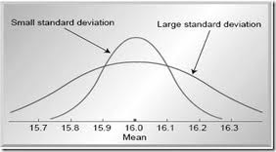
Standard Deviation and the Shape of the Distribution
Sample Variance and Standard Deviation indicate:
The accuracy of the mean as a model representing our data.
9 7 6 6 7 || 4 3 9 9 10 → x = 7
the shape of the distribution

Slide 65
Measures of Central Tendency & Types of Distributions
Normal Distribution (α)
As the sample size increases, it tends toward a normal distribution.
Mode, median, and mean coincide.
Positive Skewness (β)
Mode → Median → Mean.
Negative Skewness (γ):
Mean → Median → Mode.
Kurtosis – Broad / Narrow
α
β
γ

Slide 66
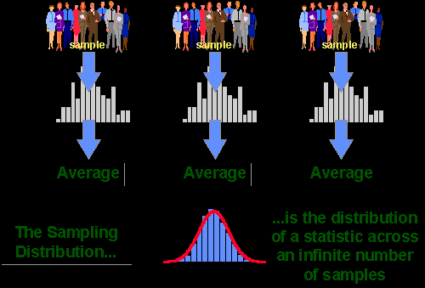
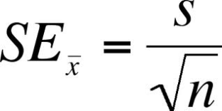
Sample Distribution – Standard Error
How well does our sample represent the population of interest?
The average among various samples from the same population will differ slightly.
How representative is the mean of our sample?
Standard error: The "standard deviation" among samples

Slide 67
Confidence Intervals (C.I.)
Common Confidence Level in Psychology: 95%
How confident are we about the upper and lower bounds that the mean of any sample will fall within?
In psychology, with a 95% confidence level:
95 out of 100 different samples we take will have their means between the upper and lower confidence limits.
Top C.I. = M + 2 * SE
Low C.I. = M – 2 * SE

Slide 68
Descriptive Statistics: Graphical Methods
Various graphical methods of representation
(Measurement scale of data is considered in the selection)
Histogram
Stem and leaf plot
Box plot
Bubble chart
Scatter plot
Run chart

Slide 69
Frequency Distribution / Bar Chart: Nominal Data
Studies Frequency Relative Frequency
All three convey the same information
(based on the same data: frequencies).
Simply different presentation.
Bar chart
Pie chart

Slide 70
Quantitative Data: Frequency Distribution
Pros of grouping: Better management for extensive data, easier estimation
Cons of grouping: Loss of information
Decision on grouping range is subjective
Notes:
Όρια διαστημάτων
Μέση τιμή διαστημάτων
Εύρος διαστημάτων
Συχνότητα διαστημάτων

Slide 71
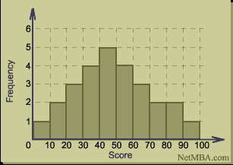
Histogram: Frewquency Distribution – Quantitative Data
How wide should the columns (bins) be?
Where should they start?
Are the apparent structures real (especially double peaks - bimodality)?
Choices on these matters can dramatically impact the apparent interpretation of the histogram.

Slide 72
Stem and Leaf Plots
Data representation in a type of historgam
54 56 57 59 63 64 66 68 68 72 72 75 76 81 84 88 106
Tens on the stem and units on the leaf
Advantage:
Impression of the general structure of the data
Includes all the data
Can be used for comparing two groups of data
5 | 4 6 7 9
6 | 3 4 6 8 8
7 | 2 2 5 6
8 | 1 4 8
9 |
10 | 6
Set A Set B
------- -------
6 5 3 | 4 |
8 7 6 5 | 5 | 4 6 7 9
7 3 2 | 6 | 3 4 6 8 8
4 2 | 7 | 2 2 5 6
6 | 8 | 1 4 8
| 9 |
| 10 | 6

Slide 73
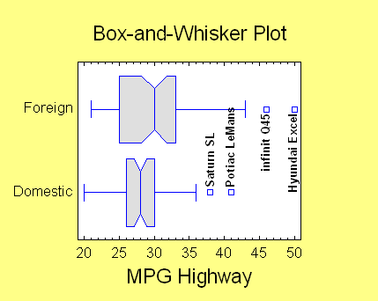
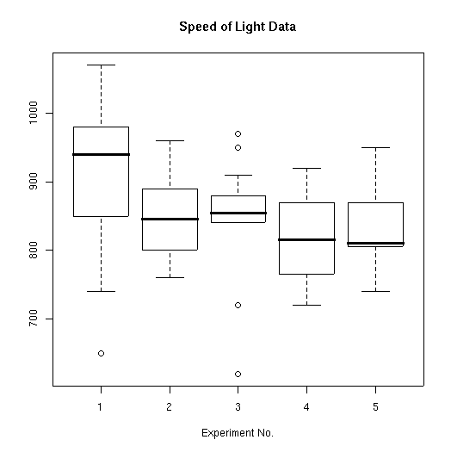
Box plot
Reporting only the mean can hide important details about the data structure.
Mean does not give the full picture regarding:
Variance
Symmetry
Floor – ceiling effects
Outliers

Slide 74
Boxplots
The 5 Number Summary
Upper fence
largest obs inside the fence (4)
Q3 (hinge)
Median (1)
Q1 (hinge)
smallest obs inside the fence (3)
Outside observation (outlier) (5) Lower fence
Whiskers
k(q3-q1)
usually k=1.5
k=3 → extreme outliers
Q3-Q1 (2) [50% of values]
k(q3-q1)
Interquartile range describes the spread
Notes:
50% of the data lies within the inter quartile range
If a data point is more the 1.5 time the inter quartile range above or bellow the relevant quartile, it is in some sense an outlier
If it is more than 3 time the inter quartile range away from the relevant quartile, it is an extreme outlier, other wise it is a mild outlier
These outliers are potentially very important and should be marked!

Slide 75
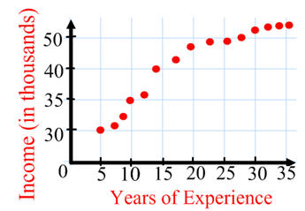
Scatter plot
Graph illustrating the relationship between two ratio variables. We are interested in understanding how the two variables correlate.
To examine this relationship, we create a scatterplot, a diagram which plots one variable against the other.
The independent variable, denoted as X, is usually placed on the horizontal axis, while the dependent variable, represented by Y, is positioned on the vertical axis.

Slide 76
Scatter plot
Linearity and Directionality are two concepts of interest
Positive Linear Association
Negative Linear Association
Weak or non-linear Association

Slide 77
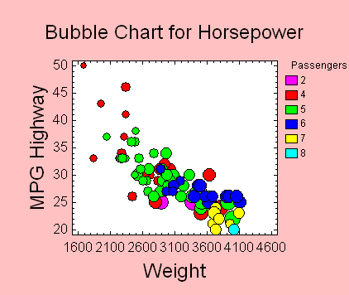
Bubble chart
The bubble chart can be used to represent four variables simultaneously:
Χ Axis
Υ Axis
Bubble Size
Bubble Color

Slide 78
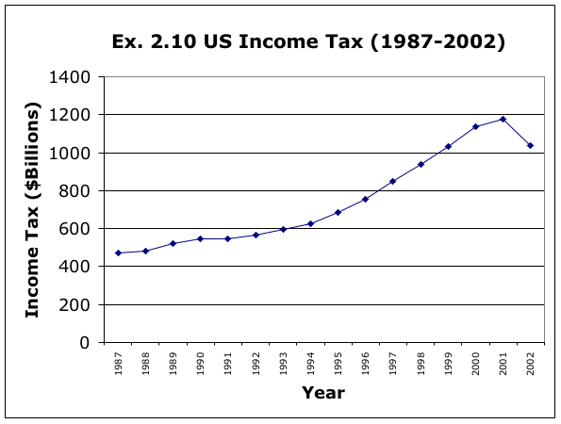
Timeseries Data
Observations taken at the same moment in time are called cross-sectional data.
Observations taken at successive time points are referred to as time-series data.
Time-series data are presented using line charts, which plot the variable's value on the vertical axis in relation to time periods on the horizontal axis.
Visualization of total income tax in USA for the years 1987 to 2002…

Slide 79
Cycling Time Improvement
Run Chart – Graphical representation of a characteristic measured over time.

Slide 80
Check List for Graphical Methods
Does a graphical representation contribute to:
Maximizing the understanding of a set of data?
Revealing the underlying structure of the data?
Extracting significant variables?
Detecting outliers and anomalies?
Checking underlying assumptions?
Developing economical (parsimonious) models?
If yes, include it!

Slide 81
Elements of Good Representation
Systematic organization for better understanding
Semantic autonomy
Accompanied by clear and supportive titles (graph, table, axes, etc.)
Pay attention to scale of measurement

Slide 82
Presenting Descriptive Statistics
In writing (in text or in tables) or graphically
Reporting means (and standard deviations) for each experimental group / control group
Standard error / confidence intervals
APA guidelines. Use 2 decimals
M = Mean
Mdn = Median
SE = Standard Error
SD = Standard Deviation
EXAMPLE: The mean number of pints a tourist will drink before starting to walk around Faliraki naked is 12 pints (SD= 2.34)
Women require a significantly smaller number of drinks (M=8.4, SD=2.53) compared to men (M=12, SD=1.22) before experiencing difficulties in walking.

Slide 83
Summary: Which Method to Use?
 | Numerical Data | Nominal Data
Data from one Variable. | Histogram, Boxplot, or Stem and Leaf Plot | Frequency Tables and Relative Frequencies, Bar Charts, and Pie Charts
Association Between two Variables | Scatterplot | Association Tables, or Bar Charts

Slide 84
SPSS: Calculating Measures of Central Tendency & Dispersion
Analyze → Descriptive Statistics → Frequencies
Statistics
Choose Mean, Median, Mode
Analyze → Descriptive Statistics → Explore
Dependent: Performance
Factor: Class
Statistics
Choose Both

Slide 85
SPSS – Descriptive Methods
Creating Frequency Tables
Analyze → Descriptives → Frequencies
Graphs
In the same menu, choose “Charts”
Bar chart, Pie chart, Histogram
Chart values: “Frequencies” or “Percentages”
Diagrams
Analyze → Descriptive Statistics → Explore
“Display” menu, option “Plots”
Stem and Leaf, Histogram, Boxplot
Line Chart: Graph → Legacy Dialogs → Line (Simple Line Chart)
Boxplot
Graphs → Legacy Dialogs → Boxplot

Slide 86
Sources
Roland Baddeley, University of Bristol (2006)
Brooks/Cole, Thomson Learning Inc. (2005)
-----------------------------------------------------------------------
Tukey (1977) Exploratory data analysis. Addison-Wesley.
The book that started all about EDA.
Hogan,D.C. Mosteller,F. and Tukey,J.W. (1983) Understanding robust and exploratory data analysis
Good in the cases where we need transformations.
Web sites:
http://www.statgraphics.com/eda.htm
http://www.itl.nist.gov/div898/handbook/eda/eda.htm
http://en.wikipedia.org/wiki/Exploratory_data_analysis

Slide 87
Statistics
Inferential Statistics Hypothesis testing Correlation, T test

Slide 88
Sampling Error, Individual Differences And the Central Limit Theorem
Sampling error
Two experimental groups sampling the same population are expected to have similar means, but there will be little difference between them (due to individual differences)
Central Limit Theorem
Averages of many different samples will probably be close to the population average
Inferential Statistics helps us to estimate the probability of error in terms of the representation of a population by characteristics of a sample (e.g. mean, standard deviation, etc.)
More generally, it defines the probability of error contained in the conclusions of a statistical analysis

Slide 89
Sample classification - Typical error
The sampling distribution is a normal distribution of different samples, so we can make predictions based on this distribution
For example, of the infinite possible samples, X has a 68.26% chance of being 1 standard deviation from m.
95% → Z = +-1.96. 99% → Z =+-2.58. 99.73% → Ζ = +-3
Z values are a way of expressing a measurement in terms of how many standard deviations it is from the mean
E.g. X = 75, s = 18, N = 36
σ_{Χ} = 18 / √36 = 3 (standard error)
CI_{95%} → Z = 75 +-1.96 * 3 → 69.12 to 80.88
CI_{99%} → Z = 75 +- 2.58 * 3 → 67.26 to 82.74
Standard error (σ): the standard deviation of the samples

Slide 90
Inferential Statistics & Hypothesis Formulation
The aim is to describe a phenomenon, to draw conclusions about a function
Hypothesis testing to investigate scientific questions
Experimental hypothesis (H1): hypothesis that the experimenter's manipulation will have some effect
Null hypothesis (H0): the experimental manipulation will have no effect - no difference between two conditions
E.g. Drinking alcohol increases the likelihood of falling H1: Alcohol users will fall more often than non-users H0: Falls are as frequent regardless of alcohol consumption

Slide 91
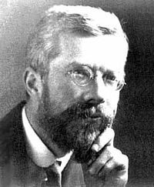
Inferential Statistics
Inferential statistics tests the probability that our experimental prediction is right or wrong
Assessing whether the data we have collected is the result of randomness
Reducing the probability of random effects increases the likelihood that they are due to our experimental manipulation
For example, the greater the difference in the means of 2 samples, the more likely they represent different populations
Rejection of H0 – Acceptance of H1
We accept our findings as true only when there is 95% confidence that our result is not a product of chance
If the probability of it being random does not exceed 5%, then we can accept our findings
95% (p < .05) has simply become accepted as a norm in psychology because of Ronald Fisher's (1890-1962) proposal

Slide 92
Increasing Confidence in Research Findings
Experimental manipulation may lead to differentiation of the mean of 1 sample, with two possible explanations:
Experimental manipulation changed what we measure (two different populations)
Samples come from the same population, but we selected individuals with opposite properties from within that population (outliers from the normal sample distribution), so experimental manipulation did not make a difference
The greater the difference between the means of 2 samples, the more likely they represent different populations

Slide 93
Hypothesis Testing
Calculating the probability that two samples come from the same population
High: No effect of experimental manipulation (H0)
Low: Effect of experimental manipulation (H1)
Exactly how much probability is low? Fisher says 5%!
How exactly do we calculate this probability?
Depends on the experimental design and method of data analysis
However, we can review some general principles...

Slide 94
Calculating the probability that the samples come from the same population
Sources of volatility:
Systematic differences due to experimental manipulation
Non-systematic differences due to individual differences between samples (e.g. intelligence, motivation)
We test the difference between two samples using statistical tests whose characteristics we know
We know the distribution, and therefore we can calculate the probability of getting any value in that distribution - example age of death!
For a comparison of two different sample means, statistical tests represent the following fraction: Systematic Differentiation / Non-Systematic Differentiation
Comparison of variability resulting from experimental manipulation with naturally occuring random variability

Slide 95
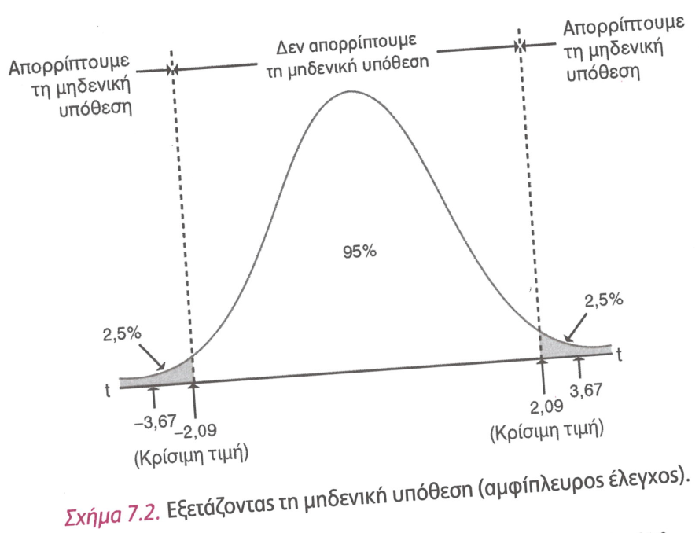
Hypothesis Testing procedure
Formulation of hypotheses
H0, H1
Selection of an appropriate statistical criterion
Type of variables
Measurement scale
E.g. parametric - non-parametric
Definition of significance level (a)
Usually 5% or 1%
Comparison with critical value
Rejection/acceptance area
Equal or greater = Statistical significance
Two-tailed (two-sided) VS. One-tailed hypothesis

Slide 96
What does the probabilistic nature of statistical tests mean?
Two objective possibilities:
Our experimental manipulation had an effect on the 2 samples
Our experimental manipulation had absolutely no effect
Statistical tests tell us which of the two alternatives is more likely.
We want to be as confident as possible, so we use a strict Fisher significance level of α=5%
Because the process is probabilistic, the conclusion may not hold, even if we have 95% confidence that the difference is not random

Slide 97
7.

Slide 98
Two types of errors
Type I error: we accept H1, i.e. that our experimental manipulation caused the differentiation of the 2 samples, when in fact it is not true.
E.g. We randomly selected two very different samples, so they also differed in the mean, regardless of our experimental manipulation
This result is one of the 5 times we could be misled if we repeated the experiment 100 times (α=.05)
Type II error: we reject H1 (and thus we accept H0), i.e. we assume that our experimental manipulation had no effect, when in fact it did.
E.g. Our intervention worked but the statistical test gave us a low value, perhaps because there is a high degree of natural variability in the 2 samples (c.f. the equation mentioned earlier)
Ideally this error should have a small probability of occurring (1-β = .2)

Slide 99
Effect Size
Measuring the magnitude of the difference in our measurement can add complementary information to the likelihood of this difference being random
Such effects may be: experimental manipulation, magnitude of association between variables
Objective and standardized measurement of the magnitude of the observed phenomenon
It can be compared between different studies, measurement units and so on.
Pearson correlation coefficient (r)
r = 0.10 - small
r = 0.30 - moderate
r = 0.50 - large
r² = The total percentage of variability that can be explained by the experiment

Slide 100
Statistical Power (Statistical Power)
The effect size is affected by:
Sample size
Level of significance (a)
Power of the test to discover a phenomenon of this magnitude
If we know the first two, we can also calculate the third
1 - b (type II error) : The probability of finding an effect that exists
After the experiment is done we know: 1) significance level (e.g. α = .05), 2) effect size of our sample, 3) sample size → we can calculate β (the power of our test), we want it to be above 0.8
Calculating the sample size in advance is necessary to discover a certain effect size: a and b are known, effect size estimation from previous surveys → from these we can deduce the number of participants in each sample

Slide 101
Sample size calculation
Complex statistical calculations, but nowadays there are corresponding programs (e.g. nQuery Adviser)
Cohen tables
Guidelines:
α = .05, β = .8
r = .1 → 783
r = .3 → 85
r = .5 → 28

Slide 102
Confidence Intervals (C.I.)
Confidence level commonly used in Psychology: 95% (99%, 90%...)
How confident are we about the upper and lower limits in which the average of any sample will be included?
95 of the 100 different samples we take will fall between the upper and lower limits of the confidence levels
Confidence interval: The range of values within which the actual value of the parameter of interest lies (e.g. mean)
Top C.I. = X + 2 * SE
Low C.I. = X - 2 * SE

Slide 103
Parametric VS Non-Parametric Analyses: when are they used?
Important decision. Wrong choice can lead to:
Using the wrong statistical analysis (breach of conditions)
Using statistical analysis of lower power (loss of statistical power)
Parametric analyses use information on the mean and variance.
Non-parametric statistics do not make assumptions about the distribution of data, so they have less statistical power because they use less information
E.g. Parametric correlation will use information on the mean and variance, while non-parametric correlation only takes into account the serial position of data pairs (scores).

Slide 104
Parametric Distribution assumptions
Parametric Distribution Assumptions
Measurement independence
Measurements come from a population that follows a normal distribution
Populations (e.g. in the comparison of 2 groups or 2 experimental groups) have the same variance (variance homogeneity hypothesis)
Non-Parametric Distribution Hypotheses
Measurement independence
The variable of interest has some continuity (can be ranked)

Slide 105
Points of differentiation
Variable characteristics:
If our measurements are on a nominal/ordinal scale, then we use non-parametric statistical analysis
If our measurements are on an equal intervals/ratio scale, then we use parametric statistical analysis
A normal distribution in the data is necessary / prerequisite for parametric analysis, as mentioned above
Contrary, the non-parametric distribution makes no assumptions about the distribution
Ranking of variables and analysis of the position of each measurement in the hierarchical ranking
As the distribution moves away from normality, the risk of inaccuracy of the parametric analysis increases, so it is preferable to use a non-parametric alternative
Small samples → non-parametric tests

Slide 106
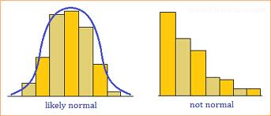
Assessing Normality of Distribution
Visual check by histograms!
Disadvantages:
Sample distribution may not be representative of the population
You can't get a clear picture of the distribution for N<30
Subjectivity! How much should it differ from the normal distribution?

Slide 107
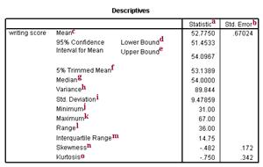
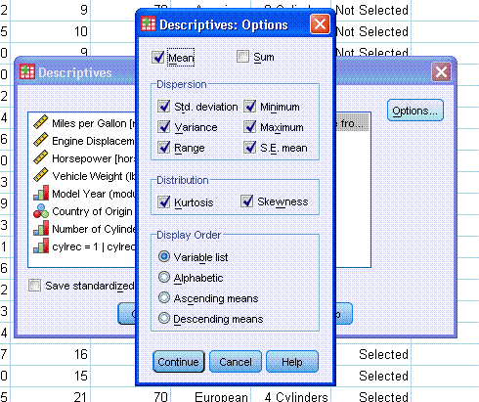
Assessing Normality of Distribution
Easy method of assessing the distribution in the SPSS frequency table: Symmetry (skewness ~= 1), Curvature (kurtosis ~= 1) → distribution width
Can be tested with statistical tests (e.g. Kolmogorov-Smirnov, Shapiro-Wilks)
Warning: statistical power for these testers also depends on sample size
Andy Field: Discovering Statistics Using SPSS

Slide 108
Types of Distributions
Normal distribution
Positive Assymetry
Negative Assymetry
Distribution curvature (kurtosis) - Wide / Thin

Slide 109
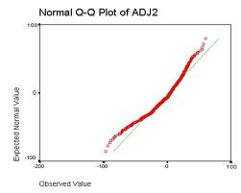
Another Way: Q-Q Plot
Expected normal distribution values vs. observed values in our sample

Slide 110
Choosing Between Parametric or Non-Parametric Analysis
Parametric when we are sure that the population where our sample comes from follows a normal distribution, with respect to the variable of interest. Non-parametric when:
Measurement is coded as a hierarchical rank, e.g. rank of student performance in a class, star rating of a movie
There are values off the measurement scale, e.g. very low/high. In non-parametric analysis we replace them with random low/high values, since it is not the exact measurement that matters but the hierarchical ranking
Population does not have a normal distribution and there is no possibility of transformation to a normal distribution (e.g. logarithmic)

Slide 111
Difficulties in Choosing Between Parametric or Non-Parametric Analysis
When there are few data, it is more difficult to decide (e.g. by visual inspection) whether they follow a normal distribution. Formal normality tests (e.g. Kolmogorov-Smirnoff test) may have reduced power to detect normal and non-normal distributions.
Often we choose non-parametric methods in cases of small samples (n < 6). Choice does not affect the result so much if the sample is large enough (but subjective just how large is enough!)
It is useful to check previous data (from other surveys). The important thing is the distribution of the population, not the sample.
Subjectivity about the most appropriate choice in case of doubt.

Slide 112
Types of Statistical tests
There is at least 1 corresponding non-parametric test for each parametric test
Categories:
Tests comparing groups (independent samples)
Tests comparing variables (dependent samples)
Tests of relationship between variables (correlation)
Note: Despite the advantages of non-parametric analysis (such as cases where the distribution in the population is unknown), there are also disadvantages:
Lower statistical power (1-b). e.g. we would need a larger sample to achieve the same power with a parametric analysis
Difficulties of interpretation (e.g. what is the meaning of a difference between ranks versus a difference in the unit of measurement of the variable of interest?)

Slide 113
Choice of Statistical Test
 | Type of Data
Goal | Measurement (from Gaussian Population) | Rank, Score, or Measurement (from Non- Gaussian Population)
Describe one group | Mean, SD | Median, interquartile range
Compare one group to a hypothetical value | one-sample t test | Wilcoxon test
Compare two unpaired groups | Unpaired t test | Mann-Whitney test
Compare two paired groups | Paired t test | Wilcoxon test
Compare three or more unmatched groups | one-way ANOVA | Kruskal-Wallis test
Compare three or more matched groups | Repeated-measures ANOVA | Friedman test
Quantify association between two variables | Pearson correlation | Spearman correlation
Predict value from another measured variable | Simple linear regression or nonlinear regression | Nonparametric regression**
Predict value from several measured or binomial variables | Multiple linear regression* or Multiple nonlinear regression**

Slide 114
Testing Normality of Distribution in SPSS
Frequency tables:
Analyze → Descriptive Statistics → Frequencies
Histograms, Boxplots, QQ-plots, PP-plots
Analyze → Descriptive Statistics → Explore (plots)
Analyze → Descriptive Statistics → Q-Q Plots
Goodness of fit checks
Kolmogorov-Smirnov (K-S)
Analyze → Nonparametric Tests → Legacy Dialogues → 1-Sample K-S
We want p > .05 (not significant)
Shapiro-Wilk (S-W)
We want a value close to 1

Slide 115
Correlation
Pearson's r
Spearman's rho (ρ)

Slide 116
Correlation
Objective: The association between variables. What happens to 1 or more variables when a 2nd variable changes?
Correlation coefficient
Measuring the degree of association between 2 variables
-1 to +1
Positive correlation
As one variable increases, so does the other
E.g. The more years of education, the higher the annual salary
Negative correlation
As one variable increases, the other decreases
E.g. As the running speed increases, the endurance reserves decrease
The higher the correlation coefficient, the stronger the variable between the 2 variables (regardless of the sign)

Slide 117
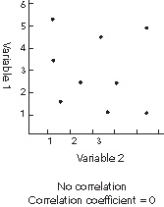
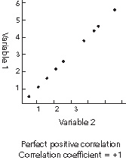
Type of Association
Illustrate correlation with scatterplot
Notional or real regression line plotting

Slide 118
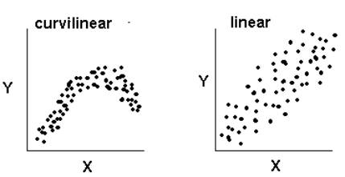
Curves Correlations
Positive curvilinear relationship
Negative curvilinear relationship

Slide 119
Correlation
Correlation coefficient (r)
Measuring the degree of association between 2 variables
The higher the correlation coefficient, the stronger the association between the 2 variables (regardless of the sign)
The sign gives information on the direction of the correlation, while the absolute numerical value (0-1) gives the strength of the correlation (distance of points from the regression line)
r > .30 → Low correlation
r > .50 → Moderate correlation
r > .70 → High correlation
r = .80 → Very high correlation

Slide 120
Correlation and Covariance
Covariance: covariation of the 2 variables
COV_{XY} = [Σ (Χ - Χ) × (Υ - Υ)] / Ν
r = COV_{XY} / s_{X} × s_{Y}

Slide 121
Factors Affecting Correlation & Interpretation
Factors affecting the correlation coefficient
Group homogeneity
Curvilinear relationship between variables
Outliers
Correlation interpretation
Co-variation, not causality
Causality implies a time series
Absence of cause, absence of effect
X cause Y, Y cause X, Z cause X & Υ

Slide 122
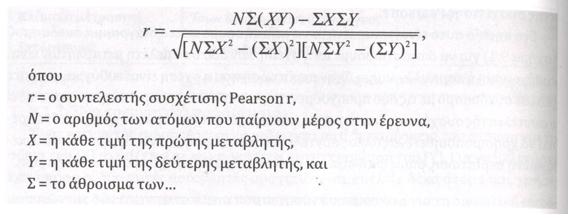
Types of Correlation Coefficients
Pearson's r
Parametric
Equal intervals / Ratio scale
Linear relationship
Spearman's rho
Non-parametric
Ordinal scale
Linear relationship
SPSS: Analyze → Correlate → Bivariate

Slide 123
Group Comparisons
T test

Slide 124
Group Comparisons: Calculating the Probability that the Samples Come From the Same Population
Sources of volatility:
Systematic differences due to experimental manipulation
Non-systematic differences due to individual differences between samples (e.g. intelligence, motivation)
We assess the difference between two samples using statistical tests whose characteristics we know (t test)
We know the distribution, and therefore we can calculate the probability of getting any value in that distribution - example age of death!
For a conditional comparison of two different samples, statistical tests represent the following fraction: Systematic Differentiation/Non-Systematic Differentiation (ANOVA)
Comparison of variability resulting from experimental manipulation with normal variability

Slide 125
T-Tet
Comparing 2 groups
t = (m - m₁₂ )/SE (estimate of the standard error of the difference between the 2 means)
Standard error reveals how well the average of a sample represents the population
Standard error of the difference of 2 means reveals the random (natural, non-systematic) variation that we might expect between the means of 2 samples
Similarly, different samples from the same population should have quite similar means and standard errors, and so should their differences (m₁ – m₂)
Therefore, t-test represents the difference between 2 means corrected (denominator) by the degree of completely random variation of these samples

Slide 126
T-test for One Sample - known Standard Deviation
Conditions
Equal interval or ratio scale
One sample of participants
Data must meet the conditions for the use of parametric criteria
t-test - Standard deviation (σ) known
Sample distribution of the mean
σ_{Μ} = σ / √N (SE, standard deviation of population means)
E.g. M = 58, N = 8
μ = 50, σ = 10
H0: m = 50. H1: μ =/= 50
z = (M - μ) / σ_{Μ} or z = (M - μ) / (σ / √N)
σ_{Μ} = σ / √N = 10 / √8 = 3.53
z = (M - μ) / σ_{Μ} = (58 - 50) / 3.53 = 2.27 < .05 so we reject H0
Compare to Z table of standardized values

Slide 127
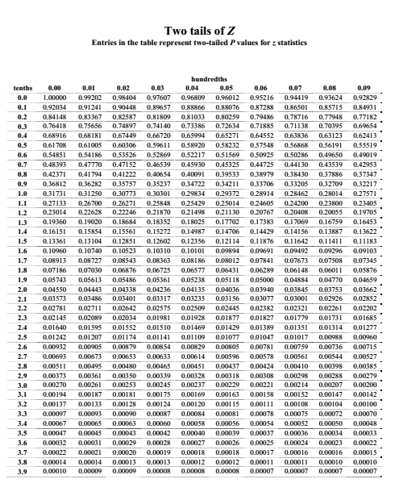
Z Table (Two-TAiled Hypothesis)

Slide 128
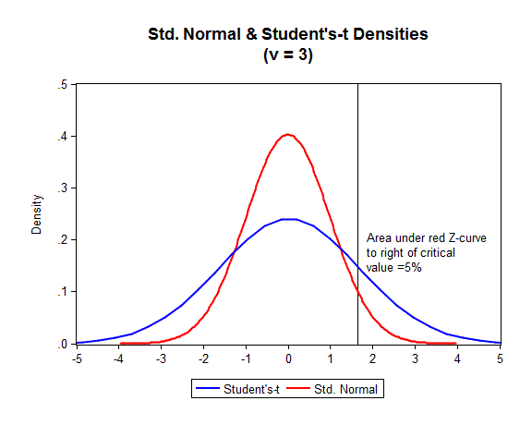
T-test for One Sample - Unknown Standard Deviation
Conditions
Equal intervals or ratio scale
One sample of participants
Data must meet the conditions for the use of parametric criteria
Variation in population unknown (σ_{Μ}/σ)
Use sample standard deviation (s)
s_{Μ} = s / √N
So, we cannot refer to a normal distribution (z), we rather use a t distribution
Similarities: symmetrical
Differences: Different distribution for each sample size. We need to check the appropriate degrees of freedom (calculated based on the sample size)
Larger rejection area than normal distribution

Slide 129
T-test for One Sample - Unknown Standard Deviation
Personality Traits Test
Does our sample tested in the number of lies per week differ from the population?
μ = 7.5
H0: μ = M. H1: μ =/= M
We calculate M = 8.7
We calculate s
s = 1.70
We calculate t
t = (M - μ) / (s / √N) = (8.7 - 7.5) / (1.70 / √10) = 2.22
Comparison with table of standard values (t)
If |t| > critical value, reject. Η0
t < 2.26, we accept H0
t(9) = 2.22, n.s.
Participant | Score
1 | 9
2 | 8
3 | 10
4 | 8
5 | 7
6 | 8
7 | 12
8 | 9
9 | 6
10 | 10

Slide 130
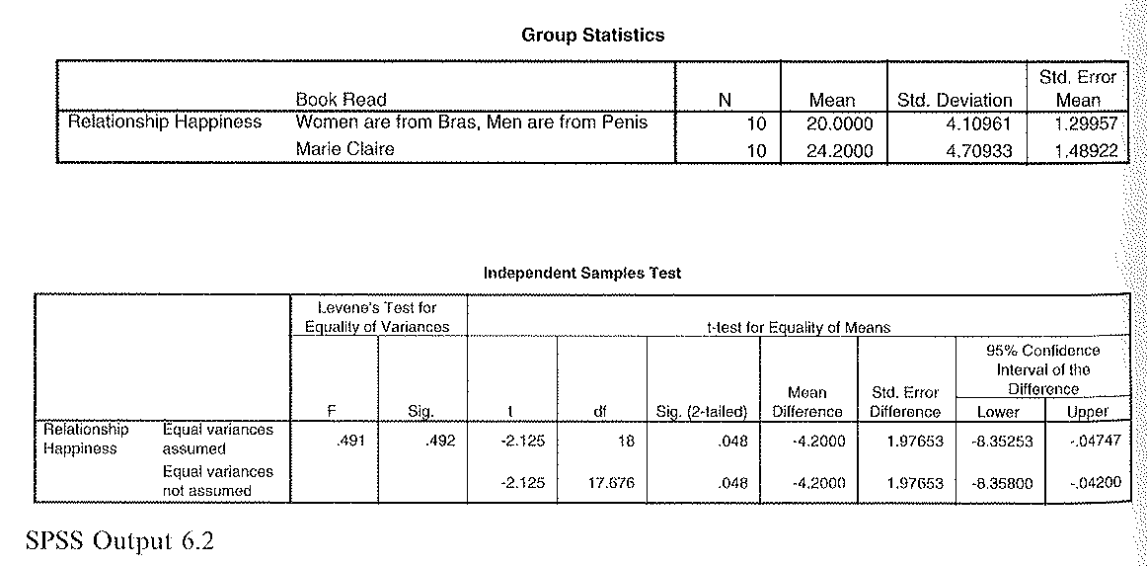
T-test for Independent Samples
Independent t-test
2 groups, different participants in each group
E.g. 2 groups of 10 people, one group read a popular psychology book, another group read Marie Claire. Dependent measurement: degree of happiness from their relationship (assume that the measurement is objective - "happiness meter").
Df = n₁ + n₂ - 2

Slide 131
Assessing Effect Size
Conversion of t to r (Pearson coefficient)
r = t² / (t² + df) = .45
Interpretation and reporting of the t-test result:
On average, the degree of happiness from the relationship after reading Marie Claire (M = 24.20, SE = 1.49) was statistically greater than the degree of happiness after reading the popular psychology book (M = 20.00, SE = 1.30), t(18) = 2.12, p = .048, r = .45)

Slide 132
T test of Independent Measures in SPSS
Analyze → Compare Means → Independent-Samples T Test
Test variable (dependent variable)
Grouping Variable → Define Groups (independent variable)
t, df, p value (sig.)
Equal variances assumed (unless Levene test < .05)
descriptives to check which group is larger, in case of statistically significant difference

Slide 133
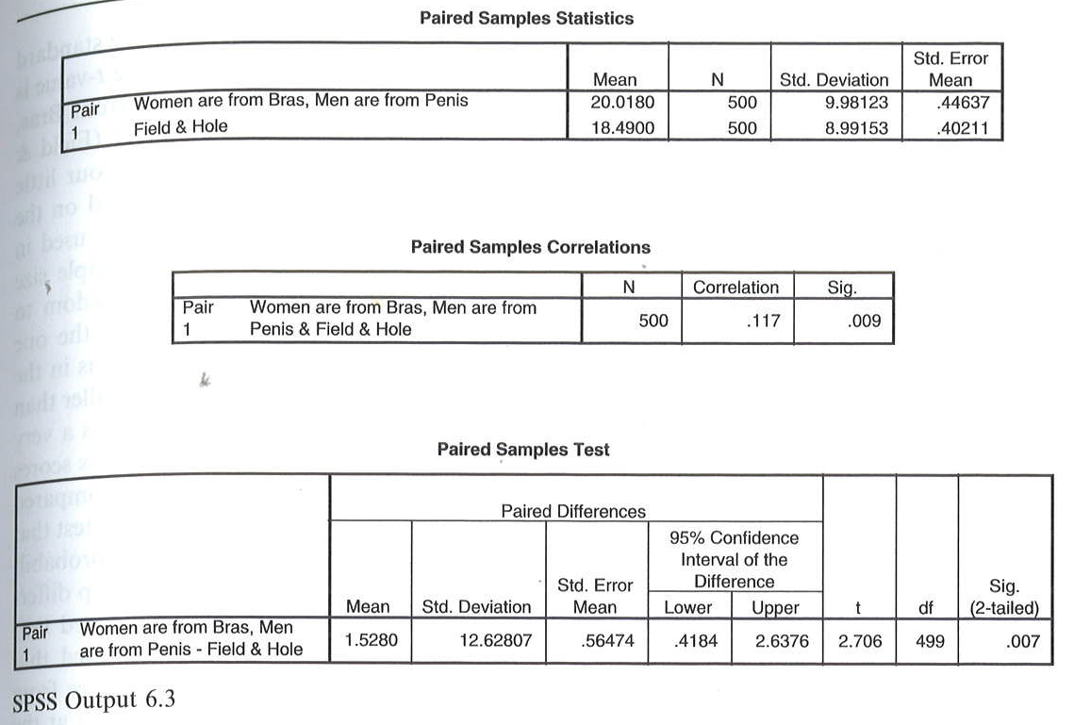
T-test for Paired Samples / Repeated Measures)
Dependent (matched pairs) t-test
2 groups, same participants in each group, repeated measurements
E.g. 1 group of 500 people, each read a book on pop psychology and a book on Research Methods by Andy Field.
Counterbalancing the order of participation in each condition, 6 months apart
Dependent measurement: degree of happiness from their relationship (assume that the measurement is objective - "happiness meter").
df = n - 1

Slide 134
Effect Size Control (Effect Size)
Conversion of t to r (Pearson coefficient)
r = t² / (t² + df) = .12
Interpretation and reporting of the t-test result:
On average, the degree of happiness from the relationship after reading the popular psychology book (M = 20.02, SE = .45) was statistically greater than the degree of happiness after reading the research methods book (M = 18.49, SE = .40), t(499) = 2.70, p = .007, r = .12)
While p is important, the coefficient r indicates a very small effect size!

Slide 135
T test of dependent measures in SPSS
Analyze → Compare Means → Paired-Samples T Test
t, df, p value (sig.)
descriptives to check which measurement is larger, in case of a statistically significant difference (increase or decrease)

Slide 136
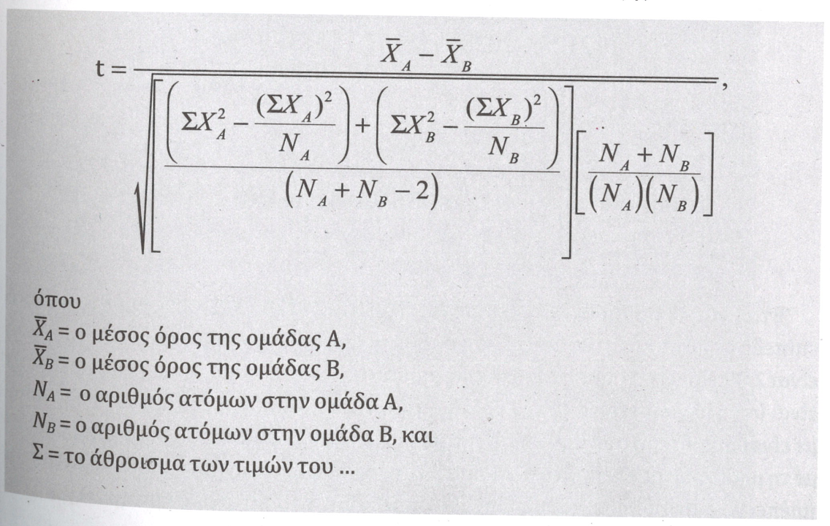
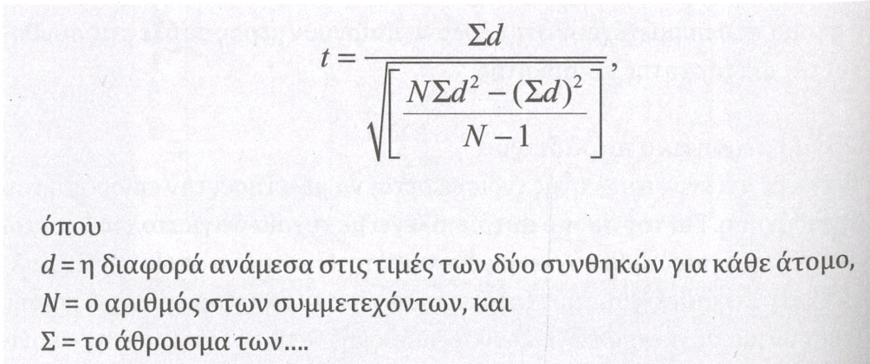
Retrieved from
Comparison with population mean, variance (s) known
z = (M - μ) / (σ / √N)
Comparison with population mean, variance (s) unknown
t = (M - μ) / (s / √N)
Comparison of the means of two independent samples
Comparison of the means of two dependent samples, or means from repeated measures in the same subjects

Slide 137
Statistics
Group comparisons IΙ:
Univariate Analysis of Variance (ANOVA) with one or more factors
Analysis of Covariance (ANCOVA)
Multivariate Analysis of Variance (MANOVA)

Slide 138
Analysis Of Variance - ANOVA
ANOVA (Analysis of Variance) essentially serves as an extension of the t-test. Its primary function is to compare more than two groups, resolving the issue of multiple comparisons (family-wise error) by conducting a unified comparison across all groups from the outset.
In essence, ANOVA offers a robust analytical framework, ensuring a comprehensive and precise assessment when dealing with complex research designs involving multiple groups and independent variables.
Handling Multiple Independent Variables
One of ANOVA's significant strengths lies in its ability to handle multiple independent variables. It not only investigates the main effect of each variable but also explores the interactions between these variables, providing a nuanced understanding of their combined impact on the observed phenomena.

Slide 139
The Logic Behind ANOVA
Variation in Independent Measurement Groups (for example, 2 groups):
Differences in Individual Values (Noise).
Individual Differences.
Random Error.
Different Means per Group:
Effect of the Independent Variable Manipulated by the Experimenter.
Overall variability: composite effect of all these sources.
Reducing Sampling Error / Noise → appropriate sampling method important, matching noise in groups (randomization is helpful)
In the Case of Statistically Significant Difference: 2 > 1
Can be expressed as a ratio, the more significant the larger: Variance due to Group Differences Random Variance (error)

Slide 140
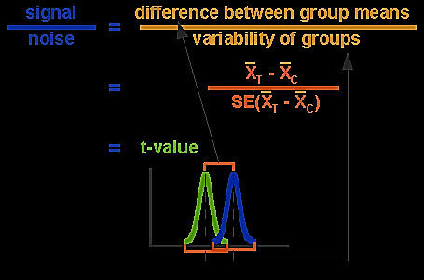
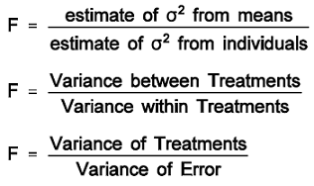
Differences Between T-Test (Τ distribution) and ANOVA (F distribution)
• Compares two samples by assessing the difference betweem two means
• Compares 1-2 samples
• Assesses only one IV
• Compares samples by assessing the variance among all samples
• Compares 2+ samples
• Assesses two or more IVs
• Assesses the interaction between IVs

Slide 141
ANOVA Assumptions
Independence of measurements of independent groups – samples (random sampling)
Scale of the Dependent Variable: interval or ratio (not nominal or hierarchical)
Symmetric (Normal) Distribution of the Dependent Variable in every group/sample (or at least similarly skewed in all groups)
Homogeneity of Variances of all groups/samples
A good overview of ANOVA:
http://old.psych.uoa.gr/~vpavlop/index.files/pdf/ANOVA_models.pdf

Slide 142
Anova Structure
Null hypothesis:
all (three or more) groups have similar means and, therefore, systematic differentiation (variance) will be similar to nonsystematic differentiation if they originate from the same population.
ΑΝΟVA based on F ratio: compares systematic variability (SS_{M} numerator) with non-systematic (random variability– SS_{R} denominator) in our data
However, since it approximates the overall differentiation of all groups, it cannot answer the question of which specific groups differ. Its function is to reject the null hypothesis, as stated above.
For this goal we conduct “planned comparisons” or “post-hoc tests”

Slide 143
Multiple Comparisons
Which levels of the variable (factor) differ?
Correction of family-wise error (decided before conducting the analysis): Planned VS. Posthoc comparisons
Separate t-tests (few planned comparisons)
LSD (lenient, small number of conditions)
Sidak
Bonferonni (stringent) (multiple planned comparisons)
α/n_{t:} alpha divided by number of comparisons (e.g. α = .05 / 6 = .0083)
Tukey HSD (very stringent) (all possible combinations)
Scheffe (quite stringent)
Games Howell (stringent) *(can be used with unequal variances, or in case of unequal sample sizes in groups)

Slide 144
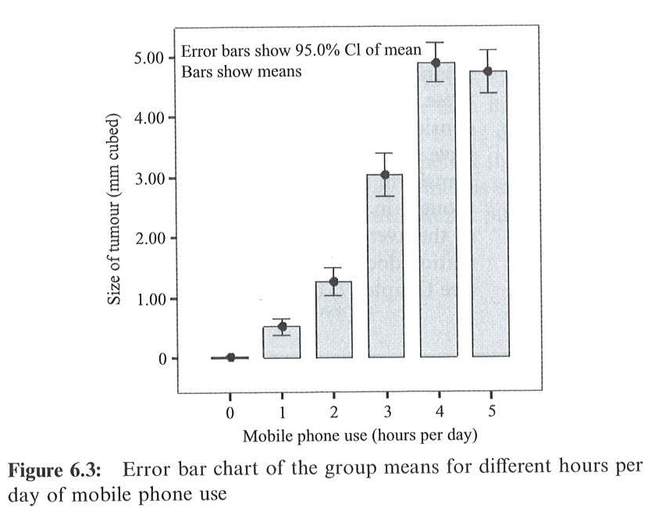
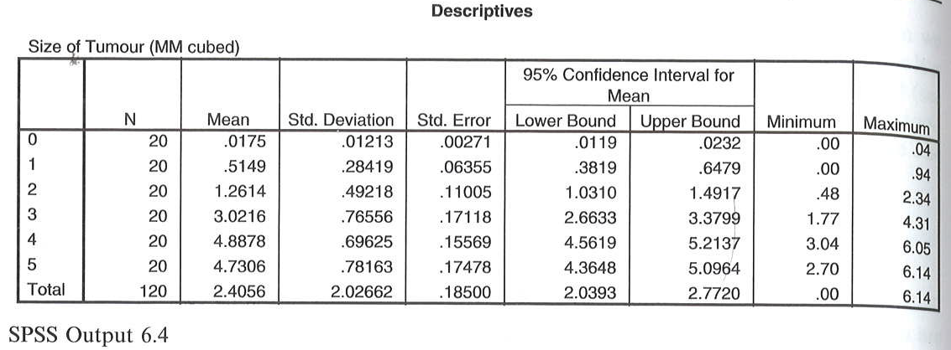
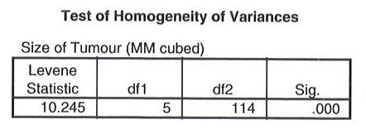
One-Way Ανοva, Bet. Subj.s: Preliminary Info.
Assumption of Homogeneity of Variances
Levene test: Is the variance equal in all groups? If p<.05, then variances are not equal, therefore we have a violation of the Assumption of Homogeneity of Variances → transformation or use of non-parametric method

Slide 145
Anova Results
Between groups: SS_{M} (M=Model) – systematic variability
Within groups: SS_{R} (R=Random) – random (expected) variability
Mean Squares (MS) = Sum of Squares (SS)/df
Some useful Post hoc tests, at increasing degrees of strictness: Bonferroni, Games-Howell, Tukey HSD

Slide 147
Reporting Results
The Levene test indicated a violation of the homogeneity assumption, F(5, 114) = 10.25, p < .001. Despite attempting data transformation, the problem persisted. Therefore, the ANOVA findings are reported. The analysis revealed a statistically significant difference in participants' brain volume sizes due to mobile phone usage, F(5, 114) = 269.73, p < .001. Post hoc comparisons (Games-Howell) showed significant differences in each group (p < .001 for each comparison) except for the 4 and 5-hour usage groups.

Slide 148
One-Way ANOVA: One Factor, Repeated Measures
Factor = variable
Comparison of multiple means from numerous (>2) measurements in a sample (repeated measures)
Each participant contributes to more than one groups/conditions
One-way ANOVA, repeated measures.
Assumptions:
Difference of Means
Interval or ratio scale
Repeated measures or matched samples
Typical assumptions for parametric analyses

Slide 149
One-way Ανοva – Repeated Measures
Additional Assumption: Sphericity
Not only groups, differences between groups should also be similarly distributed
Difference between every pair of groups/conditions (paired scores, e.g. weight before and after training) have similar variance
SPSS: Mauchly’s test of sphericity
Statistical significance means violation of sphericity

Slide 150
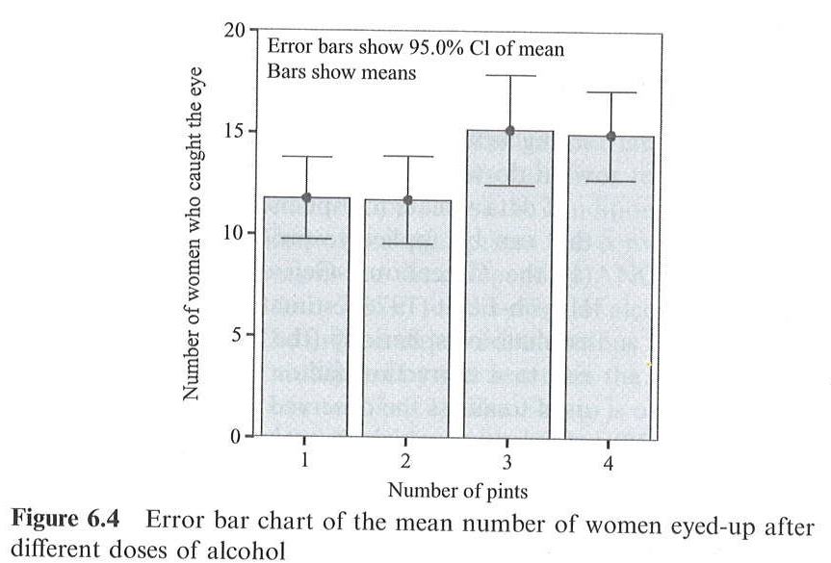
SPSS EXAMPLE: 1-Way Repeated
IV: Number of drinks consumed (1-4 drinks)
DV: Number of people notices/flirting
Is this bevavior influenced by alcohol consumption?

Slide 151
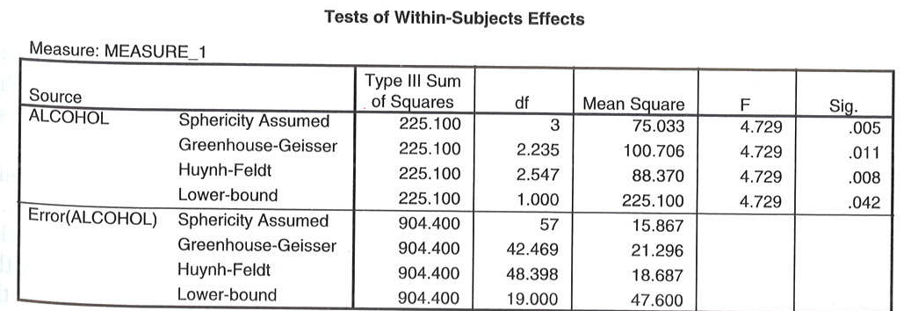
Sphericity & Within-Subjects Effects
Testing for sphericity
If violated, we will use corrected values (correction on degrees of freedom):
Greenhouse- Geisser (stricter)
Huynh-Feldt
Lower Bound

Slide 152
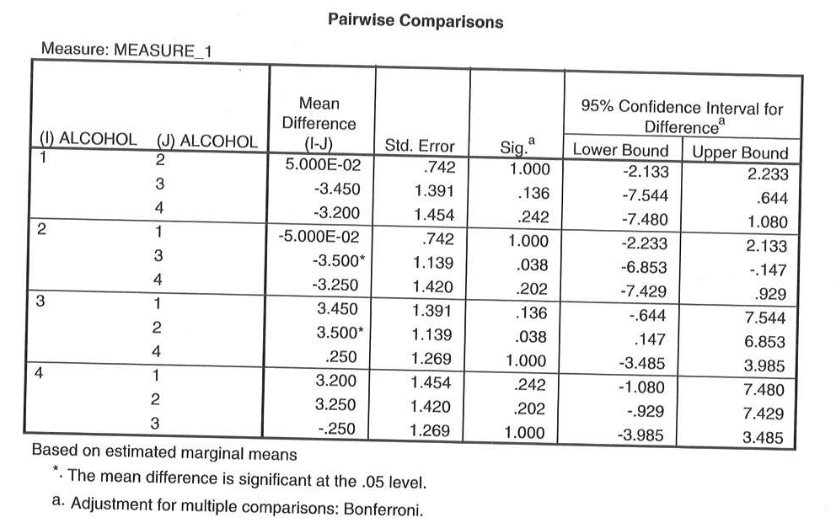
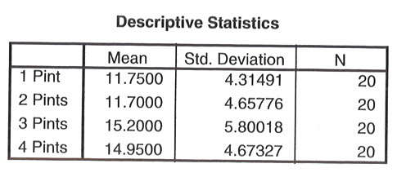
Post hocs
The violation of Mauchly's sphericity test (χ2 = 13.12, p = .022) necessitated the use of Huynh-Feldt correction for degrees of freedom. The results revealed that men's perception of women was influenced by alcohol consumption [F(2.55, 48.40) = 4.73, p = .008, η² = .20]. Post hoc comparisons with Bonferroni correction indicated a significant difference between the consumption of 2 and 3 drinks (M2 vs M3: p = .038). This implies that men's perception significantly differed when they consumed 2 drinks compared to 3 drinks. The effect size (r=.40) suggests a moderate effect.

Slide 153
One-way ANOVA in SPSS
1 Factor, Independent Measures
Analyze → Compare Means → One-Way ANOVA
Dependent: DV
Factor: IV
1 Factor, Repeated Measures
Analyze → General Linear Model → Repeated Measures
Within-Subject Factor Name: Name your IV and fill in the number of levels
Measure Name: Name your DV

Slide 154
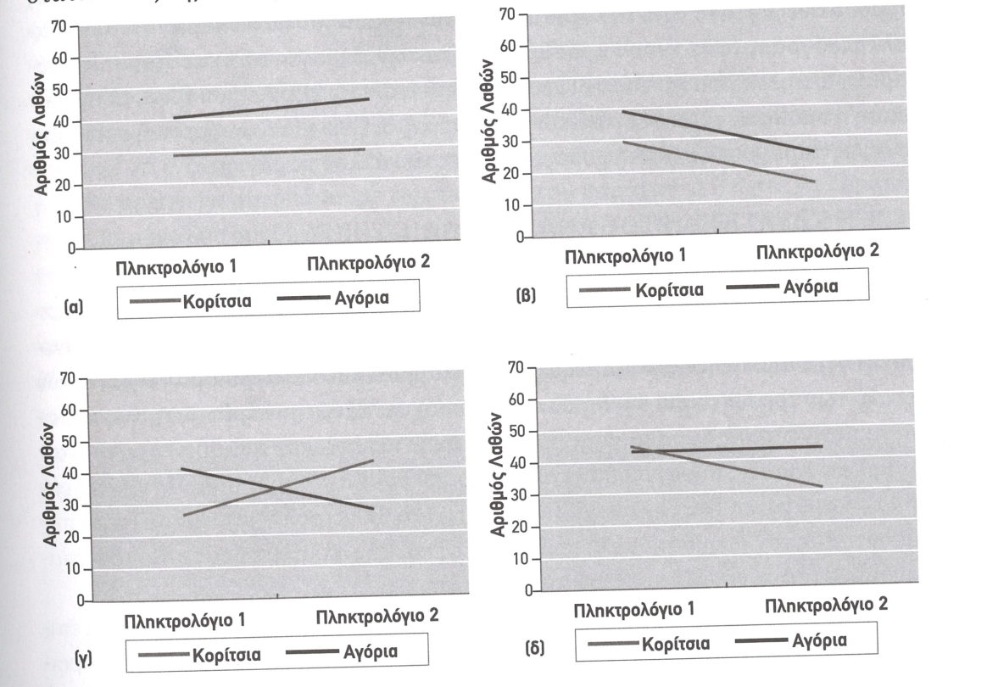
ANOVA: Two or More Factors: Main Effects & Interactions
Main effect
The separate effect of each IV on the DV
What is the effect of gender (difference between men and women)
What is the effect of keyboard (difference between the two keyboards)
Interaction
The effect of each level of an IV on each level of the other IV
How does each keyboard affect independently men and women?
Alternatively, is there any difference between the two keyboards only in men, or only in women?
All potential combinations of the IVs
2 × 2, 3 × 6 etc.
E.g. 2 keyboards, 2 genders (2 × 2)

Slide 155
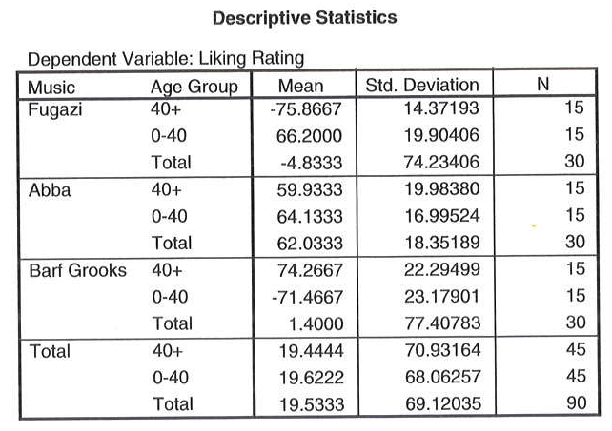
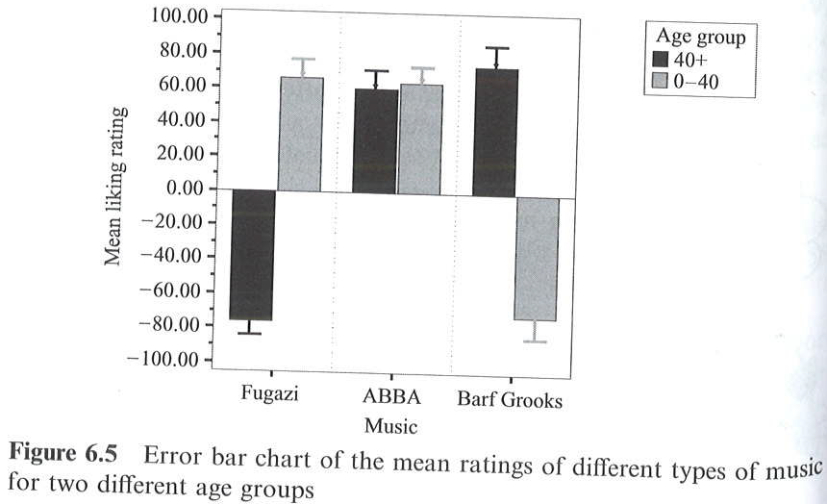
Two-way ANOVA – Independent Measures
Two IVs, independent samples / groups
EXAMPLE:
Α. Age (< 40, > 40), Β. Music Genre (3 levels)
DV: Rating for preference at each music genre (-100 έως +100)

Slide 156
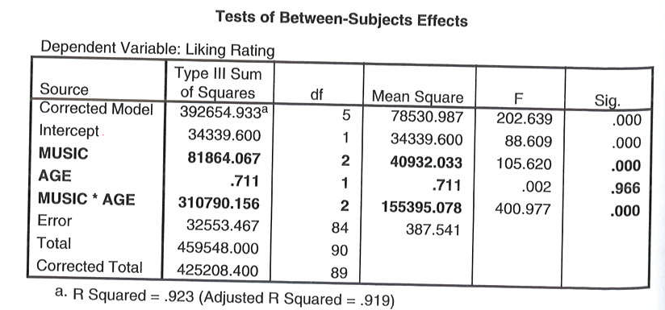
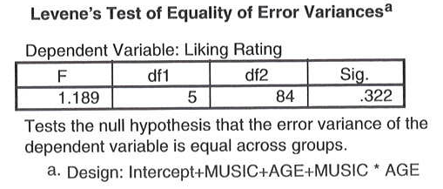
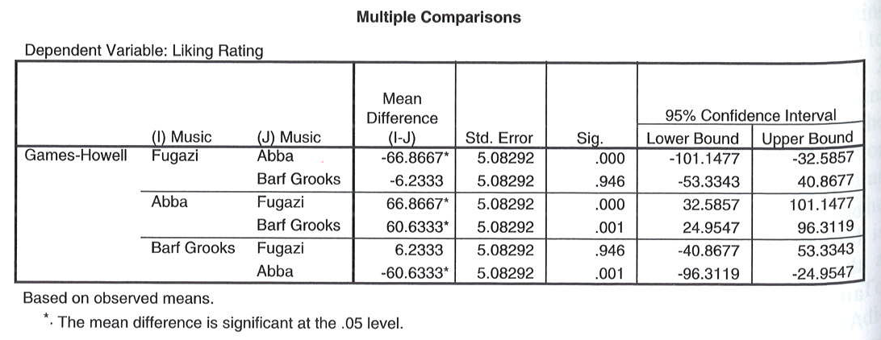
Ανοva Results
Testing homogeneity of variance

Slide 157
Reporting Results
The results indicate that music genre significantly influences the ratings [F(2, 84) = 105.62, p < .001]. Subsequent pairwise comparisons (adjusted with Games-Howell correction) reveal that ABBA received higher ratings compared to Fugazi and Barf Grooks (ps < .001).
There was no statistically significant difference in ratings between age groups.
The interaction between age and music genre was statistically significant [F(2, 84) = 400.98, p < .001), suggesting that different music genres were rated differently by individuals of different ages. Specifically, Fugazi was rated more positively by younger individuals (M = 66.20, SD = 19.90) compared to older individuals (M = -75.87, SD = 14.37); ABBA received similar ratings from both younger (M = 64.13, SD = 16.99) and older individuals (M = 59.93, SD = 19.98); Barf Grooks had less positive ratings from younger individuals (M = -71.47, SD = 23.17) compared to older individuals (M = 74.27, SD = 22.29).
These findings emphasize the nuanced influence of both age and music genre on individuals' preferences, highlighting the need for targeted analyses when exploring the complexities of factors affecting subjective evaluations.

Slide 158
Two-way ANOVA – Repeated Measures
Two IVs, repeated measure
EXAMPLE (sample of 4 patients and 4 conditions – 2 × 2):
Α. Drug (antidepressant, placebo)
Β. Therapy (None, Cognitive-Behavioral)
DV: Number of suicidal thoughts in the last week of each month
Drug | Placebo |  | Anti-depressant
Therapy | None | CBT | None | CBT
Α.Χ. | 70 | 60 | 81 | 52
Λ.Μ. | 66 | 52 | 70 | 40
Φ.Δ. | 56 | 41 | 60 | 31
Β.Κ. | 68 | 59 | 77 | 49
Average | 65 | 53 | 72 | 43

Slide 159
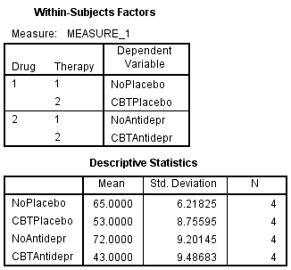
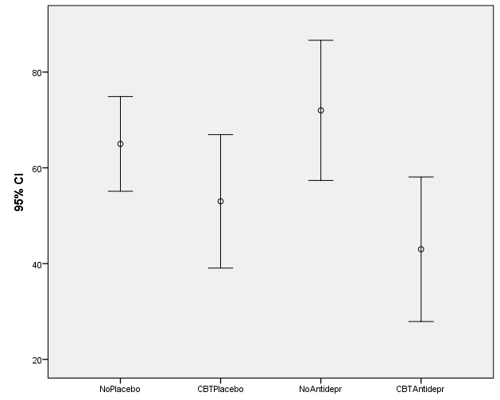
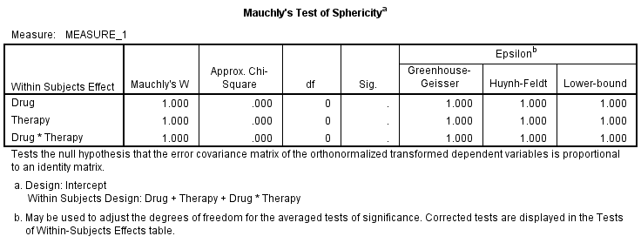
Two-way ANOVA – Repeated Measures
Descriptives
Testing similarity of variances
(sphericity)

Slide 160
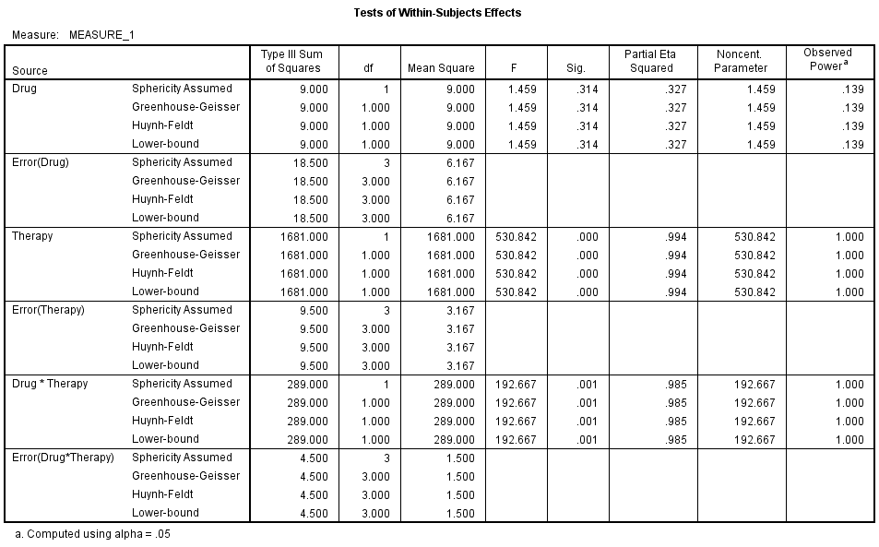
Ανοva Results (Significance)

Slide 161
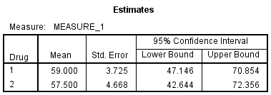
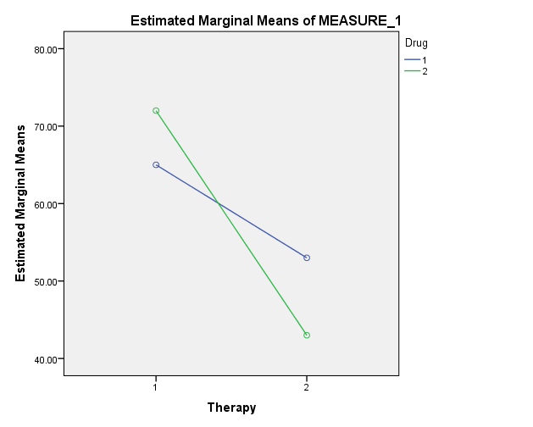
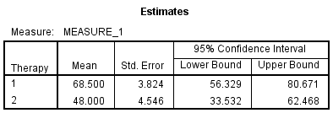
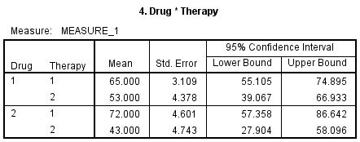
Ανοva Results (Means)
Drug
Placebo
Αντικατ
Therapy
Interaction
Καμία ΓΣΘ
CONCLUSION?

Slide 162
ΑΝCOVA (Analysis Of Covariance)
Adapting the results of ANOVA based on the linear relationship (c.f., regression analysis) of the DV and the covariate.
The covariate intervenes the relationship between the independent and dependent variables.
Useful in cases of non-experimental approaches where handling important confounding variables is challenging.
Same logic and process as ANOVA, with the only difference being the use of adjusted means.
Same assumptions, but an additional requirement: homogeneity of regression.
Absence of interaction between the covariate and the independent variable.
Also, lack of correlation between them, especially when multiple covariates are involved.

Slide 163
ANOVA in SPSS: 2 Factors
2 Factors, Independent Measures
Analyze → General Linear Model → Univariate
Dependent Variable: DV
Fixed Factor(s): IV(s)
2 Factors, Repeated Measures
Analyze → General Linear Model → Repeated Measures
Within-Subject Factor Name: Name the IVs and register the number of levels for each
Between Subjects Factor: Independent measures factor(s) (mixed design)
Measure Name: Name the DV

Slide 164
MANOVA / MANCOVA
Multivariate Analysis of Variance
Multiple DVs, one or more IVs
Do the population means on a set of dependent variables vary across the levels of a factor or factors?
More than one DVs
Should be moderately correlated with one another
MANCOVA
Same logic with ANCOVA: what would happen if all cases scored equally on the covariates, so that the effect of the factors over and beyond the covariates can be isolated.

Slide 165
STEPS
MANOVA statistics, testing main multivariate hypothesis (that the population means on the multiple dependent variables are equal across groups)
Wilks’ Lambda, Pillai’s Trace, Hotelling’s Trace (T), Roy’s Largest Root
Also report effect sizes (Partial eta-square η²)
If statistically significant, test separate ANOVA results per DV (with Bonferroni corections)

Slide 166
MANOVA ASSUMPTIONS
Multivariate normality*
dependent variables are multivariately normally distributed for each population
each variable is normally distributed ignoring the other variables and each variable is normally distributed at every combination of values of the other variables
Homogeneity of variance-covariances matrices*
variances for each dependent variable are approximately equal in all groups & covariances between pairs of dependent variables are approximately equal for all groups
Independence of measurements
Random sampling of participants, independent measurements
*robust to violations when groups sized (Ns) are roughly equal

Slide 167
Example
The pupils at a high school come from three different primary schools.
The head teacher wanted to know whether there were academic differences between the pupils from the three different primary schools.
20 students randomly selected from each School
DV: marks in end-of-year English and Maths exams. ("English score" and "Maths score“)
IV: "School", three levels (A, B, C)

Slide 168
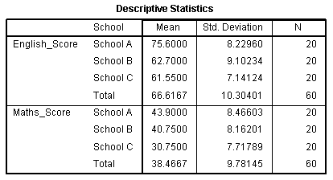
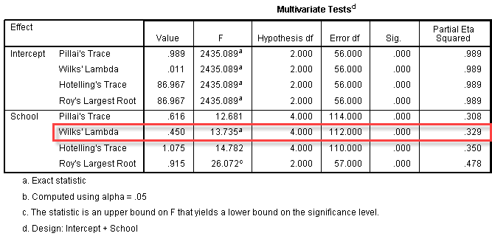
SPSS Output
Statistically significant difference in ac. perf. among schools
F (4, 112) = 13.74, p < .0005; Wilk's Λ = 0.450, partial η2 = .33.

Slide 169
Univariate ANOVAs
English (F (2, 57) = 18.11; p < .0005; partial η2 = .39)
Maths (F (2, 57) = 14.30; p < .0005; partial η2 = .33).
Bonferroni corrected critical α: p < .025.

Slide 170
Multiple Comparisons
English: Sig. A vs B (p < .0005), A vs C (p < .0005), Non-sig. B vs C (p = .897).
Math: Sig. A vs C (p < .0005), B vs C (p = .001), Non-sig. A vs B (p = .443).

Slide 171
PLOTS
MANOVA / MANCOVA @ SPSS: Analyze → General Linear Model → Multivariate

Slide 172
Statistics
Non parametric tests

Slide 173
Parametric vs. Non-Parametric Analyses: When to Use
Key Decision: Incorrect choice can lead to:
Incorrect statistical analysis (violation of assumptions)
Lower statistical power (loss of statistical power)
Parametric Statistics: Utilize information about the mean and variance.
Non-Parametric Statistics: Make no assumptions about the data distribution, hence have lower statistical power due to less information used.
Example: Parametric correlation uses information about the mean and variance, while non-parametric correlation considers only the sequential position of data pairs (ranks).

Slide 174
Parametric vs. Non-Parametric Analyses
Parametric:
Data in Numeric Scores (Interval/Ratio Scale)
Use of Means & Variance
Involves assumptions about the population distribution's shape.
Non-parametric:
Data in Categories or Hierarchical Order (Nominal/Ordinal Scale)
Use of Frequencies
Doesn't assume any specific population distribution shape.

Slide 175
Assumptions of Parametric & Non-Parametric Distributions
Assumptions of Parametric Distribution:
Independence of measurements.
Measurements are derived from a population following a normal distribution.
Populations (e.g., in comparing 2 groups or 2 experimental conditions) have equal variances (homogeneity of variance assumption).
Assumptions of Non-Parametric Distribution:
Independence of measurements.
The variable of interest has some form of continuity (can be ranked or ordered).

Slide 176
Paranetric vs. Non-Parametric Analyses
Parametric method | Equivalent Non-Parametric
One sample t-test | Chi-square test (test of good fit)
t-test independent measures | Mann-Whitney’s U test
t-test repeated measures | Wilcoxon’s Signed Rank Test
One-way ANOVA, independent measures | Kruskal-Wallis test
One-way ANOVA, repeated measures | Friedman test

Slide 177
Parametric vs. Non-Parametric Analyses: When to Use
We have already discussed the basic differences between parametric and non-parametric analyses.
Parametric analyses use information about the mean and variance, whereas non-parametric statistics make no assumptions about the data distribution, leading to lower statistical power due to the utilization of fewer pieces of information.
This emphasizes the importance of descriptive analysis of our data, especially checking for the normality of the distribution. This can be verified in various ways using software like SPSS…

Slide 178
Checking For Normal Distribution
Visual Inspection Using Histograms!
Disadvantages:
The sample distribution might not be representative of the population.
It's challenging to have a clear picture of the distribution for N<30.
Subjectivity! How much deviation from normality is significant?

Slide 179
Checking For Normal Distribution
Easy Distribution Check Method in SPSS Frequency Table:
Symmetry (skewness ≈ 1), Kurtosis (kurtosis ≈ 1) → Distribution Spread
It can also be assessed through statistical tests (e.g., Kolmogorov-Smirnov, Shapiro-Wilks).
Caution: Statistical power for these tests also depends on the sample size.
Andy Field: Discovering Statistics Using SPSS

Slide 180
Another Way: Q-Q Plot
Expected (based on Normal Distribution) VS Observed Values in Our Sample

Slide 181
Checking For Normal Distribution in SPSS
Frequency Tables:
Analyze → Descriptive Statistics → Frequencies
Histograms, Box-plots, QQ-plots, PP-plots
Analyze → Descriptive Statistics → Explore (Plots)
Analyze → Descriptive Statistics → Q-Q Plots
Tests of good fit
Kolmogorov-Smirnov (K-S)
Analyze → Nonparametric Tests → Legacy Dialogs → 1-Sample K-S
Required p > .05 (non significant)
Shapiro-Wilk (S-W)
Value should be around 1

Slide 182
What Do We Do in Case of Parametric Assumptions Violation?
Note: Despite the advantages of non-parametric analysis (such as in cases where we don't know the population distribution), there are drawbacks:
Lower statistical power (1−β) – increased risk of Type II errors. For example, we might need a larger sample to achieve the same power as a parametric analysis.
Do We Settle for the Loss of Statistical Power? Not necessarily. We can attempt an intermediate solution: make our data parametric!
Addressing skewness in the distribution.
Handling outliers.
Checking for linearity.
Addressing unequal variances.
This approach can potentially preserve the advantages of parametric analysis while dealing with the challenges posed by non-parametric situations.

Slide 183
Data Transformations
Data Trimming: Handling Outliers
E.g., 2-3 standard deviations above/below the mean.
Data Transformations: statistically acceptable
The only thing to watch out for is the interpretation of the data!
Transformation is the process where a mathematical formula is applied to our data (to each score) to address issues like non-normality.
Caution: Only in cases of models involving the relationship between variables (e.g., regression analysis), can transformation be applied to a single variable. In variable comparisons, all variables must be transformed.
Feel free to try multiple alternatives and choose the best one!

Slide 184
Popular Transformations
Use “Compute” function in SPSS
Logarithmic Transformation (positive skewness, non-linearity)
Cannot be applied to zero or negative values (unless a constant is added to all values).
Square Root Transformation (Positive Skewness, Lack of Linearity)
Same issue with negative values.
Reciprocal Transformation (1/X)
Minimum becomes 0 (for very large scores).
Inversion of small and large scores*.
Cannot be applied to zero values.
Inverse Transformation (Using any of the previous methods: Negative Skewness)
Feel free to try these transformations and choose the one that best fits your data!

Slide 185
Suggested Transformations
As suggested by Tabachnick and Fidell (2007) and Howell (2007), the following guidelines (including SPSS compute commands) should be used when transforming data.
If your data distribution is… Use this transformation method.
Moderately positive skewness Square-Root
→ NEWX = SQRT(X)
Substantially positive skewness Logarithmic (Log 10)
→ NEWX = LG10(X)
Substantially positive skewness (with zero values) Logarithmic (Log 10)
→ NEWX = LG10(X + C)
Moderately negative skewness Square-Root
→ NEWX = SQRT(K – X)
Substantially negative skewness Logarithmic (Log 10)
→ NEWX = LG10(K – X)
C = a constant added to each score so that the smallest score is 1. K = a constant from which each score is subtracted so that the smallest score is 1; usually equal to the largest score + 1.

Slide 186
SPSS Exercise Data
Festival data
Compute variable
Transforms: Ln, SQRT
Histograms

Slide 187
Non Parametric Tests

Slide 188
Chi-Square test (χ²⁾

Slide 189
Parametric vs. Non-Parametric Analyses
Parametric | Non-Parametric
Single sample t-test | Chi-square test for goodness of fit
Chi-square test – testing whether Observed Frequency distribution differs in statistically significant way from Expected Frequency
1 variable: Criterion for good fit/appropriateness.
2 variables: Independence.
Requirements:
Qualitative data - categorical scale.
Frequencies.
Prediction of the number of participants in each category.
20 participants per variable, 5 per cell.
Each participant contributes to only one cell.

Slide 190
Χ²: 1 variable - goodness of fit
Instead of a One-Sample t-Test
To test the differences between observed (actual) and expected (random) variables - Deviation from a random model:
Χ² = Σ [(O - E)² / E]
χ² = Σ [(Observed - Expected)² / Expected]
Example
Α = Ν / k = 120 / 3 = 40
df = k - 1 = 3 - 1 = 2
x²= [(51-40)² / 40] + [(27 - 40)² / 40] + [(42 - 40)² / 40] = 7.35 > 5.99 (critical value from table)
x²(2) = 7.35, p = .025
Students’ Study Method
Regular | Irregular | Combined | Total
51 | 27 | 42 | 120

Slide 191
Χ² - Independence of Measurement
Differences between Observed and Expected Variables (When the Two Variables are Independent)
Test for Independence of the Two Variables
Double-Entry Cross Table
Use absolute frequencies, not percentages (convert if N is known).
Example
Teaching Method | Low | Average | High | Total
New | 6 | 15 | 23 | 44
Old | 10 | 8 | 24 | 42
Total | 16 | 23 | 47 | Τ = 86

Slide 192
Hypotheses
Η0: the two variables (performance and teaching method) are independent.
or
The number of students with low, moderate, and high performance will be equal for both teaching methods.
Η1: The two variables are dependent (related to each other).
or
The number of students with low, moderate, and high performance will be different for the two teaching methods.

Slide 193
Χ² - Calculation
Calculate x² with the same formula
x² = Σ [(O - E)² / E]
x² = [(6 - 8.19)² / 8.19] + [(15 - 11.77)² / 11.77] + [(23 - 24.05)² / 24.05] + [(10 - 7.81)² / 7.81] + [(8 - 11.23)² / 11.23] + [(24 - 22.95)² / 22.95] = 3.11
df = (Σ - 1) * (Γ - 1) = 2
3.11 > 5.99 (critical value from table)
Therefore we accept Η0: x² (2) = 3.11, ns
If we aceepted Η1 we should test in pairs: low - average, low - high, average - high
Bonferroni correction: α = .05/3 = .017
Calculation for Α
Α = (Γ * Σ) / Τ
Α1 = (44 * 16) / 86 = 8.19
Α2 = (44 * 23) / 86 = 11.77
Α3 = (44 * 47) / 86 = 24.05
Α4 = (42 * 16) / 86 = 7.81
Α5 = (42 * 23) / 86 = 11.23
Α6 = (42 * 47) / 86 = 22.95
Ά1 + Α2 + ... + Αi = Τ (here 86)

Slide 194
SPSS: x²
1 qualitative variable
Analyze --> Nonparametric tests --> legacy dialogs --> chi-square
2 qualitative variables
Analyze --> Descriptive statistics --> Crosstabs
Statistics: choose x² or other test

Slide 195
Mann-Whitney U-Test
Instead of t-test - independent samples
Using data on an ordinal scale:
H0 Correct: The hierarchical order in Group A will not be systematically higher/lower than Group B.
H0 Incorrect: The hierarchical order in Group A will be systematically higher/lower than Group B.
It tests whether the hierarchical scores of the two samples are randomly mixed or systematically clustered at different extremes of the scale.
Procedure:
Rank groups A & B (from lower to higher).
Compute UA and UB: How many scores from the other group follow the sequence of this specific score.

Slide 196
Calculation for Mann-Whitney U http://faculty.vassar.edu/lowry/utest.html
 | Ordered Scores |  | Points for | Points for
Rank | Score | Sample | Sample A | Sample B
1 | 2 | (A) | 6 points
2 | 6 | (Α) | 6 points
3 | 8 | (Β) |  | 4 points
4 | 9 | (Α) | 5 points
5 | 15 | (Α) | 5 points
6 | 18 | (Β) |  | 2 points
7 | 27 | (Α) | 4 points
8 | 48 | (Α) | 4 points
9 | 63 | (Β) |  | 0 points
10 | 68 | (Β) |  | 0 points
11 | 71 | (Β) |  | 0 points
12 | 94 | (Β) |  | 0 points
 |  |  | U_{A} = 30 | U_{B} = 6

Slide 197
Mann-Whitney U Assumptions
NOT required:
Normal distribution
Homogeneity of Variance
Assumes:
DV is continuous
Few equal rank scores (hierarchical order)

Slide 198
Mann-Whitney U-Test
EXAMPLE: Comparing men to dogs regarding the number of behaviors typically exhibited by dogs. Sample of 20 "individuals" from each group. Natural observation for 24 hours and recording of behaviors.
Checking the normality of the distribution:

Slide 199
Mann-Whitney U Calculation http://faculty.vassar.edu/lowry/utest.html
Descriptive information using our ranked data (rankings)
Informs us about which group has the lowest and highest scores.
There is no statistically significant difference in "dog-like" behaviors between men and dogs.

Slide 200
Mann-Whitney U-Test Results
Men (Median = 27) did not significantly differ from dogs (Median = 24) in the number of "dog-like" behaviors exhibited (U = 194.5, p = .881).
Can also calculate effect size: r = Z / √N = -0.15/√40 = -.02

Slide 201
Wilcoxon Signed-Ranks Test
Alternative to t-test – repeated measures
Ordinal scale data (can be assigned ranks)
Α/α Treatments
Συμ 1 2 Διαφορά Ιεραρχ. Σειρά
1 18 43 +25 6 (largest)
2 9 14 +5 2
3 21 20 -1 1 (smallest)
4 30 48 +18 5
5 14 21 +7 3
6 12 4 -8 4
Summary of rankings whose difference is positive: 6 + 2 + 5 + 3 = 16
Summary of rankings whose difference is negative: 1 + 4 = 5
Wilcoxon T smallest of the two values: 5

Slide 202
Assumptions of Wilcoxon Signed-Ranks
NO distribution normality assumed
Assumptions:
DV continuous
Few identical/tied scores (rankings)
If there several scores have 0 ranking, we distribute the tied ranks equally between the groups of values with negative and positive signs.
If two scores have the same difference, assign them the average of the tied ranks (e.g., a tie between the 3rd and 4th rank will result in a rank of 3.5 for both scores).

Slide 203
Wilcoxon Signed-Ranks Test
Example:
Do hidden messages in TV ads affect beverage consumption?
32 pps, half see ad without hidden message first, after 6 months same spot with hidden message. The other half followed the reverse order.
DV: How many beverages consumed the week after watching the ads.
If H0 correct: the difference between rankings will not be systematically positive or negative
Uniform mixture of positive and negative score differences.
No difference between conditions
If H0 incorrect: Systematic difference in scores, more positive or negative
Sign. difference between conditions

Slide 204
Wilcoxon Signed-Ranks Test: Results
Assessing normality of distribution:
Test Results:
Smaller of the 2, compared to critical value from table
Τ-
Τ+

Slide 205
Wilcoxon Signed-Ranks: Results
Transformation to Ζ score → Follows normal distribution (μ = 0, σ = 1)
Non parametric test is not influenced by outliers!
Beverages Consumed
Conclusion: The number of beverages consumed after the subconscious message (Mdn = 9) is significantly lower than beverages consumed after the regular advertisement(Mdn = 11), Τ = 111.50, p = .036

Slide 206
Kruskal-Wallis Test
Alternative to One-Way ANOVA, independent groups
Ordinal scale data

Slide 207
Kruskal-Wallis Test
If H0 is true: Hierarchy under a condition (T) will not be systematically higher or lower than others. No difference between the conditions.
If H0 is false: Hierarchy under at least one condition (T) will be systematically higher or lower than another condition. There is a difference between the conditions.
Does NOT assume normal distribution

Slide 208
Kruskal-Wallis Test
In case of a statistically significant result in the Kruskal-Wallis Test – which groups differ?
We employ Mann-Whitney U tests between pairs of groups.
Critical value might require Bonferroni correction (= α / number of comparisons)
Not all possible comparisons, only theoretically meaningful ones.

Slide 209
Kruskal-Wallis Test
EXAMPLE: Treatment of fear of clowns in children. 3 groups (15 children/group), different positive information about clowns.
A) McDonald's Advertisements
B) Story
C) Real Clown
Also, 1 control group
Dependent variable: Clown phobia assessment (ascending scale, 0-5).

Slide 210
Kruskal-Wallis Test
Assessing normality of distribution
Test Results:

Slide 211
Kruskal-Wallis Test
Test Results:
Conclusion: Different presentation methods of positive information about clowns affect children's fear ratings.
Which groups differ though?
Following x² distribution, df = k -1
k = number of groups

Slide 212
Kruskal-Wallis Test - Mann-Whitney Post-Hocs
Use Mann-Whitney U test between group pairs. Not all possible comparisons, but only theoretically meaningful ones.
ritical value may need Bonferroni correction (= α / number of comparisons) → .05/3 = .0167

Slide 213
Kruskal-Wallis Test – Reporting Results
Children's fear of clowns was significantly influenced by the way information was presented (H(3) = 17.06, p = .001). This result was further explored with Mann-Whitney tests, using Bonferroni correction with a significance level of .0167.
Children's fear significantly increased after watching advertisements, compared to the control group (U = 37.50, p = .001). However, children's fear did not significantly change after hearing stories or being exposed to a real clown (U = 65 and U = 72.5 respectively).

Slide 214
Friedman Test
Alternative to one-way ANOVA, repeated measures
Data on a hierarchical (ordinal) scale
Does NOT assume normality
Requires continuous DV
If H0 is true:
The ranking of a group or time-point measurement is not systematically greater or smaller than the ranking of another time point.
No difference between conditions.
If H0 is false:
The rankings of at least one group or time-point will be systematically greater or smaller than the hierarchical order of another time point.
There is a significant difference between conditions.

Slide 215
Friedman Test - Παράδειγμα
EXAMPLE: Television Program Influences on Daily Life of Couples. 54 couples watch 3 types of programs, in random order.
Dependent Variable: How many times they argue within the next hour after watching.

Slide 216
Friedman Test
Assessment of normality of distribution:
Test Results:
Following x² distribution, df = k -1
k = number of conditions

Slide 217
Friedman Test – Wilcoxon Post-Hocs
Using the Wilcoxon Signed-Ranks test among pairs of conditions. Not all possible comparisons, only theoretically significant ones.
Critical value might need Bonferroni correction (= α / number of comparisons).

Slide 218
Friedman Test – Reporting Results
The number of arguments between couples significantly varied depending on the TV program they watched (χ² = 7.59, p = .023). This result was further explored using Wilcoxon tests, for which Bonferroni correction was applied – the significance level used was .025.
Watching the soap opera led to a significant increase in arguments compared to watching the documentary (Z = 330.50, p = .005). In contrast, arguments were not significantly affected by watching the sitcom 'Friends,' compared to watching the documentary (Z = 462, p > .05).
In conclusion, it appears that watching the soap opera results in a significant increase in arguments between couples compared to watching the documentary, while watching the sitcom does not cause any differentiation compared to the control condition.

Slide 219
Summary - SPSS
Nominal or Ordinal Variables
Non-parametric tests have fewer assumptions but also less power – higher chance for Type II error
Chi-square test (one-sample t testt)
1 qualitative variable: Analyze → Nonparametric tests → legacy dialogs → chi-square
2 qualitative variables: Analyze → Descriptive statistics → Crosstabs
Mann-Whitney U (t-test independent measures)
Analyze→ Non-parametric tests → Legacy Dialogs → 2 Independent Samples
Wilcoxon Signed Rank (t-test repeated measures)
Analyze→ Non-parametric tests → Legacy Dialogs → 2 Related Samples
Kruskal-Wallis (One-way ANOVA – independent measures)
Analyze→ Non-parametric tests → Legacy Dialogs → K Independent Samples
Friedman (One-way ANOVA – repeated measures)
Analyze→ Non-parametric tests → Legacy Dialogs → K Related Samples

Slide 220
Statistics
Principal Components Analysis (PCA)

Slide 221
Factor Analysis (FA) & Principal Components Analyis (PCA)
Suitable to reduce our data by using less variables
Especially in Psychology, we often deal with difficult to measure phenomena or constructs (unlike direct measurement in positive sciences)
Utilizing various measurements (e.g., survey questions).
All these parts might be components of a common factor, hidden behind them.
Alternatively: describe the association between variables and confirm theories about these associations.
Objective: Discover these common patterns, the underlying (hidden) factors expressing our various measurements.
Find the smallest number of factors expressing the largest possible percentage of the initial variance.

Slide 222
Basic Principles
Two highly correlated variables likely represent the same phenomenon.
Combining them into a factor simplifies the studied phenomenon and reduces measurement errors/noise.
E.g. years of service in a job (e.g., mail carrier) and the number of delivered letters
→ Professional Experience: The type of "factor" or "principal component" we aim to discover.
Different phrasing of our objective::
To summarize relationships among a large number of variables concisely and accurately, so as to make a concept or quality more understandable.

Slide 223
Alcohol
Use X1
Substance
Use
F1
Marijuana
Use X2
Hard Drug
Use X3
Distress
Y1
Psychosocial
Functioning
F2
Self-Esteem
Y2
Powerless-
ness Y3
PCA-FA example with 3 main (continuous line) loadings and 3 non significant (dotted lines) loadings for each factor.

Slide 224
PCA
Explains the Total Variance in our dataset (Common, Unique, & Error)
Extracts the maximum possible percentage of variance using the minimum number of components.
Good method to decrease the number of our factors
principal components are linear combinations of the original factors and can be thought of as “new” factors
Initial factors need to be correlated and have similar variances
The first component accounts for the highest percentage of variance.
Each subsequent component accounts for as much remaining variance as possible.
All variance is fully accounted for if all components are retained.

Slide 225
PCA Assumptions
There needs to be a linear relationship between all variables.
The reason for this assumption is that a PCA is based on Pearson correlation coefficients, and as such, there needs to be a linear relationship between the variables
You should have sampling adequacy
for PCA to produce a reliable result, large enough sample sizes are required.
Your data should be suitable for data reduction.
Effectively, you need to have adequate correlations between the variables to be reduced to a smaller number of components.
There should be no significant outliers.

Slide 226
Independence Between Factors
Note: Principal Components (PCs) are not correlated to one another
We want PCs to be independent from one another
c.f correlation matrix
Lack of correlation guarantees independence of PCs only when our data are normally distributed

Slide 227
Markers of Principal Components
Communalities (based on Eigenvalues): Percentage of variance accounted for by all factors
Similar to R² in Regression Analysis
Loadings: Percentage of variance of each (initial) factor that is accounted for by each factor
Similar to β
> .5 → strong
> .3 → medium
< .3 → small

Slide 229
1st Important Question: How Many Principal Components?
Retaining all factors (e.g., 12 distinct survey questions) perfectly expresses all our data - but we did not actually summarize.
With very few variables (e.g., 1), significant pieces of information hidden within the total variance might be lost.
So, which is the optimal number of principal components needed to summarize our data adequately? Alternative ways to decide:
Kaiser criterion: Statistical test (eigenvalues > 1)
Scree Plot: Where we have a decrease of the steepness of change in the gragh
As many needed to account for 70-80% of the total variance

Slide 230
Scree Plot: One Method To Assess The Optimal Number of PCs

Slide 231
2nd Important Question: Interpretation of PCs
Most often the next step is the rotation of the principle components
Rotations of axes ΧΥ
Might significantly improve the interpretation
Does not change the percentage of total variance accounted for,
BUT the percentage of variance accounted for by each factor, therefore the identity/nature of each factor as well

Slide 232
Usual Rotation Methods
No rotation
Even though default option in SPSS, rarely selected. It is more or less always good to include a rotation.
Varimax rotation
Simplifies PCs, maximizes loadings.
The most usual choice.
Quartimax rotation
Simplifies PCs, minimizes the number of PCs needed to summarize each factor.
Equimax rotation
Balanced intermediate of Varimax and Quartimax.
Non orthogonal rotations… (e.g. “Direct Oblimin”, “Promax”)
More complicated
Pcs are not independent, might be partially correlated

Slide 233
Example: Unrotated solution

Slide 234
Example: Solution after Rotation

Slide 235
Rotations: Main Points
No rotation needed with only one factor
Orthogonal rotations are all mathematically similar, some create a result more easy to interpret
Varimax: usually the best performing and easier to interpret, therefore the most extensively used

Slide 236
Steps for PCΑ
Compute Correlation Matrix: Calculate correlations among variables.
Build Full Model: Include all factors initially.
Decide on Retained Factors: Determine how many factors to keep based on:
Total Explained Variance
Percentage of Variance Explained per Variable
Interpretability
Replicability
PCs “rotation” and naming (interpretation) (can be quite tricky sometimes)
Computing “factor scores” (replacing initial datapoints with the new datapoins of the reduced number of factors - PCs)
“Apply” the selected solution (number of PCs)
Theoretical implications – understanding of the reduced dataset
Statistical implications – we can use the new composite principle component scores in further statistical analyses

Slide 237
To Conclude…
We often have more quantity and depth in our data than we can intuitively comprehend
Both FΑ and PCA summarize our data
This option proves invaluable, enhancing our understanding and enabling clearer insights.

Slide 238
Statistics
Factor Analysis (FA)

Slide 239
Factor Analysis (FA) & Principal Components Analyis (PCA)
Suitable to reduce our data by using less variables
Especially in Psychology, we often deal with difficult to measure phenomena or constructs (unlike direct measurement in positive sciences)
Utilizing various measurements (e.g., survey questions).
All these parts might be components of a common factor, hidden behind them.
Alternatively: describe the association between variables and confirm theories about these associations.
Objective: Discover these common patterns, the underlying (hidden) factors expressing our various measurements.
Find the smallest number of factors expressing the largest possible percentage of the initial variance.

Slide 240
Basic Principles
Two highly correlated variables likely represent the same phenomenon.
Combining them into a factor simplifies the studied phenomenon and reduces measurement errors/noise.
E.g. years of service in a job (e.g., mail carrier) and the number of delivered letters
→ Professional Experience: The type of "factor" or "principal component" we aim to discover.
Different phrasing of our objective::
To summarize relationships among a large number of variables concisely and accurately, so as to make a concept or quality more understandable.

Slide 241
Alcohol
Use X1
Substance
Use
F1
Marijuana
Use X2
Hard Drug
Use X3
Distress
Y1
Psychosocial
Functioning
F2
Self-Esteem
Y2
Powerless-
ness Y3
Example of PCA-FA each with 3 main (bold-faced) loadings and each with 3 inconsequential (dashed-line) loadings.

Slide 242
Factor Analysis
Types:
Exploratory Factor Analysis (EFA)
Confirmatory Factor Analysis (CFA)
Assumptions
Normally distributed data
Variables measured in ratio scale
Correlation among variables sufficient (r > .20) but not too high (r < .80)
Linear relationship between the variables (linearity)
No outliers
Big enough sample necessary (Comrey & Lee, 1992)
50 cases is very poor, 100 is poor, 200 is fair, 300 is good, 500 is very good, and 1000 or more is excellent.
As a rule of thumb, a bare minimum of 10 observations per variable is necessary to avoid computational difficulties.
Variables = (3x to 5x) × Factors

Slide 243
Exploratory Factor Analysis (EFA)
Used only for the initial exploration and summary of a set of variables, achieved through their grouping in composite factors
Goal is to analyze only the percentage of common variance among the variables
Useful when our goal is to create/construct factors
Introduced by Charles Spearman at the beginning of the 20th century

Slide 244
Example

Slide 245
Confirmatory Factor Analysis (CFA)
Test theory-based hypotheses
Useful for examining whether a hypothesized pattern/matrix of associations between some variables (correlations) is verified/supported by our data
Example…

Slide 246
Example

Slide 247
Step to Conduct FA (Similar to PCΑ)
Compute Correlation Matrix
Note: The main difference is that here we only take into account common variance among the variables
Choose the extraction method
Principal factor analysis (also called Principal axis FA), maximum likelihood, generalized least squares, unweighted least squares
Decide the Number of Factors to keep, based on:
Total Explained Variance
Percentage of Variance Explained per Variable
Interpretability
Replicability
Factor “rotation” and interpretation
Computing “factor scores” (replacing initial datapoints with the new datapoins of the reduced number of factors)
“Apply” the selected solution (number of factors)
Theoretical implications – understanding of the reduced dataset
Statistical implications – we can use the new composite factor scores in further statistical analyses

Slide 248
FA in SPSS –1st Step
The quality of our data (relevant to the adherence to the assumptions presented earlier) can be assessed in SPSS using:
Keiser-Meyer-Olkin value
Sample sufficiency (>.50), the closer to 1 the better
Bartlett’s Test of Sphericity value
Do the correlations between variables allow the use of FA? (p <0.05)

Slide 249
FA in SPSS – 2nd STEP
Correlation Matrix
1 2 3 4 5
1 2 3 4 5

Slide 250
FA & Differences to PCA
In many books/articles, PCA (Principal Component Analysis) and EFA (Exploratory Factor Analysis) are described together.
Even in SPSS, they are included under the Factor Analysis section.
However, they are not the same; their logic is different.
PCA: attempts to account for αll the variance
EFA: accounts only for the common variance among the variables

Slide 251
PCA vs. EFA
PCA
data = variance (+error)
Error is considered to be equal for all measurements
EFA
data = common variance + specific variance + error
The specific variance (that is NOT common with other variables) might differ from variable to variable

Slide 252
PCA vs. EFA Path Diagram: Exploratory factor analysis
EFA
PCA

Slide 253
Factors VS. Principal Compenents
Factors are real/existing hidden variables, that cause the covariance of the measured variables
Principal Components are empirically defined sums of variables, without the necessity of a theoretical framework supporting their hypothesized existence.

Slide 254
PCA and EFA
EFA or PCA?
When variance is similar for all variables, both methods produce similar results
If we analyze a large number of variables, both methods will produce similar results
If every variable has a different level of noise (unequal variances) it is preferable to use Factor Analysis (EFA)

Slide 255
FA Στο SPSS
Choose:
Analyze → Data reduction → Factor
Input the variables of interest
Extraction method: Principal Components (or other…)
Define the method of Extraction (e.g. “Based on Eigenvalue”)
Tick: Correlation matrix, scree plot
Select rotation method (usually Varimax)

Slide 256
Example
Rate how much you enjoy the following music genres:
Country
Blues
Classical
Folk
Jazz
Opera
Rap
Heavy Metal

Slide 257
Correlation matrix

Slide 258
Commonalities

Slide 259
Variance explained

Slide 260
Scree Plot

Slide 261
The raw factors extracted

Slide 262
And when they have been tidied up by varimax

Slide 263
And how you convert between raw and cleaned up factors

Slide 264
Factor Plot (useful?? …but can be rotated)

Slide 265
To CONCLUDE
We often have more quantity and depth in our data than we can intuitively comprehend
Both FΑ and PCA summarize our data
There are significant similarities but also differences between the two methods
Choice of the most appropriate option depending on our goals
The difference is smaller when we have large datasets and big numbers of variables
This option proves invaluable, enhancing our understanding and enabling clearer insights.

Slide 266
Statistics
Cluster Analysis (CA)

Slide 267
What is Cluster Analysis (CA)?
Another exploratory method aiming to identify homogenous groups of cases, for groupings not previously known (a posteriori grouping, on the basis of how closely associated they are)
Typically used when no assumption about the likely relationships within the data
Can handle binary, nominal, ordinal, and interval and ratio scale data
Often used in conjunction with other analyses (such as discriminant analysis).
Recently often used in machine learning, data mining, and big data analysis.
The primary value of cluster analysis lies in the classification of data, as suggested by "natural" groupings of the data themselves.
Cluster analysis is comparable with factor analysis in its objective of assessing structure; cluster analysis differs from factor analysis in that cluster analysis groups objects, whereas factor analysis is primarily concerned with grouping variables.

Slide 268
Example

Slide 269
Use / Interpretation of Cluster Analysis (CA)
Interpretation of the researcher is important, to decide if the result is meaningful
An process of knowledge discovery or interactive multi-objective optimization that involves trial and failure
“Clustering is in the eye of the beholder" (Estivill-Castro, V., 2002)
Typical applications
As a stand-alone tool to get insight into data distribution
As a preprocessing step for other algorithms

Slide 270
CA Applications in Social Sciences
Cluster analysis was originated in anthropology by Driver and Kroeber in 1932^{[1]} and introduced to psychology by Joseph Zubin in 1938^{[2]} and Robert Tryon in 1939^{[3]} and famously used by Cattell beginning in 1943^{[4]} for trait theory classification in personality psychology. (Source: Wikipedia)
EXAMPLE: Identify student groups that need special attention
Researchers may measure psychological, aptitude, and achievement characteristics. A cluster analysis then may identify what homogeneous groups exist among students
Potential Clusters:
high achievers in all subjects
students that excel in certain subjects but fail in others

Slide 271
Different Types (Methods) for CA
3 methods for CA:
K-means cluster - quickly cluster large data sets.
Define the number of clusters in advance. Useful to test different models with a different assumed number of clusters.
Hierarchical cluster - the most common.
Series of models: 1 (all cases in one cluster) to n (each case is an individual cluster). Can also cluster variables together, like FA. Can handle nominal, ordinal, and scale data; however it is not recommended to mix different levels of measurement.
Two-step cluster analysis 1) pre-clustering and 2) hierarchical methods. Combination of the above 2 methods.
Can handle large data sets that would take a long time to compute with hierarchical cluster methods. Can handle scale and ordinal data in the same model, automatically selects the number of clusters.

Slide 272
Organizational Principles of Different Types (Methods) for CA
3 methods for CA:
K-means cluster.
Centroid-based clustering: each cluster represented by a central vector, not necessarily a member of the data set.
k cluster centers, squared distances from the cluster are minimized
Usually require k to be specified in advance
Prefer clusters of approximately similar size, might incorrectly cut borders of clusters (which is not surprising since the algorithm optimizes cluster centers, not cluster borders).
Hierarchical cluster.
Connectivity-based clustering: objects more related to nearby objects than to objects farther away
Extensive hierarchy of clusters that merge with each other at certain distances.
Potential for "chaining phenomenon": outliers will either show up as additional clusters or even cause other clusters to merge
Two-step cluster analysis
Combination of the above 2 methods.

Slide 273
K-Means Clustering
K-means cluster.
+
relatively efficient and easy
-
not suitable for categorical data
k needs to be specified in advance
bad with noise / outliers

Slide 274
Hierarchical Clustering
Iterative Procedure
Randomly generate k clusters and determine the cluster centers, or directly generate k seed points as cluster centers.
Assign each point to the nearest cluster center.
Recompute the new cluster centers.
Repeat until some convergence criterion is met (usually that the assignment hasn't changed).
Hierarchical algorithms can be agglomerative (bottom-up) or divisive (top-down). Agglomerative algorithms begin with each element as a separate cluster and merge them in successively larger clusters. Divisive algorithms begin with the whole set and proceed to divide it into successively smaller clusters.

Slide 275
Single Linkage Method: Nearest Neighbor

Slide 276
Hierarchical Clustering
Hierarchical cluster.
+
Simple and fast
Can handle nominal, ordinal, and scale data
Apart from cases, it can also cluster variables together, like FA.
-
Does not yield the same result with each run, since the resulting clusters depend on the initial random assignments.

Slide 277
CA in SPSS
Choose:
Analyze → Classify→
Two-step cluster
K-Means Cluster
Hierarchical Cluster

Slide 278
Example
Clusters of students emerging based on standardized test scores in mathematics, reading, and writing.
Use hierarchical cluster analysis.
3 basic steps:
calculate the distances,
link the clusters, and
choose a solution by selecting the right number of clusters.

Slide 279
CA in SPSS

Slide 280
Input Variables of Interest
Note
Choice of Clustering:
Cases
Variable

Slide 281
Sub-Menu: Statistics
Proximity matrix = the distances calculated in the first step of the analysis
Predicted cluster membership of the cases in our observations.
Can also ask for specific number of clusters or a range of solutions

Slide 282
Sub-Menu: Plots
Choose Dendrogram
graphically shows how the clusters are merged
allows us to identify what the appropriate number of clusters is

Slide 283
Sub-Menu: Method I
Choose distance measure
Interval (scale)
Counts (ordinal)
Binary (nominal)
And estimation method
Squared Euclidean is a popular choice for interval and binary data
Chi-squared / Phi-Squared (standardized version of Chi-Squared) is a popular choice for counts data
Notes:
Squared Euclidean is a popular choice for interval: increases the importance of large distances, while weakening the importance of small distances

Slide 284
Sub-Menu: Method II
Choose clustering method. Common options:
Between-groups linkage (use the average distance of all data points within these clusters),
Nearest neighbor (single linkage: use the smallest distance between two data points in the clusters),
Furthest neighbor (complete linkage: use the largest distance between two data points in the clusters),
Ward’s method (distance of all clusters to the grand average of the sample).

Slide 285
Sub-Menu: Method III
Single linkage works best with long chains of clusters,
Complete linkage works best with dense blobs of clusters.
Between-groups linkage works with both cluster types.
Use single linkage first - helps in identifying outliers.
Exclude these outliers.
Then use Ward’s method - uses the F value (like in ANOVA) to maximize the significance of differences between clusters.
Standardization: to Z scores or by centering the scale.
Can also transform to absolute values, when appropriate.
Notes:
Single linkage works best with long chains of clusters, while complete linkage works best with dense blobs of clusters. Between-groups linkage works with both cluster types. It is recommended is to use single linkage first. Although single linkage tends to create chains of clusters, it helps in identifying outliers. After excluding these outliers, we can move onto Ward’s method. Ward’s method uses the F value (like in ANOVA) to maximize the significance of differences between clusters.
Standardize when variables have different scales and means

Slide 286
SPSS Output – Andy Field Clustering Symptoms Example
Having eyeballed the dendrogram and decided how many clusters are present, we re-run the analysis asking SPSS to save a new variable in which cluster codes are assigned to cases (with the researcher specifying the number of clusters in the data).
Here, we ask cluster group codings for three clusters. The resulting codes for each case in this analysis map exactly onto the DSM-IV classifications.
Although this example is very simplistic it shows you how useful cluster analysis can be in developing and validating diagnostic tools, or in establishing natural clusters of symptoms for certain disorders.

Slide 287
Other Examples
Example of K-Means Cluster Analysis
https://www.youtube.com/watch?v=e27G-UCju0E
https://www.youtube.com/watch?v=yWwHi8RTYnQ
Example of 2 step Cluster Analysis
https://www.youtube.com/watch?v=DpucueFsigA&list=PLnMJlbz3sefIgZdXeXxL8QgKiDLyH6Q-w
https://www.youtube.com/watch?v=BrmfYtT98W0
https://www.youtube.com/watch?v=Odk0kLuUGvY
Other resources
http://calcnet.mth.cmich.edu/org/spss/staprocclassification.htm

Slide 288
Limitations of CA
There are several things to be aware of when conducting cluster analysis:
The different methods of clustering usually give very different results. This occurs because of the different criterion for merging clusters (including cases). It is important to think carefully about which method is best for what you are interested in looking at.
With the exception of simple linkage, the results will be affected by the way in which the variables are ordered.
The analysis is not stable when cases are dropped: this occurs because selection of a case (or merger of clusters) depends on similarity of one case to the cluster. Dropping one case can drastically affect the course in which the analysis progresses.
The hierarchical; nature of the analysis means that early ‘bad judgements’ cannot be rectified.

Slide 289
To CONCLUDE
We often have more quantity and depth in our data than we can intuitively comprehend
It is sometimes helpful to discover clusters in our data, without an a-priori expectation of how many or which clusters will be discovered (data-driven clustering)
CA, FΑ and PCA summarize our data
There are significant similarities but also differences between the three methods
CA and FA/PCA can be combined, e.g. first conduct FA and cluster factor data → you can reduce messiness and complexity in your data and arrive more quickly at a manageable number of clusters.

Slide 290
Statistics
Regression Analysis
(Linear, Simple, Multiple, Mixed-Model)

Slide 291
Regression Analysis
Regression
Predicting Values of a Variable from Values of One (Simple Regression) or Multiple Other Variables (Multiple Regression)
Extension of Correlation (r) and ANOVA
Statistical Model of the Relationship between Variables
Prediction: One of the Key Goals in Science
Independent / Predictive Variable
Dependent Variable / Criterion Variable
Types of Regression
Simple / Multiple
Linear / Non-linear (e.g., Curvilinear, Sigmoid, Logarithmic [Logistic Regression])

Slide 292
Simple Linear Regression
Assumptions:
Sufficient correlation between the 2 variables
Linear relationship
EXAMPLE: Predicting Job Satisfaction (Y) based on Conscientiousness (X) (personality trait)
Testing correlation →

Slide 293
Descriptive Analysis
Before the statistical analysis, we can create a scatter plot to examine the relationship between the variables.
Regression Line:
Passes as Close as Possible to All Data Points
Regression Coefficients:
a: Value where the line intersects the X-axis (constant)
b: Slope of the line (significance matters)
Equation:
Y = a + bX + error
This is our statistical model.

Slide 294
Calculating the Regression Line (Least Squares Method)
Difference (d) between observed (Υ) and predicted value (Ŷ): Prediction Error
Mathematical formula for minimizing the sum of these squared errors.

Slide 295
Assessing the Predictive Value of Regression
The predictive value of each model is expressed by the coefficient of determination (R²).
It represents the percentage of the variance in the dependent variable Y explained by the independent variable X (simple regression).
It also represents the percentage of the total variance in the dependent variable (DV) explained by the set of independent variables (IVs) (multiple regression).
Simple Linear Regression
Υ = α + βΧ + ε
Multiple Linear Regression
Υ = α + βΧ + β₂Ζ + … + β_{i}Ω + ε
β…β_{i}: beta coefficients
In multiple regression, high correlation between predictor variables is undesirable (multicollinearity).

Slide 296
Simple Linear Regression
10(39341) – (616)(611)
b = = 0.74
10(40262) – (379456)
a = 61.1 – (0.74 × 61.6) = = 61.1 – 45.6 = 15.5
Ŷ = 15.5 + 0.74 × Χ
To draw the regression line (scatterplot) we need at least two pairs of values.
E.g. (40, 45.1), (50, 52.5)
(10, ?)
Coefficient of determination (r²)
The shared percentage of variation explained by the 2 variables
r² = Σ(Ŷ – Υ) / Σ(Υ – Υ)

Slide 297
Multiple Linear Regression
Assumptions:
2 or more independent variables
Satisfactory correlation between each independent variable and the dependent variable
BUT not between the independent variables (multicollinearity)
Linear relationship
EXAMPLE: Predict vocational sucess (Υ) based on age (Χ₁), education (Χ₂), and professional experience (Χ₃)
Multiple correlation coefficient (R): (R): the overall correlation of the DV with all the IVs
R = COV(Y, Ŷ) / s_{Y}s_{Ŷ}
COV = covariance
s = standard deviation
R²: the percentage of total variance in the dependent variable explained by the set of independent variables

Slide 298
Regression Coefficients in Multiple Linear Regression
Regression coefficients (b) for every IV
Calculated independently, similar to simple regression
Assessing the predictive value of each independent variable through b
Standardized regression coefficient (β)
obtained by converting to z-scores, equalizing the variances of all coefficients
Makes comparison more «fair»
R² calculated for each β separately

Slide 299
Reporting Regression Results
The model created describes the factors that significantly predict professional success (R² = .82). Professional success is influenced by work experience [t(196) = 12.26, p < .001], education [t(196) = 12.12, p < .001], and employee's age [t(196) = 4.55, p < .001].
Work experience explains 51% of the variance in measuring professional success, education explains 51%, and the employee's age explains 19% of the variance.

Slide 300
Simple Linear Regression in SPSS
Predict health levels (Υ) based on optimism (Χ)
Analyze → Regression → Linear
Adjusted based on sample size
How successful is the model’s prediction
Asesses the assumption of linear association
a
b

Slide 301
Multiple Linear Regression in SPSS
Predicting the level of happiness (Y) based on emotional intelligence scale and emotional expression scale (emotion recognition, emotion use, emotion control, emotion understanding, positive & negative expression: Χ₁-Χ₆)
Analyze → Regression → Linear
Method: ?
CAUTION! (in some input methods the order of input is meaningful)
Statistics, Plots (zresid * zpred) and other options

Slide 302
Multiple Linear Regression in SPSS
Analyze → Regression → Linear
Predictive success of the model
Percentage of model improvement (compares to previous)
Significance of improvement
a
Comparison with standardized values (β)
b₁₋₄

Slide 303
Hierarchical Multiple Linear Regression in SPSS
Researcher decides on the order in which the independent variables will be imput (based on theoretical/empirical criteria).
Analyze → Regression → Linear
Block…

Slide 304
Mixed Models

Slide 305
Mixed Models Advantages
In simple linear regression models: Υ = a + bX + error
The percentage of the variance that is unrelated to the independent variable(s) is accounted for by the error.
In mixed models, one or more significant variables unrelated to experimental manipulation (e.g., stimulus type - such as word/image, grammatical structure, condition, etc.) explain part of the remaining variance.
Essentially, our model better accounts for the data, minimizing the residual variance due to error.

Slide 306
Mixed Models Advantages ΙΙ
The mixed model:
It can handle cases of correlated variables or violations of measurement independence (e.g., similarities in students' mathematical abilities within a class, multiple measurements from each participant - such as performance in a video game).
It can handle heterogeneous variances.
- ML / REML (maximum likelihood) vs ANOVA
It can handle hierarchical data (e.g., groups of students selected from a cohort of selected schools).

Slide 307
Criterion Variables in Mixed Models
Fixed effects
IVs such as age, gender, years of experience etc.
Random effects
Variables related to the sample and our data (participants, word in a list, image in the set of experimental visual stimuli, school class, etc.).
Model:
DV = IV₁ + IV₂ + … + IV_{ν} + RV₁ + … + RV_{ν} + Err

Slide 308
Example
Winter & Grawunder (2012)
Predicting voice pitch based on the appropriate politeness of the situation (polite vs. informal, e.g., asking a favor from a teacher or a friend).
DV = voice pitch (continuous measure)
IV₁ = appropriate politeness (2 levels)
IV₂ = gender (men < women)
RV₁ = individual differences (participant)
RV₂ = differences between items
http://www.bodowinter.com/tutorial/bw_LME_tutorial2.pdf

Slide 309
Fixed VS. Random Effects
So, a random effect is generally something that can be expected to have a nonsystematic, idiosyncratic, unpredictable, or “random” influence on your data. In experiments, that’s often “subject” and “item”, and you generally want to generalize over the idiosyncrasies of individual subjects and items.
Fixed effects on the other hand are expected to have a systematic and predictable influence on your data.
But there’s more to it. One definition of fixed effects says that fixed effects “exhaust the population of interest”, or they exhaust “the levels of a factor”. Think back of sex. There’s only “male” or “female” for the variable “gender” in our study, so these are the only two levels of this factor. Our experiment includes both categories and thus exhausts the category sex. With our factor “politeness” it’s a bit trickier. You could imagine that there are more politeness levels than just the two that we tested. But in the context of our experiment, we operationally defined politeness as the difference between these two categories – and because we tested both, we fully “exhaust” the factor politeness (as defined by us).
In contrast, random effects generally sample from the population of interest. That means that they are far away from “exhausting the population” … because there’s usually many many more subjects or items that you could have tested. The levels of the factor in your experiment is a tiny subset of the levels “out there” in the world.

Slide 310
Type of Variance Analysis is Dependent on Scale of Measurement of the DV
Continuous DV:
Linear regression model with mixed effects
Dual-type DV (e.g. 0-1)
Logistic regression model with mixed effects)

Slide 311
Conducting Mixed Model Analysis
SPSS (using Syntax)
Linear Mixed-Effects Modeling in SPSS: An introduction to the mixed procedure
Mixed models in SPSS short guide
Using open access software R
http://www.r-project.org/
Needs familiarization / basic programming skills, but it is nothing too scary or difficult…
Lme4 package for mixed models
Mixed Effects Models in R

Slide 312
Q & A

Slide 313
Additional Resources
Please find activities, readings, video and websites on e-class!

Slide 314
Thank you!
Psychology Department
Doctoral Studies Program

