Slide 1
Postgraduate Course MSFP101 Systems for Food Risk Management
Prof. Eng. Stefan G. Dragoev DSc.
Corresponding Member of Bulgarian Academy of Sciences

Slide 2
Chapter 1 Requirements of Food Safety Management Systems Based on ISO 22000: 2018 for the Organizations in the Food Chain
Prof. Eng. Stefan G. Dragoev DSc.
Corresponding Member of Bulgarian Academy of Sciences

Slide 3
Content
1.1. Areas of application of ISO 22000:2018. Terms and definitions applicable in the food safety management systems.
1.2. Basic requirements of ISO 22000:2018 management system of food safety and requirements documents and records.
1.3. Management responsibilities associated with the maintenance and operation of the food safety management system.
1.4. The safe food planning and realization.
1.5. Resource management related to maintenance and operation of the food safety management system.
1.6. Validation, verification and improvement of food safety management system.

Slide 4
Foreword
ISO (the International Organization for Standardization) is a worldwide federation of national standards bodies (ISO member bodies). The work of preparing International Standards is normally carried out through ISO technical committees. Each member body interested in a subject for which a technical committee has been established has the right to be represented on that committee. International organizations, governmental and non-governmental, in liaison with ISO, also take part in the work. ISO collaborates closely with the International Electrotechnical Commission (IEC) on all matters of electrotechnical standardization.
International Standards are drafted in accordance with the rules given in the ISO/IEC Directives, Part 3.
The main task of technical committees is to prepare International Standards. International Standards adopted by the technical committees are circulated to the member bodies for voting. Publication as an International Standard requires approval by at least 75 % of the member bodies casting a vote.
ISO 22000 was prepared by Technical Committee ISO/TC 34, Food products, Subcommittee SC.

Slide 5
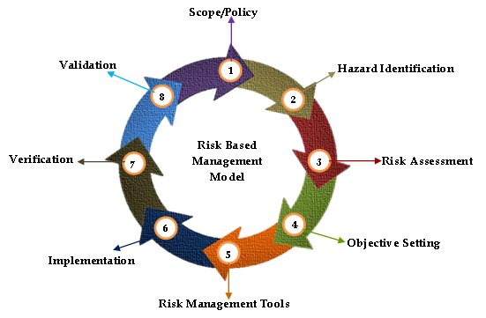
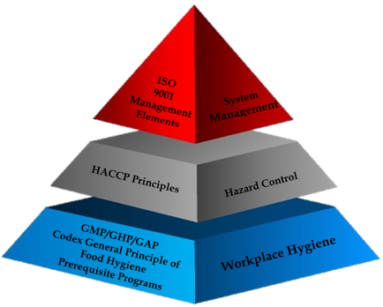
1.1. Areas of application of ISO 22000:2018
Terms and definitions applicable in
the food safety management systems

Slide 6
INTRODUCTION
The introduction of a food safety management system (FSMS) is a strategic decision of the organization that can help it improve its overall performance in terms of food safety. The potential benefits for the organization from the implementation of FSMS based on ISO 22000: 2018are:
- ability to continuously deliver safe food and products and services that meet the requirements of the customers and the applicable requirements of regulations established by a legislative or other competent government agency;
- focus on the risks associated with its objectives;
- ability to demonstrate compliance with specified FSMS requirements.
The ISO 22000:2018 uses a process approach, which combines the PDCA cycle (Plan – Do - Check - Act - PDCA). The process approach allows the organization to plan its processes and their interactions. The PDCA cycle enables the organization to ensure that its processes are provided with the appropriate resources and are managed appropriately and that opportunities for improvement are identified and operational.
Risk-based thinking enables the organization to identify the factors that may cause deviations from the expected results of its processes and the FSMS, to apply control measures to prevent or limit adverse consequences.

Slide 7
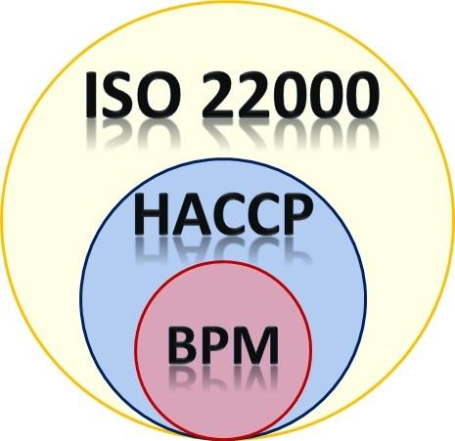
Food safety is related to the presence of food hazards during consumption (consumption by a consumer). Food hazards can occur at any stage of the food chain. That is why adequate control in the food chain is essential. Food safety is ensured through the joint efforts of all actors in the food chain. The ISO 22000:2018 describes the requirements for FSMS, which combines the following generally recognized key elements:
exchange of information;
system management;
prerequisite programs;
principles for Hazard Analysis and Critical Control Points (HACCP).
In addition, the ISO 22000:2018 is based on principles that are common to ISO standards for management systems. The management principles are:
Focus on the customers;
leadership;
staff involvement;
process approach;
improvement;
making decisions based on evidences;
relationship management.
An example of communication channels between typical stakeholders in the food chain is shown in Figure 1.

Slide 8
Legislative bodies and
regulatory authorities
Plant growers
Feed manufacturers
Livestock breeders
Primary unit of food producers - slaughterhouses, mills, milk enterprises, etc.
Secondary unit of food producers – food processors.
Distributors of finished products
Retailers
Restaurants / Catering
Producers of pesticides, fertilizers, and veterinary drugs
Producers of ingredients and additives
Transport and storage operators
Producers of equipment
Producers of packaging materials
Producers of detergents and disinfectants
Service providers
Other supplying food chains
Costumers
Figure 1. Example for communication along the food chain

Slide 9
0.3 Process approach
0.3.1 General
Thе ISO 22000: 2018 encourages the adoption of a process approach to the development and implementation of FSMS and the improvement of its effectiveness to support the production of safe products and services while respecting applicable requirements.
Understanding and managing the interacting processes as a system contributes to the more efficient and effective achievement of the intended results of the organization.
The process approach is based on the systematic identification and management of processes and their interaction, so as to achieve the intended results in accordance with food safety policy and the strategic direction of the organization.
The management of the processes and the system as a whole can be done by applying the cycle planning-doing-checking-action and its full integration into risk-based thinking in order to seize opportunities and prevent and limit undesirable results.
Recognition of the role and position of the organization in the food chain is essential to ensure effective interactive communication throughout the food chain.

Slide 10
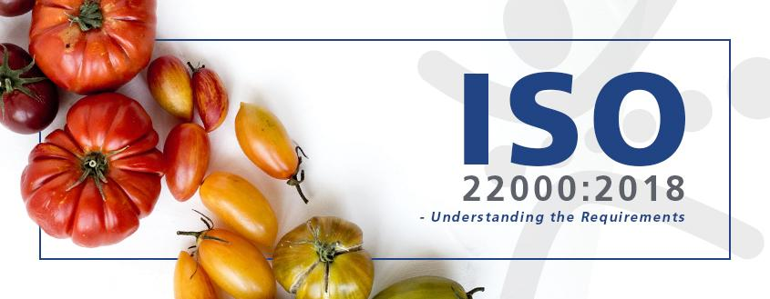
0.3.2 The planning-doing-checking-
action cycle (PDCA)
The PDCA cycle can be briefly described as follows:
Planning: defining the objectives of the system, its processes and resources needed to achieve results, as well as identifying and reporting risks and opportunities;
Doing: implementing what is planned.
Checking - : monitoring and (where applicable) measurement of processes and the resulting products and services, analysis and evaluation of information and data from monitoring, measurement and verification activities, and reporting of results.
Action: take action to improve performance as needed.
As shown in Figure 2, the process approach uses the concept of the PDCA cycle on two levels.
The first covers the overall framework of the FSMS (points 4 to 7 and points 9 to 10).
The other level covers the operational processes within the food safety system, which are described in point 8.
Communication between the two levels is therefore essential.

Slide 11
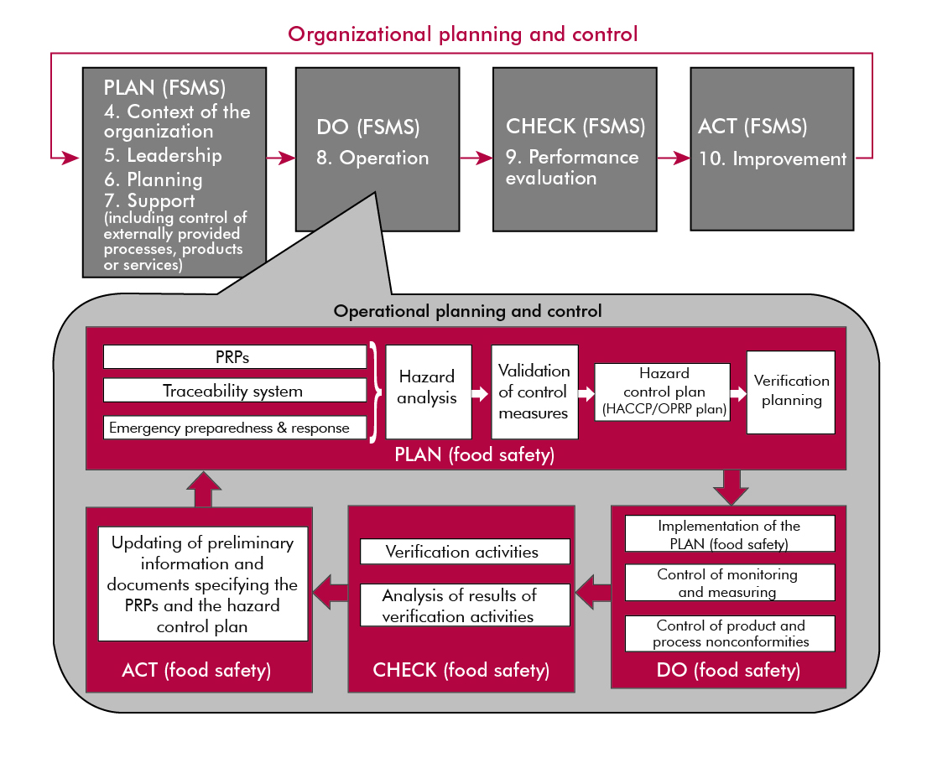
Figure 2. Illustration of the two levels of the PDCA cycle
(planning - doing /implementation/ - checking - action)

Slide 12
0.3.3 Risk-based thinking
0.3.3.1 General Risk-based thinking is important to create an effective food safety management system. In the ISO 22000: 2018, risk-based thinking also applies to both levels - organizational (see 0.3.3.2) and operational (see 0.3.3.3), which is in line with the process approach described in 0.3.2.
0.3.3.2 Risk management of the organization
Risk is an effect of uncertainty. Any uncertainty can have a positive or negative effect. In the context of organizational risk management, the positive deviation arising from the risk may provide opportunities, but not all positive effects of risk lead to opportunities. To meet the requirements of this document, the organization must plan and implement actions to address the risks (see section 6). Dealing with risks creates a basis for increasing the effectiveness of the food safety management system, for achieving better results and for preventing undesirable consequences.
0.3.3.3 Hazard analysis - operational processes
The concept of risk-based thinking through HACCP principles at the operational level is built into the ISO 22000: 2018. The next steps in the HACCP process can be considered as necessary measures to prevent or reduce hazards to acceptable levels to ensure food safety at the time of consumption (see section 8). Decisions taken in the HACCP implementation must be based on scientific advances, without bias and have to be documented.

Slide 13
All requirements of the ISO 22000: 2018 are generic and are intended to be applied by all organizations wishing to develop and implement an effective FSMS, regardless of their size and complexity.
This includes organizations that are directly or indirectly involved in one or more steps of the food chain.
Directly involved organizations are feed manufacturers, agricultural producers, farmers, producers of food ingredients (soy, egg, blood, dairy and other protein preparations, we-six, etc.), food processors, retailers, catering establishments, catering operators, organizations providing services such as cleaning, transport, storage, distribution, indirectly included.
Organizations indirectly involved in the food chain are the manufacturers of technological equipment, detergents, packaging and other materials that come into contact with food.
The ISO 22000: 2018 allows small farms, small distributors of packaged foods, small retailers or small eateries to apply externally developed combinations of control measures.

Slide 14
04 Relation to other standards for control systems
This standard was developed by ISO and follows the High Level Structures (HLS). The aim of HLS is to improve compatibility between individual standards for ISO management systems.
The ISO 22000: 2018 enables the organization to use a process approach combined with the PDCA cycle and risk-based thinking to align or integrate the approach of the food safety management system with the requirements of other management systems and supporting standards.
The ISO 22000: 2018 provides the basic principle and framework for food safety management systems.
It sets out the specific food safety management requirements for organizations throughout the food chain.
Other food safety guidelines, specifications and/or requirements specific to food sectors may be used in conjunction with this framework.
In addition, ISO has developed a series of related documents. This includes documents for: prerequisite programs (ISO/TS 22002 series) for certain sectors of the food chain; - requirements for auditing and certification bodies; traceability.
ISO also provides organizations with guidance on how to implement ISO 22000: 2018and related standards.

Slide 15
1. Object and field of application
ISO 22000: 2018 sets out the requirements for a food safety management system to enable an organization directly or indirectly involved in the food chain to:
plan, implement, implement, maintain and update a food safety management system (FSMS) designed to provide products and services that are intended to be safe for the consumers;
demonstrates compliance with the applicable regulatory requirements for food safety;
assess and assess customer requirements and demonstrate compliance with food safety requirements agreed with customers;
exchange information effectively with food chain stakeholders on food safety issues;
ensure compliance with the declared food safety policy;
demonstrate this compliance to interested parties;
receive certification or registration of its food safety management system from an external organization or perform a self-assessment or declare compliance with this International Standard.
All requirements of this International Standard are general and are intended for application by all organizations in the food chain, regardless of their size and complexity. Organizations directly or indirectly involved include, but are not limited to: feed manufacturers, pet food manufacturers, farmers, ingredient manufacturers, food processors, retailers and service-related organizations, catering establishments, catering organizations, organizations providing services such as cleaning, transport, storage, warehousing and distribution, suppliers of technological equipment, cleaning and disinfection preparations, packaging and other materials that come into contact with food.
This standard allows organizations that are in the field of small and/or medium-sized businesses (e.g. small farms, pre-packaged food distributors, retailers or service providers) to implement a combination of control measures developed by external specialists. Internal and/or external resources may be used to comply with this standard.

Slide 16
2. LINKS
ISO 9001:2015 Quality management systems — Fundamentals and vocabulary are essential to the realization of this standard.
For undated references, the latest edition of a document including any amendments ISO 9001:2015 Quality management systems — Fundamentals and vocabulary

Slide 17
3. Terms and Definitions
3.1 Acceptable level - level of food hazard (3.22) in the final product (3.15) determined by the organization (3.31), which must not be exceeded;
3.2 Criterion for action - measured or observed observation value (3.27) of the OPRP (3.30)
NOTE 1: The criterion for action is established to determine whether the OPRP remains under control and to distinguish between what is acceptable (criterion "meets" or "achieved" means that the OPRP is working as intended) and unacceptable (nor is the criterion complied with and implemented, nor does the OPRP works as intended).
3.3 Audit - systematic, independent and documented process (3.36) for obtaining audit evidence and evaluating it objectively to determine the extent to which the audit criteria are met;
NOTE 1: An audit may be an internal audit (first party) or an external audit (second or third party) and may be a combined audit (a combination of two or more disciplines).
NOTE 2: An internal audit is performed by the organization itself or externally on its behalf.
NOTE 3: The terms "audit evidence" and "audit criteria" are defined in ISO 19011.
NOTE 4: Relevant disciplines are, for example, food safety management, quality management or environmental management.

Slide 18
3.4 Competence – ability to apply knowledge and skills to achieve desired results;
3.5 Compliance – fulfillment of requirement (3.38)
3.6 Contamination - introduction or occurrence of contaminants, including food hazard (3.22) in the product (3.37) or the environment
3.7 Continuous – improvement repetitive actions to improve performance (3.33)
3.8 Control measure - action or activity which is essential to prevent a significant risk to foodstuffs (3.22) or to reduce it to an acceptable level (3.1);
NOTE 1: to the term: See definition of significant food hazard (3.40).
NOTE 2: to the term: The control measure (s) is identified by hazard analysis.
3.9 Correction - action to eliminate the discrepancy found (3.28)
NOTE 1 to the term: The adjustment involves the handling of potentially dangerous products and can therefore be made in conjunction with corrective action (3.10).
NOTE 2 to the term: Correction may be, for example, reprocessing, post-processing and / or elimination of the adverse effects of non-compliance (e.g. referral for other uses or special labeling).
3.10 Corrective action – action to eliminate the cause of the non-compliance (3.28) and to prevent its recurrence
NOTE 1 to the term: There may be more than one reason for non - compliance.
NOTE 2 to the term: Corrective action includes an analysis of the causes.

Slide 19
3.11 Critical control point (CCP) - stage of the process (3.36) in which a control measure (s) (3.8) is applied to prevent or reduce to an acceptable level a significant food hazard (3.40) and the defined critical limits (3.12) and measurement (3.26) provide for the application of corrections (3.9).
3.12 Critical limit - a measurable value that separates the acceptable from the unacceptable
NOTE 1 to the term: Critical limits are established to determine whether a CCP (3.11) remains under control. If the critical limit is exceeded or not met, the affected products must be treated as potentially dangerous products.
[SOURCE: CAC / RCP 1‐1969, as amended - Definition changed and note 1 added to the term]
3.13 Documented information - the information required to be managed and maintained by the organization (3.32) and the medium on which it is contained
NOTE 1 to the term: The documented information may be in any format and medium and from any source.
NOTE 2 to the term: Documented information may relate to:- the management system (3.25), including related processes (3.36);- information created in order for the organization to perform its activity (documentation);- evidence of the results achieved (records).
3.14 Efficiency - the extent to which the planned activities have been implemented and the planned results have been achieved 3.15 final product (3.37) which is not further processed or processed by the organization (3.31)
NOTE 1 to the term: A product that is further processed or processed by another organization is a final product for the first organization and a raw material or ingredient for the second organization.
3.15 Final product (3.37) - which is not further processed or processed by the organization (3.31)
NOTE 1 to the term: A product that is further processed or processed by another organization is a final product for the first organization and a raw material or ingredient for the second organization.

Slide 20
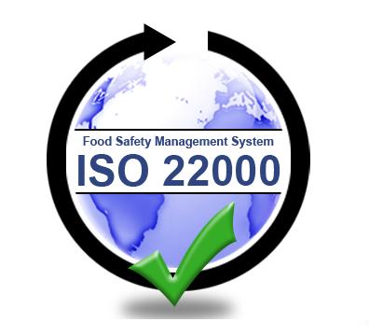
3.19 Animal feed - one or more products, whether processed, semi-processed or raw, intended for feeding to non-food producing animals
NOTE 1 to the term: In ISO 22000: 2018a distinction is made between the terms food (3.18), feed (3.16) and animal feed (3.19):
the food is intended for human and animal consumption and includes feed and animal feed;
the feed is intended for feeding to animals kept for food production (productive animals);animal feed is intended for feeding to animals that are not kept for food production, such as pets.
[SOURCE: CAC / GL 81-2013, as amended - The word "materials" is replaced by "products", the word "no" is added and the word "direct" is deleted.]
3.20 Food chain - sequence of steps and operations involved in the production, processing, distribution, storage and processing of foodstuffs (3.18) and their ingredients from primary production to consumption
NOTE 1 to the term: This includes the production of feed (3.16) and animal feed (3.19).
NOTE 2 to the term: The food chain also includes the production of materials intended to come into contact with raw materials or foodstuffs.
NOTE 3 to the term: The food chain also includes service providers.

Slide 21
3.21 Food safety - a guarantee that the food will not have an adverse effect on the health of the consumer when it is prepared and/or consumed in accordance with its intended use.
NOTE 1 to the term: food safety is related to the presence of food hazards (3.22) in the final products (3.15) and does not include other health aspects related to for example with malnutrition.
NOTE 2 to the term: Not to be confused with the availability of and access to food (food security).
NOTE 3 to the term: this includes feed and animal feed.
[SOURCE: CAC / RCP 1-1969, as amended - The word 'harm' has been replaced by 'adverse health effects' and remarks have been added to the term.]
3.22 Food hazard - biological, chemical or physical agent in foodstuffs (3.18) which has the potential to cause adverse health effects
NOTE 1 to the term: The term "hazard" should not be confused with the term "risk" (3.39), which in the context of food safety is a function of the likelihood of an adverse health effect (eg disease onset) and the severity of this effect (death, hospitalization, etc.) under the influence of a certain danger.
NOTE 2 to the term: Allergens and radioactive substances are part of food hazards.
NOTE 3 to the term: With regard to feed and feed ingredients, the hazards are those which may be present in and / or on feed and feed ingredients and which may be transferred to food through the consumption of animal feed and may therefore have the potential cause adverse effects on animal or human health. For operations other than those that directly process feed and food (eg packaging material manufacturers, disinfectants), the relevant food hazards are those that can be directly or indirectly transferred to the food when used as intended (see 8.5.1.4).
NOTE 4 to the term: With regard to feed, the hazards are those which are dangerous to the animal species for which the food is intended.

Slide 22
3.23 Stakeholder - a natural person or organization (3.31) which may influence, be influenced by or be perceived as affected by a decision or activity.
3.24 Batch - a quantity of a product (3.37) produced and / or processed and / or packaged under the same conditions.
NOTE 1 to the term: The batch is defined by the parameters established in advance by the organization and can be described by other terms, for example a batch of bulk product.
NOTE 2: The batch may be reduced to one unit of product.
[SOURCE: CODEX STAN 1, as amended - The expression "and / or processed and / or packaged" is included in the definition and remarks are added to the term.]
3.25 Management system - a set of interconnected or interacting elements of an organization (3.31) to create policies (3.34) and goals (3.29) and processes (3.36) to achieve these goals.
NOTE 1 to the term: The management system may refer to one discipline or to several disciplines.
NOTE 2 to the term: The elements of the system include the structure of the organization, roles and responsibilities, planning and activities.
NOTE 3 to the term: The scope of the management system may include the whole organization, specific and defined functions of the organization or one or more functions for a whole group of organizations.
NOTE 4 to the term: Relevant disciplines are, for example, a quality management system or an environmental management system.

Slide 23
3.26 Measurement - value determination process (3.36).
3.27 Observation - determining the state of a system, process (3.36) or activity.
NOTE 1 to the term: Inspection, control or critical monitoring may be required to determine the condition.
NOTE 2 to the term: With regard to food safety, monitoring is the conduct of a planned sequence of observations or measurements to assess whether a process is functioning as intended.
NOTE 3 to the term In this document, the terms validation (3.44), monitoring (3.27) and verification (3.45) are distinguished:- validation is applied before performing an activity and provides information about the possibilities for achieving the desired results;- monitoring is applied during the implementation of the activity and provides information on the implementation of the activity within a certain period;- verification / verification is applied after the implementation of the activity and provides information for confirmation of conformity.
3.28 Non-conformity - non-compliance (3.38).
3.29 Purpose - result to be achieved
NOTE 1 to the term: the goal can be strategic, tactical or operational.
NOTE 2 to the term: Objectives may relate to different areas (such as finance, health and safety and environmental objectives) and may be applied at different levels (strategic level, organization level, project, product and process level). 3.36)).
NOTE 3 to the term: The purpose may be expressed in other ways, for example as an intended result, intention, operational criterion, as a goal of the food safety management system or by using other words with similar meaning (eg purpose, end goal or task).
NOTE 4 to the term: In the context of the food safety management system, the objectives are set by the organization in accordance with the food safety policy to achieve concrete results.
3.30 Operational program - prerequisite OPRP-s - a control measure (3.8) or a combination of control measures applied to prevent or reduce to an acceptable level (3.1) a significant food hazard (3.40) and where the action criteria (3.2) and the measurement (3.26) or monitoring allow effective process control (3.36) and / or product (3.37)

Slide 24
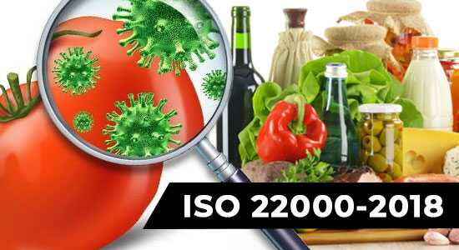
3.31 Organization - a person or group of persons who have their functions with responsibilities, powers and relationships to achieve their goals (3.29).
NOTE 1 to the term: The concept of organization includes, but is not limited to: sole trader, company, corporation, firm, enterprise, competent governmental body, partnership, charitable organization or institution, part or combination thereof, whether or not registered as legal entities or not, whether public or private.
3.32 Outsourcing - reaching an agreement in which an external organization (3.32) performs part of a function or process (3.36) of an organization.
NOTE 1 to the term: The external organization is outside the scope of the management system (3.25), although the function or process performed by the external organization is within its scope.
3.33 Result - a measurable result
NOTE 1 to the term: Performance can refer to quantitative or qualitative findings.
NOTE 2 to the term: Performance may refer to the management of activities, processes (3.36), products (3.37) (including services), systems or organizations (3.31).
3.34 Policy - intentions and guidelines of an organization (3.31), officially expressed by its top management (3.41)
3.35 Prerequisite programs (PRP-s) - basic conditions and activities necessary to maintain food safety within the organization (3.31) and throughout the food chain (3.20)
NOTE 1 to the term: The required prerequisite programs (PRPs) depend on the sector of the food chain in which the organization operates and on the type of organization. Examples of equivalent terms are: good agricultural practice (GAP), good veterinary practice (GVP), good industrial practice (GMP), good hygiene practice (GHP), good manufacturing practice (GPP), good distribution practice (GDP), good trade practice (GTP).

Slide 25
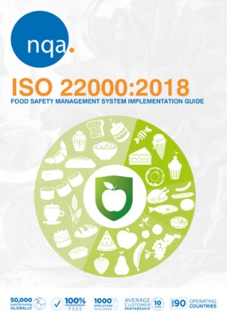
3.36 Process - a set of interconnected or interacting activities that convert input elements into output elements.
3.37 Product - output element resulting from a process (3.36).
NOTE 1 to the term: the product may be a service.
3.38 Requirement - an expressed need or expectation that is usually implied or mandatory.
NOTE 1 to the term: "Usually implied" means that it is common or common practice for the organization and stakeholders to consider a need or expectation that is implied.
NOTE 2 to the term: A specific requirement is a requirement that is formulated, for example, in documented information.
3.39 Risk - influence of uncertainty.
NOTE 1 to the term: The impact is a deviation from the expected - positive or negative.
NOTE 2 to the term: Uncertainty is a state of lack of information, even partial, about the understanding or knowledge of an event, its consequences or probability.
NOTE 3 to the term: Risk is often characterized by reference to potential events (as defined in ISO Guide 73: 2009, 3.5.1.3) and “consequences” (ISO Guide 73, 3.6.1.3) or a combination thereof.
NOTE 4 to the term: Risk is often expressed as a combination of the consequences of an event (including changes in circumstances) and the associated probability (ISO Guide 73, 3.6.1.1) of its occurrence.
NOTE 5: The risk to food safety is a function of the likelihood of adverse health effects and the severity of this effect due to hazard (s) in food (3.18) (as defined in the Codex Alimentarius Manual) [11].
3.40 Significant food hazard - food hazard (3.22) identified by hazard assessment to be controlled by control measures (3.8)

Slide 26
3.41 Senior management - a person or group of persons who lead and control an organization (3.31) at the highest level
NOTE 1 to the term: Senior management has the right to delegate authority and provide resources within the organization.
NOTE 2 to the term: If the scope of the management system (3.25) includes only a part of the organization, then the term "senior management" refers to those who lead and control that part of the organization.
3.42 Traceability - the ability to trace the history, use, movement and location of an object during certain stages of production, processing and distribution
NOTE 1 to the term: Movement may refer to the origin of materials, the history of processing or the distribution of foodstuffs (3.18).
NOTE 2 to the term: The object can be a product (3.37), material, unit, equipment, service, etc.
[SOURCE: SAS / GL 60-2006, with changes - the note to the term has been added].
3.43 Update - immediate and / or planned action to ensure the use of up-to-date information.
NOTE 1 to the term: The term "update" differs from the terms "maintenance" and "save". maintenance - keeping something in good condition; save - to save something that can change.
3.44 Validation - "food safety" obtaining evidence that the control measure (3.8) (or combination of control measures) will effectively control the significant food hazard (3.40)
NOTE 1 to the term: Validation (Confirmation) is performed when a combination of control measures is designed or when changes are made to the applied control measures;
NOTE 2 to the term: In ISO 22000: 2018the terms validation (3.44), monitoring (3.27) and verification (3.45) are distinguished: - validation is applied before performing an activity and provides information about the possibilities for achieving the desired results; - monitoring (observation) is applied during the implementation of the activity and provides information on the implementation of the activity within a certain period; - verification / verification is applied after the implementation of the activity and provides information for confirmation of conformity.

Slide 27
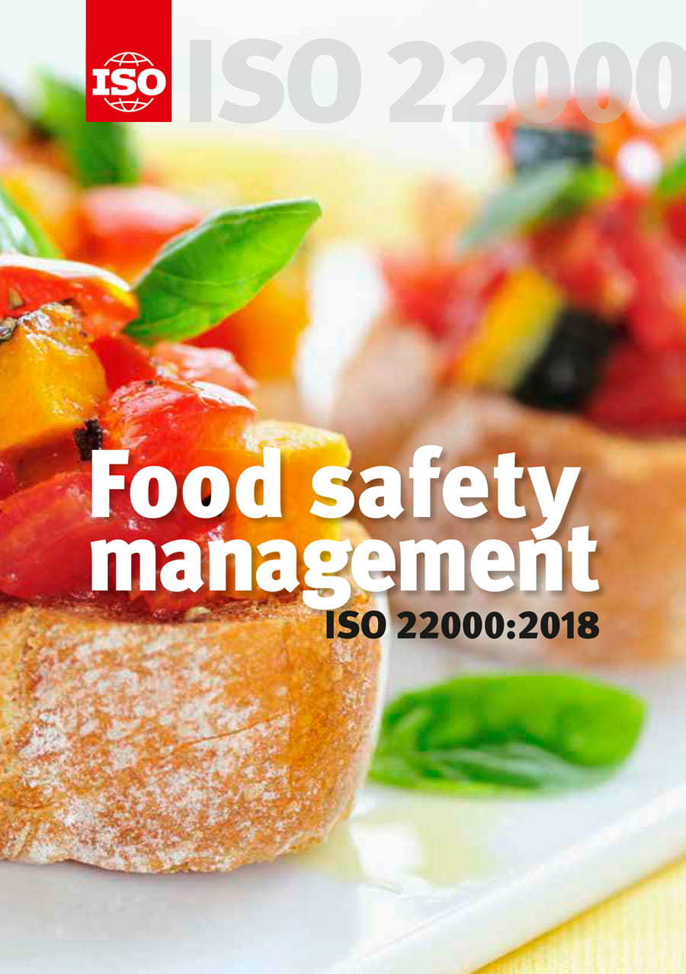
3.45 Verification - approval by presenting objective evidence that the specified requirements (3.38) are met
NOTE 1 to the term: In this document, the terms validation (3.44), monitoring (3.27) and verification (3.45) are distinguished:
- validation is applied before performing an activity and provides information about the possibilities for achieving the desired results;
- monitoring (observation) is applied during the implementation of the activity and provides information on the implementation of the activity within a certain period;
- verification / verification is applied after the implementation of the activity and provides information for confirmation of conformity.

Slide 28
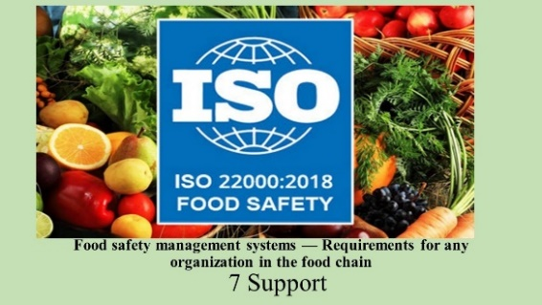
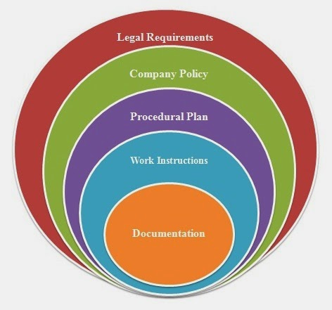
1.2. Basic requirements of ISO 22000: 2018 management system of food safety and requirements to documents and records

Slide 29
4. Context of the organization
4.1. Understanding the organization and its context
The organization shall identify external and internal circumstances that are relevant to its purpose and that affect its ability to achieve the desired results of its food safety management system.
The organization shall identify, review and update information related to these external and internal circumstances.
NOTE 1: Circumstances may include positive and negative factors or conditions to be considered.
NOTE 2: Understanding the context can be facilitated by considering external and internal circumstances that are not limited to legal, technological, competitive, market, cultural, social and economic environments, cybersecurity and food fraud, food protection and intentional contamination. , knowledge and implementation of the organization whether international, national, regional or local.
4.2. Understanding the needs and expectations of stakeholders
To ensure that the organization is able to continuously provide products and services that meet the applicable regulatory and customer requirements for food safety, the organization must determine:
stakeholders involved in the food safety management system;
the requirements of stakeholders related to the functioning of the food safety management system.
The organization shall identify, review and update information related to stakeholders and their requirements.

Slide 30
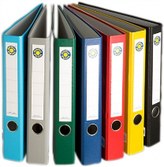
4.3 Determining the scope of the food safety management system
The organization must define the limits and applicability of the food safety management system in order to establish its scope.
The scope defines the products and services, processes and production sites that are subject to the food management system. The scope includes activities, processes, products or services that may affect the safety of final food products.
In determining the scope, the organization should consider
the external and internal circumstances referred to in 4.1;
the requirements of the stakeholders referred to in 4.2.
The scope should be accessible and maintained as documented information.
4.4 Food safety management system
The organization shall establish, implement, maintain, update and continuously improve the food safety management system, including the necessary processes and their interactions in accordance with the requirements of this document.

Slide 31
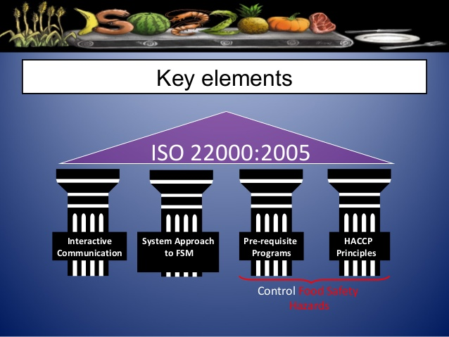
1.3. Management responsibilities associated with the maintenance and operation of the food safety management system

Slide 32
5. Leadership
5.1 Leadership and commitment
The senior management must demonstrate leadership and commitment to the food safety management system by:
ensure that the food safety policy and the objectives of the food safety management system are established and consistent with the strategic direction of the organization;
ensure the integration of the requirements of the food safety management system into the business processes of the organization;
ensure that the necessary resources are available for the food safety management system;
inform about the importance of effective food safety management and compliance with the requirements of the food safety management system, the applicable regulatory requirements and the mutually agreed requirements of the customers related to food safety;
ensure that the food safety management system is evaluated and maintained to achieve the desired results (see 4.1);
guide and assist people to contribute to the effectiveness of the food safety management system;
encourages continuous improvement;
supports other important management positions to demonstrate their leadership in food safety when it comes to their areas of responsibility.
NOTE: The reference to "business" in ISO 22000: 2018means those activities that are essential to the existence of the organization.

Slide 33
5.2 Food safety policy
5.2.1 Creating a food safety policy
Senior management should establish, implement and maintain a food safety policy that: should establish, implement and maintain a food safety policy that:
is appropriate to the purposes and context of the organization;
provide a framework for defining and reviewing the objectives of the food safety management system;
include a commitment to meet applicable food safety requirements, including regulatory requirements and mutually agreed customer safety requirements;
is aimed at internal and external communications;
include a commitment to continuous improvement of the food safety management system;
addresses the need to ensure food safety competencies.
5.2.2 announcement of food safety policy
The food safety policy must be:
available and maintained as documented information;
announced, understood and implemented at all levels within the organization;
available to relevant stakeholders, where appropriate

Slide 35
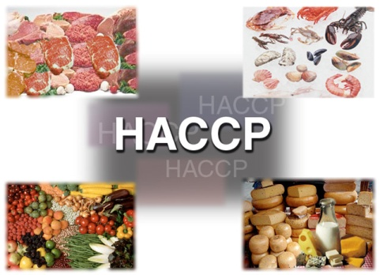
5.3 Roles, responsibilities and
powers in the organization
5.3.1 Senior management must ensure that responsibilities and authorities for the respective roles are assigned, disclosed and understood within the organization. Senior management should allocate responsibilities and authority to:
ensuring that the food safety management system complies with the requirements of this document;
reporting on the effectiveness of the food safety management system to senior management;
designation of a HACCP team and team leader of the food safety team;
identifying persons with specific responsibilities and powers to initiate and document actions.
5.3.2 The Head of the HACCP team
is responsible for:
ensure that the food safety management system is established, implemented, maintained and updated;
manage and organize the work of the food safety team;
provide appropriate training and competencies for the food safety team (see 7.2);
report to senior management on the effectiveness and suitability of the food safety management system.
5.3.3 All persons should be responsible for reporting problem(s) to designated persons in the food safety management system.
I’m the HACCP team leader!

Slide 36
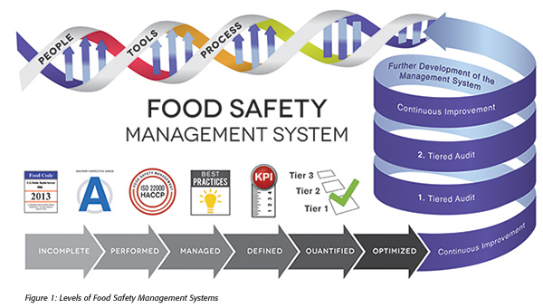
1.4. The safe food planning and realization

Slide 37
6. Planning
6.1 Actions to manage risks and opportunities
6.1.1 Actions to manage risks and opportunities
When planning the food safety management system, the organization shall consider the issues set out in 4.1 and the requirements set out in 4.2 and 4.3 and identify the risks and opportunities to be considered:
to ensure that the food safety management system can achieve the intended results;
to improve the ability to achieve the desired results;
to prevent or reduce adverse effects;
to achieve continuous improvement.
NOTE: In the context of this document, the concept of risks and opportunities is limited to events and their consequences related to the effectiveness and efficiency of the food safety management system. Public institutions are responsible for addressing public health risks. Organizations are required to manage food hazards (see 3.22) and the requirements related to this process set out in point 8.
6.1.2 The organization shall plan:
actions to manage these risks and opportunities;
the manner in which:
1) integrates and implements these actions in the processes of its food safety management system;
2) evaluate the effectiveness of these actions.

Slide 38
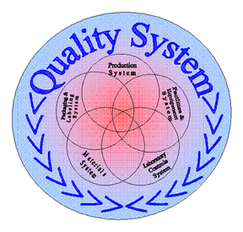
6.1.3 The actions taken by the organization to address risks and opportunities should be proportionate to:
the impact on food safety requirements;
the conformity of food products and services with customer requirements;
the requirements of stakeholders in the food chain.
NOTE 1: Ways to manage risks and opportunities may include: avoiding risk, taking risk to take advantage of an opportunity, eliminating the source of risk, changing the likelihood or consequences, sharing the risk, or accepting risk based on of an informed decision.
NOTE 2: Opportunities can lead to the introduction of new practices (changes in products or processes) through the use of new technologies and other desirable and feasible opportunities to respond to the needs of the organization or its customers.
6.2 Objectives of the FSMS and planning of activities for their achievement
6.2.1 The organization shall establish objectives of the food safety management system for the relevant functions and levels.The objectives of the food safety management system must:
in accordance with the food safety policy;
be measurable (if possible);
take into account the applicable food safety requirements, including regulatory and customer requirements;
be monitored and checked;
be disclosed;
be maintained and updated as appropriate.
The organization shall keep documented information for the purposes of the food safety management system.

Slide 39
6.2.2 When planning how to achieve its objectives in the food safety management system,
the organization shall determine:
what will be done;
what resources will be needed;
who will be responsible;
when it will be completed;
how the results will be evaluated.
6.3 Planning of the changes
When the organization determines the need for changes in the food safety management system, including changes in staff, the changes are made and disclosed as planned.
The organization must consider:
the purpose of the amendments and their potential consequences;
the integrity of the food safety management system;
the availability of resources for the effective implementation of the amendments;
the distribution of responsibilities and powers.

Slide 40
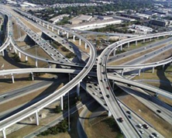
7. maintenance
7.1 Resources
7.1.1 General provisions
The organization must identify and provide the necessary resources to develop, implement, maintain, update and continuously improve the food safety management system.
The organization must consider:
the possibilities and limitations of existing internal resources; and
the need for resources to be supplied from external sources.
7.1.2 Human resources
The organization must identify and provide competent persons (7.2) who are necessary for the implementation and maintenance of an effective food safety management system.
Where the assistance of external experts is required for the development, implementation, operation or evaluation of the food safety management system, agreements or contracts defining the competence, responsibility and authority of external experts should be kept as documented information.
7.1.3 Infrastructure
The organization must provide the resources to identify, establish and maintain the infrastructure necessary to comply with the requirements of the food safety management system.
NOTE: Infrastructure may include: - land, machinery, buildings and related utilities;- equipment, including hardware and software;- vehicles;- information and communication technologies.

Slide 41
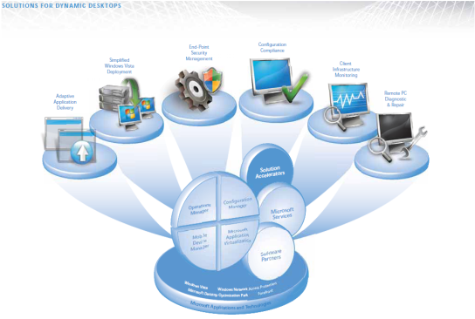
7.1.4 Work environment
The organization shall identify, provide and maintain resources for the creation, management and maintenance of the work environment necessary to comply with the requirements of the food safety management system.
NOTE: The appropriate environment may be a combination of human and physical factors, such as:
social (e.g. non-discrimination, calm environment without confrontations);
psychological (e.g. stress reduction, prevention of exhaustion, emotional protection);
physical (e.g. temperature, heat, humidity, light, air circulation, hygiene, noise).
These factors may differ significantly depending on the products and services provided.
7.1.5 Externally developed elements of the food safety management system
When an organization creates, maintains, updates and continuously improves its food safety management system through the use of externally developed elements of a food safety management system, including PRPs, hazard analysis and control plan hazards (see 8.5.4), the organization must ensure that the elements provided are:
developed in accordance with the requirements of this document;
applicable to the organization's facilities, processes and products;
specially adapted by the HACCP teamto the processes and products of the organization;
implemented, maintained and updated as required by this document;
stored as documented information.

Slide 42
7.1.6 Management of processes, products or services offered
by external suppliers
The organization must:
establish and implement criteria for evaluation, selection, monitoring of results and re-evaluation of external suppliers of processes, products and / or services;
ensure adequate communication of requirements to external suppliers;
ensure that processes, products or services provided by external sources do not adversely affect the organization's ability to consistently meet the requirements of the food safety management system;
keep documented information on these activities and all necessary actions resulting from evaluations and re-evaluations.

Slide 43
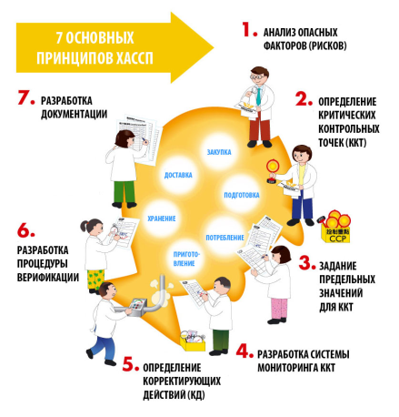
7.2 Competence
The organization must:
determine the necessary competence of the person (s), including external suppliers working under its control, which affects the effectiveness of food safety and the effectiveness of the food safety management system;
ensure that those persons, including the HACCP teamand those responsible for the operation of the hazard control plan, are competent on the basis of appropriate education, training and / or experience;
ensure that the HACCP teamcombines multidisciplinary knowledge and experience in the development and implementation of the food safety management system. This includes, but is not limited to, food products, processes, equipment and hazards within the scope of the food safety management system;
take action (where necessary) to acquire the necessary competence and to assess the effectiveness of the action taken;
keep the necessary documented information as proof of competence.
NOTE: NOTE: Actions taken may include, for example, the provision of training, mentoring or reassignment of employees; or the hiring or contracting of competent persons.

Slide 44
7.3 Awareness
The organization shall ensure that all persons working under its control must be familiar with:
food safety policy;
the objectives of the food safety management system related to their task (s);
the importance of their individual contribution to the effectiveness of the food safety management system, including the benefits of improving food safety performance;
the consequences of non-compliance with the requirements of the food safety management system.
7.4 Exchange of information
7.4.1 General provisions
The organization shall determine the means of internal and external exchange of information appropriate to the food safety management system, including:
on what issues information will be exchanged;
when to exchange information;
with whom to exchange information;
how to exchange information;
who to exchange information.
The organization must ensure that the requirement for the effective exchange of information is understood by all persons whose activities have an impact on food safety.

Slide 45
7.4.2 External exchange of information
The organization must ensure that sufficient information is passed on outside and made available to food chain stakeholders. The organization shall establish, implement and maintain an effective exchange of information with:
external suppliers and contractors;
customers and/or consumers in relation to:
product information to enable safe handling, display, storage, preparation, distribution and use of the product in the food chain or by the consumer;
the identified food hazards that need to be controlled by other organizations in the food chain and / or by consumers;
contractual agreements, inquiries and orders, including their amendments;
feedback from customers and / or consumers, including complaints;
c) legislative and regulatory authorities;
d) other organizations that affect or will be affected by the effectiveness or updating of the food safety management system.
Designated staff must have the responsibility and authority to externally communicate any information on food safety.
Where appropriate, information obtained through external information exchange is included as input for manual review (see 9.3) and for updating the food safety management system (see 4.4 and 10.3). Evidence of external exchange of information is stored as documented information.

Slide 46
7.4.3 Internal exchange of information
The organization must develop, implement and maintain an effective system for the exchange of information within the organization on issues that affect food safety.
In order to maintain the effectiveness of the food safety management system, the organization shall ensure that the HACCP team is informed in a timely manner of changes to the following:
the products or new products;
raw materials, ingredients and services;
production systems and equipment;
production facilities, equipment location and environment;
cleaning and sanitation programs;
packaging, storage and distribution systems;
competences and / or allocation of responsibilities and powers;
applicable regulatory requirements;
knowledge of food hazards and control measures;
customer, industry and other requirements that the organization complies with;
inquiries and communications from external stakeholders;
complaints and alerts indicating food hazards related to the final product;
other circumstances affecting food safety.
The HACCP teammust ensure that this information is included in the update of the food safety management system (see 4.4 and 10.3).Senior management should ensure that relevant information is included as input to the management review (see 9.3).

Slide 47
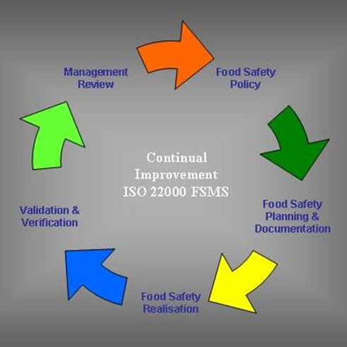
7.5 Exchange of information
7.5.1 General provisions
The food safety management system of the organization have to include:
documented information required by this document;
documented information identified by the organization as necessary for the effectiveness of the food safety management system;
documented information and food safety requirements required by legislators and regulators and customers.
NOTE: The scope of documented information within a food safety management system may vary by organization due to:
- the size of the organization and the type of its activities, processes, products and services;
the complexity of the processes and their interactions;- the competence of the staff.
7.5.2 Create and update
When creating and updating documented information, the organization have to provide appropriate:
identification and description of the documented information (e.g. title, date, compiler or reference number);
form (e.g. language, software version, graphics) and medium (e.g. paper, electronic);
review and approval for suitability and adequacy.

Slide 48
7.5.3 Management of documented
information
7.5.3.1 The documented information required by the food safety management system and by ISO 22000:2018 must be managed to ensure that:
is accessible and suitable for use where and when necessary;
is adequately protected (for example, against breach of professional secrecy, misuse or breach of integrity).
7.5.3.2 To manage documented information, the organization shall implement the following activities, as applicable:
distribution, access, recovery and use;
preservation and protection, including readability;
change management (e.g. publication control);
storage and destruction.
The documented information of external origin identified by the organization as necessary for the planning and operation of the food safety management system must be properly identified and managed.
Documented information stored as proof of compliance must be protected from unintentional tampering.
NOTE: Access may mean a decision to grant the right to read only documented information or the right and authority to read and amend documented information.

Slide 49
8. Activities
8.1 Operational planning and management
The organization shall plan, implement, manage, maintain and update the processes necessary to meet the requirements for the delivery of safe products, as well as implement the actions set out in 6.1 by:
establishing criteria for the processes;
exercising process control in accordance with the criteria;
storage of documented information necessary to show that the processes have been carried out as planned.
The organization shall manage the planned changes and analyze the consequences of unforeseen changes and, if necessary, take action to limit any adverse effects. The organization must ensure that the processes outsourced are managed (see 7.1.6).
8.2 Prerequisite Programs (PRPs)
8.2.1 The organization shall establish, implement, maintain and update prerequisite programs to facilitate the prevention and / or reduction of contaminants (including food safety hazards) in products and the product processing environment.
8.2.2 The prerequisite programs must be:
appropriate to the organization and its context with regard to food safety;
appropriate to the size of the organization, the type of operations and the nature of the products produced and / or processed;
applied at all levels throughout the production system, either as generally applicable programs or as programs applicable to a specific product or process;
approved by the food safety team.

Slide 50
8.2.3 When selecting and/or establishing a PRP(s), the organization shall ensure that the applicable regulatory requirements and mutually agreed customer requirements are identified.
The organization must consider:
the applicable technical specification of the ISO / TS 22002 series;
applicable standards, codes of good practice and guidelines.
When establishing a PRP(s), the organization should consider the following:
the construction and location of buildings and related communications;
the location of the premises, including zoning, the workspace and the installations used;
the supply of air, water, energy and other utilities;
pest control, waste and sewage disposal and ancillary services;
the suitability of the facilities and technological equipment, the extent to which they are accessible for cleaning, repair and technological maintenance;
supplier approval and assurance processes (e.g. raw materials, ingredients, chemicals and packaging);
receipt of input materials, storage, dispatch, transportation and processing of products;
measures to prevent cross-contamination;
cleaning and disinfection;
personal hygiene;
product information/consumer awareness;
others, as appropriate
There must be documented information identifying the selection, establishment, applicable monitoring and verification of the PRP (s).

Slide 51
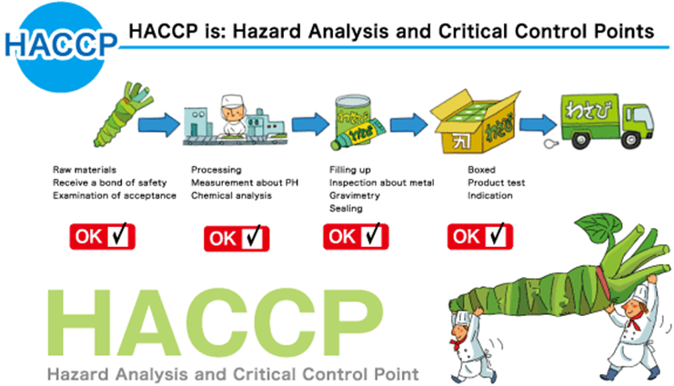
8.3 Traceability system
The traceability system must be able to unambiguously identify the incoming materials from the immediate suppliers and to the first link in the distribution chain of the final product.
The establishment and implementation of the traceability system shall take into account at least the following:
the relationship between the batches of materials, ingredients and intermediates / work in progress obtained in relation to the final products;
processing of materials / products;
the distribution of the final product;
The organization must ensure that the applicable regulatory requirements and mutually agreed customer requirements are identified.
The documented information as evidence of the traceability system shall be kept for a certain period of time, which shall include at least the shelf life of the final product.
The organization must verify and test the effectiveness of the traceability system.
NOTE: Where appropriate, verification of the traceability system is expected to include the reconciliation of the quantities of finished products with the amount of ingredients as evidence of efficacy.

Slide 52
8.4 Emergency preparedness
and responsiveness
8.4.1 General provisions
Senior management should provide procedures that address potential emergencies and incidents that may affect food safety and that are appropriate to the organization's role in the food chain.
Documented information should be created and maintained to manage these situations and incidents.
8.4.2 Dealing with emergencies and incidents
The organization must:
respond appropriately to emergencies and incidents such as:
1) ensure that the applicable regulatory requirements are identified;
2) carries out internal exchange of information;
3) carries out external exchange of information (for example with suppliers, customers, relevant authorities, media);
take action to reduce the consequences of the emergency, commensurate with the scale of the emergency or incident and the potential impact on food safety;
perform periodic testing of the procedures, where practicable;
review and, if necessary, update documented information, in particular following an incident, emergency or test.
NOTE: Examples of emergencies that may affect food and / or production safety are natural disasters, environmental accidents, bioterrorism, accidents at work, public health emergencies, and other accidents such as disruption of basic services such as water, electricity or refrigeration supply.

Slide 53
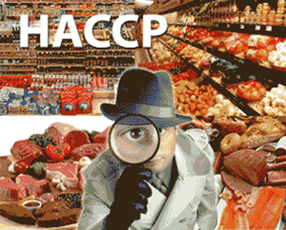
8.5 Hazard control
8.5.1 Preliminary steps for performing a
hazard analysis
8.5.1.1 General
In order to perform a hazard analysis, preliminary information is collected, updated and maintained by the food safety team.
This includes, but is not limited to:
the applicable regulatory and customer requirements;
the products, processes and equipment of the organization;
the food hazards associated with the food safety management system.
8.5.1.2 Characteristics of raw materials, ingredients and contact materials for products
The organization shall ensure that all applicable food safety regulations are identified for all raw materials, ingredients and contact materials.
The organization shall maintain documented information on all raw materials, ingredients and materials in contact with products to the extent necessary to perform a hazard analysis (see 8.5.2) including the following, where appropriate:
biological, chemical and physical characteristics;
composition of the formulation, including additives and auxiliary materials;
origin (e.g. animal, inorganic or vegetable)
method of production;
methods of packaging and delivery;
storage conditions and shelf life;
preparation and / or handling before use or before processing;
acceptance criteria related to food safety or specifications of purchased materials and ingredients according to their intended use.

Slide 54
8.5.1.3 Characteristics of the final products
The organization shall ensure that all applicable regulatory requirements for food safety are identified for all finished products produced.
The organization shall maintain documented information on the characteristics of the final products to the extent necessary to perform a hazard analysis (see 8.5.2), including information on the following, where appropriate:
product name or similar identification;
composition;
biological, chemical and physical characteristics related to food safety;
intended shelf life and storage conditions;
packaging;
food safety labeling and/or instructions for handling, preparation and use;
methods of distribution and delivery;
8.5.1.4 Intended use
The intended use, the reasonably expected handling of the final product, as well as any unforeseen but reasonably expected misuse and abuse of the final product, shall be considered and maintained as documented information to the extent necessary to perform a hazard analysis (see 8.5.2).
If necessary are identified groups of consumers/users for each product. Consumers/user groups are identified, for which it is known that they are particularly vulnerable to specific food hazards. The user/consumers groups for which is known that they are particularly vulnerable to specific food hazards are identified.

Slide 55
8.5.1.5 Technological schemes and description of the processes
8.5.1.5.1 Preparation of technological schemes
The HACCP team have to establish, maintain and update technological schemes as documented information on products or product categories and processes included in the scope of the FSMS.
Technological schemes provide a graphical representation of the process.
Technological schemes are used in performing hazard analysis as a basis for assessing the likely occurrence, increase, decrease or introduction of hazards to food products.
Technological schemes must be clear, precise and sufficiently detailed to the extent necessary to carry out a hazard analysis.
Technological schemes shall, where appropriate, include the following:
the consistency and interaction of all stages of production;
all external processes subcontracted;
the stages at which raw materials, ingredients, auxiliaries, packaging materials, devices and intermediates are included in the manufacturing process;
the stages at which reprocessing and recycling take place;
the stages at which finished products, intermediates, by-products and waste are exported or disposed of.
8.5.1.5.2 Confirmation of technological schemes on site
The HACCP team have to verify on the spot the accuracy of the technological schemes, update them where appropriate and keep them as documented information.

Slide 56
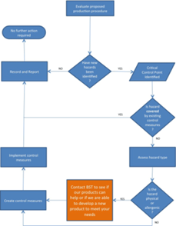
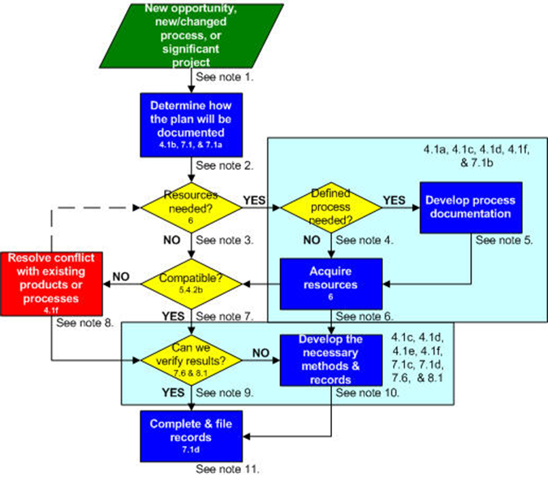
8.5.2 Hazard analysis
8.5.2.1 General
The HACCP team have to perform a hazard analysis based on prior information to determine the hazards to be controlled. The degree of control ensures food safety and, where appropriate, a combination of control measures is used.
8.5.2.2 Identification of hazards and determination of acceptable levels
8.5.2.2.1 The organization shall identify and document any food hazards that are logically expected to arise in relation to the type of product, the type of process and the process environment. Identification must be based on:
the preliminary information and data collected in accordance with 8.5.1;
experience;
internal and external information, including, as far as possible, epidemiological, scientific and other historical data;
information provided by the food chain on food hazards related to the safety of finished products, intermediates and foodstuffs at the time of consumption;
regulatory and customer requirements.
NOTE 1: Experience may include information from personnel and external experts who are familiar with the product and / or processes in other facilities.
NOTE 2: Regulatory requirements may include food safety targets (FSOs). The Codex Alimentarius Commission defines FSOs as "the maximum frequency and / or concentration of hazards in a food during consumption that provides or contributes to an appropriate level of protection (ALOP)".
Hazards must be considered in sufficient detail to assess and select appropriate control measures.

Slide 57
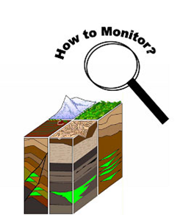
8.5.2.2.2 The organization shall identify each stage (e.g. receipt of raw materials, processing and distribution and delivery of food) at which any food hazard may arise, introduce, increase or continue to exist. In identifying hazards, the organization should pay attention to:
the stages which precede and which follow in the food chain;
all stages in the technological scheme;
equipment, utilities, environment and personnel;
8.5.2.2.3 The organization shall determine the acceptable level of each identified hazard in the final product, where possible. In determining acceptable levels, the organization should:
ensure that the applicable regulatory and customer requirements are identified;
take into account the intended use of the finished products;
take into account any other similar information.
8.5.2.3 Hazard assessment
The organization shall maintain documented information on the determination of acceptable levels and justification for acceptable levels.
The organization shall perform an assessment of any identified food hazards to determine whether its prevention or reduction to an acceptable level is essential.
The organization must assess any food hazards in relation to:
the likelihood of its occurrence in the final product before the application of the control measures;
the severity of the adverse health effects related to the intended use (see 8.5.1.4).
The organization must identify all significant food hazards. The methodology used must be described and the results of the hazard assessment must be kept as documented information.

Slide 58
8.5.2.4 Selection and categorization of control measure(s)
8.5.2.4.1 Based on the hazard assessment, the organization shall select an appropriate control measure or combination of control measures that will be able to prevent or reduce the identified significant food hazards to the specified acceptable levels.
The organization should categorize the selected identified control measures by determining whether to manage them through operational prerequisite programs (OPRPs) (see 3.30) or as critical control points (CCPs) (see 3.11). Categorization should be performed using a systematic approach. It assesses for each of the control measures:
the likelihood of failure of a control measure;
the seriousness of the consequences in the event of failure to implement; this assessment includes:
1) the impact on the identified significant food hazards;
2) its place in the system in comparison with other control measures;
3) whether the control measure is specially designed and implemented to reduce the hazards to an acceptable level;
4) whether it is a single measure or part of a combination of control measures.
8.5.2.4.2 In addition, for each control measure, the systematic approach shall include an assessment of the feasibility of:
the establishment of measurable critical limits and / or measurable / observable performance criteria;
monitoring to detect any non-compliance with critical limits and / or measurable / monitored criteria for action;
making timely corrections in case of failed implementation.
The decision-making process and the results of the selection and categorization of control measures are stored as documented information. External requirements (e.g. regulatory and customer requirements) that may affect the choice and stringency of control measures are also stored as documented information.

Slide 59
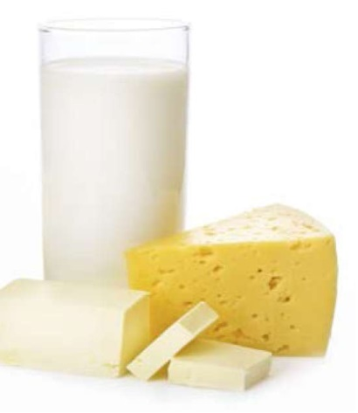
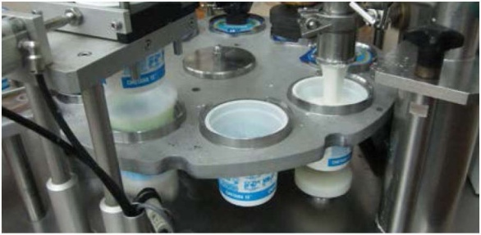
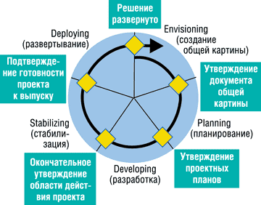
8.5.3 Validation of control measures and combinations of control measures
Prior to the implementation of the control measures to be included in the hazard control plan (see 8.5.4) and after any change thereto (see 7.4.2, 7.4.3, 10.2, 10.3), the HACCP team confirms that the control measures chosen are capable of achieving the intended control of the significant food hazards for which they are intended.
When the result of the confirmation shows that the control measure(s) are not able to achieve the intended control, the HACCP team must amend and re-evaluate the control measure(s) and/or the combination of control measures.
The HACCP team maintains as documented information the methodology for confirming and obtaining evidence of the possibilities of the control measure(s) to achieve the envisaged control.
NOTE: The change may include changes in the control measure (s) (i.e. process parameters, stringency and / or combination thereof) and / or change (changes) in raw material production technologies, final product characteristics, methods of distribution and purpose of the final products.

Slide 60
8.5.4 Hazard control plan (HACCP/OPRP plan)
8.5.4.1 General
The organization must establish, implement and maintain a hazard control plan. The hazard control plan must be maintained as documented information and include the following information for each control measure of each CCP or OPRP:
food hazards must be controlled in the CCP or by the OPRP;
critical CCP limits or OPRP performance criteria;
monitoring procedures;
actions to be taken if critical limits or action criteria are not met;
responsibilities and powers;
surveillance records.
8.5.4.2 Defining critical limits and criteria for action
Critical limits for CCPs and OPRP performance criteria need to be set. The justification for their determination must be kept as documented information. The critical limits for CCPs must be measurable. Compliance with critical limits must ensure that the acceptable level is not exceeded. The criteria for the operation of OPRPs must be measurable or observable. Compliance with the action criteria must ensure that the acceptable level is not exceeded.
8.5.4.3 CCP and OPRPs monitoring systems
A monitoring system must be set up for each CCP for each control measure or combination of control measures to detect non-compliance with critical limits.
The system must include all planned measurements relating to the critical limits.

Slide 61
For each OPRP, a monitoring system must be set up for each control measure or combination of control measures to detect non-compliance with the criteria for action.
The monitoring system for each CCP and for each OPRP must consist of documented information including:
measurements or observations that provide results in a timely manner;
the means or methods of monitoring used;
the applicable calibration methods or for OPRPs, equivalent methods for verifying reliable measurements or observations (see 8.7);
the frequency of monitoring;
the results of the monitoring;
responsibilities and powers related to monitoring;
responsibilities and powers related to the evaluation of the results of the monitoring.
For each CCP, the monitoring method and frequency must be able to detect any non-compliance with critical limits in a timely manner to allow timely isolation and evaluation of the product (see 8.9.4).
For each OPRP, the method and frequency of monitoring should be proportionate to the likelihood of its failure and the severity of the consequences.
Where the observation of the OPRP is based on subjective observation data (e.g. visual inspection), the method must be supported by instructions or specifications.

Slide 62
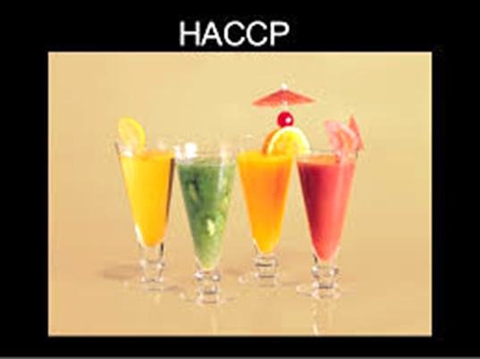
8.5.4.4 Actions to be taken when critical limits or action criteria are not met
The organization shall identify corrections (8.9.2) and corrective actions (see 8.9.3) to be taken when critical limits or action criteria are not met and must ensure that:
potentially dangerous products are not released for sale (see 8.9.4);
the cause of the non-compliance has been identified;
the parameters controlled for the CCP or by the OPRP return to the critical limits or the performance criteria are met
the recurrence of the non-compliance is prevented.
The organization shall make corrections in accordance with 8.9.2 and corrective actions in accordance with 8.9.3.
8.5.4.5 Implementation of the hazard control plan
The organization shall implement and maintain a hazard control plan and keep relevant evidence as documented information.

Slide 63
8.6 Updating information on PRPs and the hazard control plan
Following the establishment of the hazard control plan, the organization shall update the following information if necessary:
characteristics of the raw materials, ingredients and materials in contact with the products;
characteristics of the final products;
intended use;
technological schemes and descriptions of the processes and the process environment.
The organization shall ensure that the hazard control plan and / or PRP (s) are kept up to date.
8.7 Monitoring and measurement management
The organization shall provide evidence that the identified monitoring and measurement methods and equipment used are appropriate for the monitoring and measurement activities related to the PRP (s) and the hazard control plan.
The monitoring and measuring equipment used must be:
calibrated or checked at specified intervals before use;
adjusted if necessary;
identified to enable the calibration state to be determined;
protected from corrections that would invalidate the measurement results;
protected from damage and deterioration of its performance.

Slide 64
The results of the calibration and verification must be kept as documented information.
The calibration of all equipment must be traceable to international or national measurement standards; where standards do not exist, the information used for calibration or verification must be documented and stored.
The organization shall evaluate the validity of previous measurement results when it is determined that the equipment or process environment does not meet the requirements.
The organization shall take appropriate action with respect to equipment, the process environment, and any nonconforming product.
The assessment and the actions taken must be kept as documented information.
The software used for monitoring and measurement within the food safety management system must be validated by the organization, software provider or third party before use.
Documented information on validation activities must be maintained by the organization and the software updated in a timely manner.
Whenever there are changes, including software configuration / changes to market-based software, they must be authorized, documented and validated before implementation.
NOTE: It should be borne in mind that commercially validated software is the most commonly used within the designed scope and can be considered appropriately validated.

Slide 65
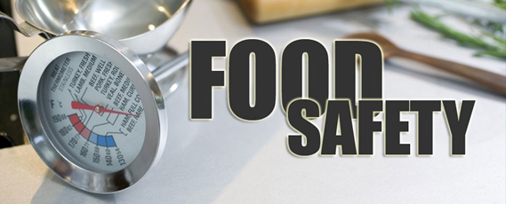
8.8 Verification related to the PRP(s) and the hazard control plan
8.8.1 Verification
The organization shall establish, implement and maintain verification activities. When planning the inspection, the purpose, methods, frequency and responsibilities for the inspection activities must be defined. Verification activities must confirm that:
the PRP (s) are applied and effective;
the hazard control plan is in place and effective;
the hazard levels are within certain acceptable levels;
the hazard analysis inputs are updated periodically;
other actions identified by the organization have been implemented and are effective.
The organization must ensure that verification activities are not carried out by the person responsible for monitoring the same activities. The results of the inspection must be kept as documented information and communicated. Where the verification is based on testing of samples of finished products or samples for direct processing and where such tests show non-conformity with the acceptable level of food hazard (see 8.5.2.2), the organization shall treat the affected batches of the product as potentially hazardous. (see 8.9.4.3) and apply corrective action in accordance with 8.9.3.
8.8.2 Analysis of the results of the verification activities
The HACCP team have to analyze the results of the inspection, which must be used as inputs to assess the performance of the food safety management system (see 9.1.2).

Slide 66
8.9 Management of non-conformities of the products and processes
8.9.1 General provisions
The organization shall ensure that the data obtained from the monitoring of the OPRP and the CCP are assessed by certain persons with sufficient competence and authority to take corrective action and corrections.
8.9.2 Corrections
8.9.2.1 The organization shall ensure that where critical limits in the CCP (s) and/or OPRP performance criteria are not met, the products affected by non-conformities are identified and controlled for their use and release for sale.
The organization shall create, maintain and update documented information that includes:
a method of identifying, evaluating and correcting the products concerned to ensure that they are handled correctly;
a review of the adjustments made.
8.9.2.2 When the critical limits of the critical control points are not met, the affected products are identified and treated as potentially dangerous products (see 8.9.4).

Slide 67
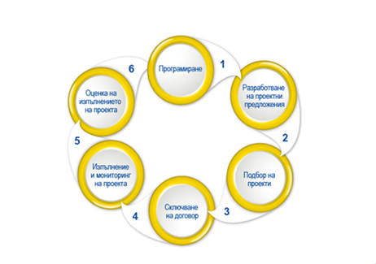
8.9.2.3 Where the criteria for the operation of the OPRP are not met, the following shall be done:
determining the consequences of this failure in terms of food safety;
determining the reason (s) for the failed implementation;
identification and processing of the affected products in accordance with 8.9.4.
The organization shall disclose the results of the evaluation as documented information.
8.9.2.4 Stored documented information shall describe the adjustments made to non-conformity products and processes, including:
the nature of the non-conformity;
the reason (s) for the failed implementation;
the consequences of non-conformity.
8.9.3 Corrective actions
Corrective action is assessed as necessary when the critical limits in the CCP (s) and/or the criteria for the operation of OPRPs are not met. The organization shall establish and maintain documented information that identifies appropriate actions to identify and eliminate the cause of non-conformities, to prevent their recurrence, and to bring the process back under control after non-conformities. These actions include:
review of discrepancies identified by customer and/or consumer complaints and/or reports from regulatory inspections;
a review of trends in monitoring results that may indicate a loss of control;
determination of the reason(s) for the discrepancies;
identifying and implementing actions to ensure that non-conformities do not recur;
documenting the results of the corrective actions taken;
verifying corrective actions to ensure that they are effective;
The organization shall keep documented information of all corrective actions.

Slide 68
8.9.4 Treatment of potentially dangerous products
8.9.4.1 General
The organization shall take action to prevent potentially dangerous products from entering the food chain, unless it is possible to demonstrate that:
the food hazard(s) is (are) reduced to the specified acceptable levels;
the risk(s) to the food will be reduced to certain acceptable levels before entering the food chain; or
the product still complies with the specified acceptable level(s) of food hazard regardless of non-conformity.
Products identified as potentially hazardous are kept under the control of the organization until they are evaluated and their intended use determined. If products that have left the organization and are no longer under its control are subsequently assessed as hazardous, the organization notifies the relevant stakeholders and initiates a withdrawal/recall (see 8.9.5). Controls and related information from relevant stakeholders and authorization to deal with potentially dangerous products are retained as documented information.
8.9.4.2 Evaluation for launch for conversion
Each batch of products affected by non-compliance must be evaluated. Products affected by non-conformity with the critical limits of the critical control points shall not be released for sale but shall be processed in accordance with 8.9.4.3. Products affected by non-conformity with the performance criteria for OPRPs are released as safe when any of the following conditions apply:
evidence, other than the monitoring system, to show that the control measures have been effective;
evidence to show that the combined effect of the control measures for that particular product is appropriate to the intended use (i.e. the identified acceptable levels);
the results of sampling, analysis and/or other verification activities show that the products concerned comply with the specified acceptable levels for the relevant food hazard(s).
The results of the evaluation for the launch of the products are stored as documented information.

Slide 69
Products affected by non-conformity with the performance criteria for OPRPs are released as safe when any of the following conditions apply:
evidence, other than the monitoring system, to show that the control measures have been effective;
evidence to show that the combined effect of the control measures for that particular product is appropriate to the intended use (i.e. the identified acceptable levels);
the results of sampling, analysis and/or other verification activities show that the products concerned comply with the specified acceptable levels for the relevant food hazard(s).
8.9.5 Withdrawal / recall
The organization must be able to ensure the timely withdrawal/recall of batches of finished products that have been identified as potentially hazardous by appointing a competent person(s) entitled to initiate and carry out the withdrawal/recall. The organization must create and maintain documented information on:
notifying relevant stakeholders (e.g. legislators and regulators, customers and / or consumers);
the processing of withdrawal/recalled products as well as products that are still in stock;
the implementation of the sequence of actions to be taken.
Withdrawn /recalled products and finished products that are still in stock must be isolated or monitored by the organization while being managed in accordance with 8.9.4.3.The reason, extent and result of the withdrawal/recall are kept as documented information and are reported to senior management as input for management review (9.3). The organization shall verify the performance and effectiveness of the withdrawal/recall using appropriate techniques (e.g., simulated withdrawal/recall playback or practical withdrawal/recall) and retain documented information.

Slide 70
9. Evaluation of effectiveness
9.1 Monitoring, measurement, analysis and evaluation
9.1.1 General provisions
The organization must determine:
what needs to be monitored and measured;
methods for monitoring, measuring, analyzing and evaluating, as appropriate, to ensure valid results;
when to monitor and measure;
when the results of monitoring and measurement are to be analyzed and evaluated;
who to analyze and evaluate the results of the monitoring and measurement.
The organization shall keep appropriate documented information as evidence of the results. The organization must evaluate the effectiveness and efficiency of the food safety management system (FSMS).

Slide 71
9.1.2 Analysis and evaluation
The organization shall analyze and evaluate appropriate data and information obtained from monitoring and measurements, including the results of verification activities related to PRPs and the hazard control plan (see 8.8 and 8.5.4), internal audits (see 9.2) and external audit.
The analysis should be performed in order to:
confirmation that the overall functioning of the system meets the planned commitments and FSMS requirements established by the organization;
identifying the need to update or improve the FSMS;
identification of trends that show an increase in potentially dangerous products or process inconsistencies;
providing information for the planning of the internal audit program on the status and importance of the areas to be audited;
providing evidence that all corrections and corrective actions taken are effective.
The results of the analysis and all resulting activities must be kept as documented information.
The results should be reported to senior management and used as input to management review (see 9.3) and FSMS updates (see 10.3).
NOTE: Data analysis methods may include statistical techniques.

Slide 72
9.2 Internal audit
9.2.1 The organization shall conduct internal audits at planned intervals to provide information on whether the FSMS:
complies with:
1) the organization's own requirements for its FSMS;
2) the requirements of this document;
(b) is applied effectively and kept up to date.
9.2.2 The organization shall:
plan, establish, implement and maintain an audit program(s) setting out the frequency, methods, responsibilities, planning and reporting requirements that take into account the importance of relevant processes, changes to the food safety management system, as well as the results of monitoring, measurements and previous audits;
define the audit criteria and the scope of each audit;
select competent auditors and conduct the audit, ensuring the objectivity and impartiality of the audit process;
ensure that the results of audits are reported to the HACCP teamand relevant management;
keep documented information as evidence of the implementation of the audit program and the results of the audit;
take the necessary corrections and corrective actions within the agreed deadlines;
determine whether the food safety management system meets the intentions of the food safety policy (see 5.2) as well as the objectives of the food safety management system (see 6.2).
The organization's follow-up activities include reviewing the actions taken and reporting the results of the audit.
NOTE: ISO 19011 provides guidance for audits of control systems.

Slide 73
9.3 Management review
9.3.1 General provisions
Senior management should review the organization's food safety management system at planned intervals to ensure its continued suitability, adequacy and effectiveness.
9.3.2 Input elements of the manual review
The review by management covers:
the status of actions decided on by previous management reviews;
changes in external and internal circumstances relevant to the food safety management system, including changes in the organization and its context (see 4.1);
information on the effectiveness and efficiency of the FSMS, including trends in:
result (s) of system update activities (see 4.4 and 10.3);
results of monitoring and measurement;
analysis of the results of the verification activities related to the PRPs and the hazard control plan (see 8.8.2);
discrepancies and corrective actions;
results of audits (internal and external);
inspections (e.g. regulatory by the client);
the performance of external suppliers;
an overview of the risks and opportunities and the effectiveness of the actions taken to manage them (see 6.1);
the extent to which the objectives of the food safety management system have been met;

Slide 74
9.3 Management review
9.3.2 Input elements of the manual review
The review by management covers:
d) the adequacy of resources;
e) emergencies, incidents (see 8.4.2) or withdrawals / returns(see 8.9.5);
f) relevant information obtained through external (see 7.4.2) and internal (see 7.4.3) communications, including requests and complaints from stakeholders;
g) opportunities for continuous improvement.
The data must be presented in such a way as to enable senior management to link the information to the stated objectives of the food safety management system.
9.3.3 Output elements of the manual review
The output elements of the management review include:
decisions and actions related to opportunities for continuous improvement;
any need for updates and changes to the food safety management system, including resource needs and the revision of the food safety policy and the objectives of the food safety management system.
The organization shall keep documented information as evidence of the results of management review.

Slide 75
10. Improvement
10.1 Discrepancies and corrective actions
10.1.1 When non-compliance with the requirements of this document occurs, the organization shall:
respond to the non-compliance and, as appropriate,: 1) take actions for its control and correction; 2) deal with the consequences;
assess the need to take action to remedy the cause (s) of the non-compliance so that it does not recur or reappear elsewhere, such as: 1) review the non-compliance; 2) determine the reasons for the discrepancy; 3) examine whether other similar discrepancies exist or could possibly arise;
take the necessary action;
review the effectiveness of the corrective actions taken;
amend the food safety management system as necessary.
Corrective action must be appropriate to the consequences of any non-compliance.
10.1.2 The organization shall keep documented information
as evidence of:
the nature of the non-conformities and any follow-up action taken;
the results of any corrective action.

Slide 76
10.2 Continuous improvement
The organization must continually improve the suitability, adequacy, and effectiveness of the FSMS.
Senior management should ensure that
1) the organization continually improves the effectiveness of the FSMS through the use of information exchange (see 7.4), management review (see 9.3), internal audit (see 9.2), and analysis of the results of verification activities (see 8.8),
2) the validation of the control measure (s) and combinations of control measures (see 8.5.3), the corrective actions (see 8.9.3) and the updating of the FSMS (see 10.3).
10.3 Updating the food safety management system
Senior management must ensure that the food safety management system is constantly updated. To achieve this, the HACCP team evaluates FSMS at planned intervals. The team then assesses whether it is necessary to review the hazard analysis (see 8.5.2), the established hazard control plan (see 8.5.4) and the established prerequisite programs (see 8.2). Update activities are based on:
the input elements of the information exchange, both external and internal (see 7.4);
input elements from other information on the suitability, adequacy and effectiveness of the FSMS;
initial elements of the analysis of the results of the verification activities (see 9.1.2);
starting points from the review by management (see 9.3).
System update activities should be stored as documented information and reported as input for management review (see 9.3).

Slide 77
bibliography
[1] ISO 9000:2015, Quality management systems — Fundamentals and vocabulary
[2] ISO 9001:2015, Quality management systems — Requirements
[3] ISO 19011, Guidelines for auditing management systems
[4] ISO/TS 22002 (all parts), Prerequisite programmes on food safety
[5] ISO/TS 22003, Food safety management systems — Requirements for bodies providing audit and certification of food safety management systems
[6] ISO 22005, Traceability in the feed and food chain — General principles and basic requirements for system design and implementation
[7] ISO Guide 73:2009, Risk management — Vocabulary
[8] CAC/GL 60-2006, Principles for Traceability/Product Tracing as a Tool Within a Food Inspection and Certification System
[9] CAC/GL 81-2013, Guidance for governments on prioritizing hazards in feed
[10] CAC/RCP 1-1969, General Principles of Food Hygiene
[11] Joint FAO/WHO Food Standards Programme. Codex Alimentarius Commission: Procedural Manual. Twenty- fifth edition, 2016
[12] Codex Alimentarius. Available from: http://www.fao.org/fao-who-codexalimentarius/en/

