Slide 1
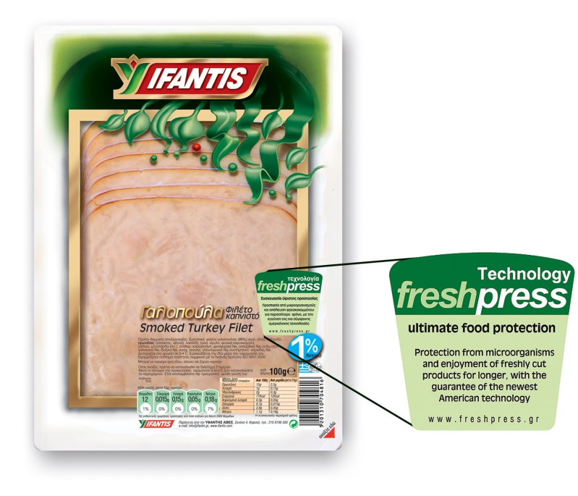
FOOD IRRADIATION
OBJECTIVES
1. Other alternative methods for food treatment;
2. Applications;
3. Benefits and changes of foodstuffs.

Slide 2
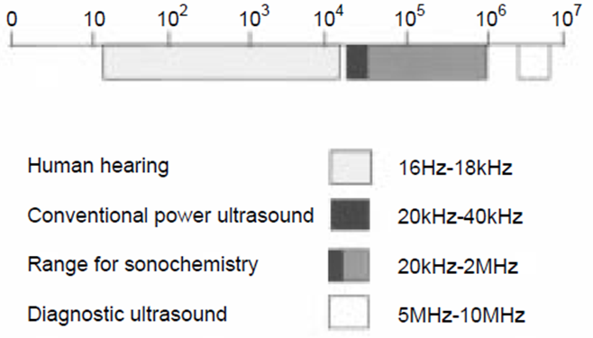
ALTERNATIVE METHODS FOR FOOD TREATMENT
1
1. Ultrasound treatment - sonication
Sound frequency ranges

Slide 3
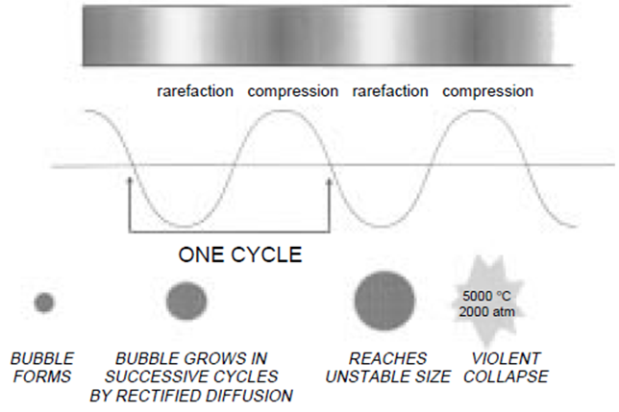
!
ALTERNATIVE METHODS FOR FOOD TREATMENT
2
1. Ultrasound treatment (sonication) - principle
Sound propagation in a liquid showing cavitation bubble formation and collapse

Slide 4
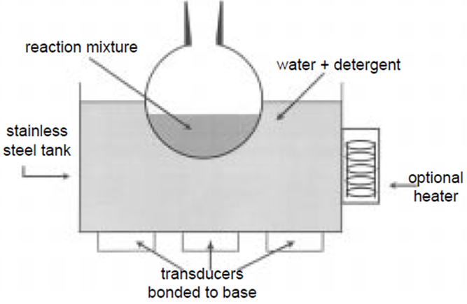
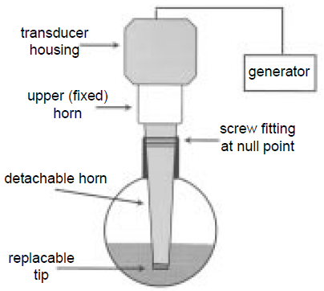
ALTERNATIVE METHODS FOR FOOD TREATMENT
3
1. Ultrasound treatment (sonication) - equipment
Simplest – ultrasonic baths
Ultrasonic probe system

Slide 5
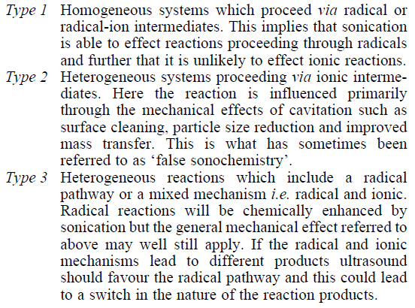
ALTERNATIVE METHODS FOR FOOD TREATMENT
4
1. Ultrasound treatment (sonication) - mechanism

Slide 6
!
ALTERNATIVE METHODS FOR FOOD TREATMENT
5
1. Ultrasound treatment (sonication) – food applications
Ultrasound in the food industry
The food industry as well as the pharmaceutical industry offer manifold possibilities for the use of sonication. Ultrasonic processors are used in food manufacturing for:
disintegration of cells
extracting (extract intracellular components or obtain cell-free bacterial enzyme)
activation (acceleration) of an enzyme reaction in liquid foods
acceleration of fermentation
mixing and homogenizing
dispersion of a dry powder in a liquid
emulsifying of oil/fat in a liquid stream
spraying
degassing
inspection, e.g. in the beverage industry
deactivation of enzymes
microbial inactivation (preservation)
crystallization
meat processing
stimulation of living cells
enhanced oxidation

Slide 7
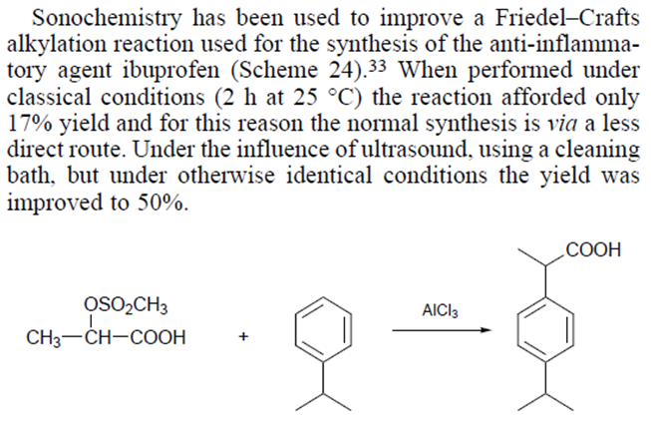
ALTERNATIVE METHODS FOR FOOD TREATMENT
6
1. Ultrasound treatment (sonication) – non-food applications

Slide 8
ALTERNATIVE METHODS FOR FOOD TREATMENT
7
2. Treatment with high pressure –
High hydrostatic pressure (HHP) or Hydrodynamic pressure processing (HDP)
1). A.M.Williams-Campbell, Morse Solomon, Reduction of spoilage microorganisms in fresh beef using
hydrodynamic pressure processing, 65(3), 2002, 571-574, Journal of food protection.
shockwave treatment
The effect of high pressure processing on food systems was first reported by Hite (Hite BH. 1899. The effect of pressure in the preservation of milk. Bull West Virginia Univ Agric Exp Stn 58:15–35.). However, few studies were published until the 1970s because of technical difficulties and costs associated with HHP processing units and packaging materials. HHP treatment – 100÷1000 MPa.
https://www.youtube.com/watch?v=8HnINq2au_8
http://www.hiperbaric.com/en/hpp
http://freshpress.gr/index.cfm?action=video&lang=EN
3). Williams-Campbell, A.M., Solomon, M.B. New non-thermal postharvest technology to improve food safety:
hydrodynamic pressure processing. The International Society for Optical Engineering (SPIE).
2000. v. 4206. p. 167-173.

Slide 9
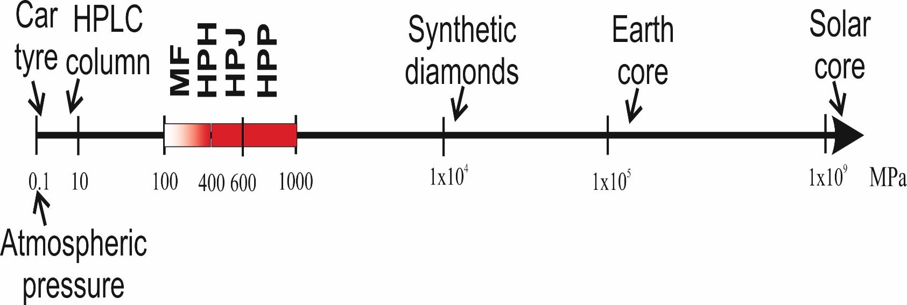
ALTERNATIVE METHODS FOR FOOD TREATMENT
7
2. Treatment with high pressure –
High hydrostatic pressure (HHP) or Hydrodynamic pressure processing (HDP)
Comparative scheme of the high pressure technologies and the pressures utilized. MF: microfluidization; HPH: high pressure homogenization; HPJ: high pressure jet processing; HPP – high pressure processing
3). Williams-Campbell, A.M., Solomon, M.B. New non-thermal postharvest technology to improve food safety:
hydrodynamic pressure processing. The International Society for Optical Engineering (SPIE).
2000. v. 4206. p. 167-173.

Slide 10
ALTERNATIVE METHODS FOR FOOD TREATMENT
7
2. Treatment with high pressure –
High hydrostatic pressure (HHP) or Hydrodynamic pressure processing (HDP)
3). Williams-Campbell, A.M., Solomon, M.B. New non-thermal postharvest technology to improve food safety:
hydrodynamic pressure processing. The International Society for Optical Engineering (SPIE).
2000. v. 4206. p. 167-173.

Slide 11
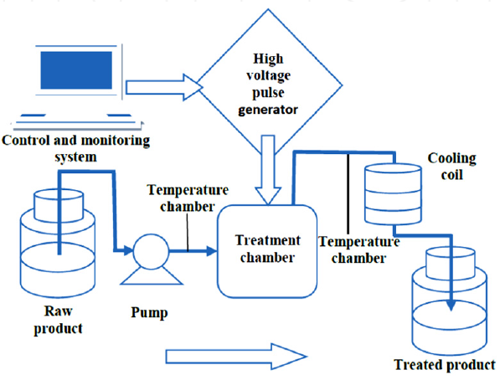
ALTERNATIVE METHODS FOR FOOD TREATMENT
8
3. Pulsed electric field (PEF) treatment
5-80 kV/cm generated by the application of short high voltage pulses (µs) between two electrodes
$450,000 to $2,000,000
https://www.youtube.com/watch?v=uSK-7dqaVLo

Slide 12
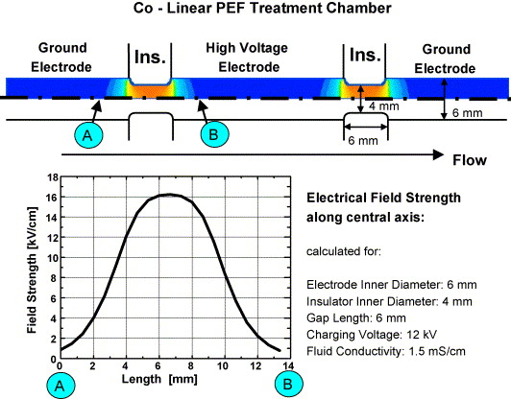
ALTERNATIVE METHODS FOR FOOD TREATMENT
9
3. Pulsed electric field (PEF) treatment
Features of co-linear PEF treatment chambers. Top: sectional view of the electrode configuration and the resulting electrical field. The central high voltage electrode is separated from two grounded electrodes on either side by an electrical insulator. One example is given which shows the field strength along the central axis at the treatment zone A–B. 5-100кV/cm
Pulsed Electric Fields for Food Processing Technology, M.E.A. Mohamed, A.H.A. Eissa in “Structure and Function of Food Engineering” (Ed. Ayman Amer Eissa), 2012, publisehd by InTech (DOI: 10.5772/1615)

Slide 13
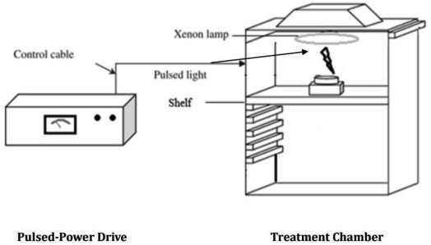
ALTERNATIVE METHODS FOR FOOD TREATMENT
10
4. Pulsed Light Technology
https://www.youtube.com/watch?v=AQ4BY93Ot8A
http://courses.washington.edu/eh451/articles/Pulsed-Light-Food.pdf

Slide 14
ALTERNATIVE METHODS FOR FOOD TREATMENT
10
5. Cold Plasma treatment
https://www.youtube.com/watch?v=HF3wVOfBVuQ

Slide 15
ALTERNATIVE METHODS FOR FOOD TREATMENT
10
6. Dense Phase CO₂ treatment
https://www.slideshare.net/mayasharma9026/maya-sharma-presentation

Slide 16
ALTERNATIVE METHODS FOR FOOD TREATMENT
10
7. Perspectives and trends
Slavov, A.M., Denev, P.N., Denkova, Z.R., Kostov, G.A., Denkova-Kostova, R.S.,
Chochkov, R.M., Deseva, I.N., Teneva, D.G. 2019.
Emerging cold pasteurization technologies to improve shelf life and ensure
food quality. In: Food Quality and Shelf Life (Ed. Charis M. Galanakis),
pp. 55–123. London, UK: Academic Press, Elsevier Inc.
https://doi.org/10.1016/B978-0-12-817190-5.00003-3

Slide 17
ALTERNATIVE METHODS FOR FOOD TREATMENT
10
A recent survey on the importance and application of the novel “cold” pasteurization technologies outlined the current status, development, major advancements, limitations, trends and future perspectives for the next 10 years (Jermann et al., 2015). Specialists from the industry, government and academic institutions from North America and Europe (two separate surveys) were interviewed and the main purpose was to identify which of the emerging technologies (commercially exploited now or with potential for commercialization) will be the most utilized in the near future. With regard to the present situation the most utilized technologies seems to be HPP and microwave heating (as alternative to the traditional thermal treatments). Nowadays more than 300 HPP units are used globally and the HPP market is estimated to be more than $10 billion (Huang et al., 2017). The UV (in North America) and PEF (for Europe) pasteurization methods were outlined also as currently often used. The predictions for future implementations and applications of the technologies revealed HPP as the most utilized method for the time period of next 5-10 years. For Europe PEF and microwave heating will be the second and the third mostly used technologies, while for North Americans the prognoses suggested microwave heating, thermal sterilization assisted by applying pressure and UV to be the next after HPP important techniques. It is interesting to note also that according to the opinions of the participants the HPP was the most researched and developed method for the past 10 years. More than 200 HPP installations are industrially available and intensively used in North America (Higgins, 2016). With regard to potential for application in different food sectors, HPP was the most promising and potentially applicable technology for meat, poultry and seafood industries, and UV was considered to be the best alternative for treatment of liquid state food systems and fresh produce industry. No doubts, the major limitation of further spread of the new technologies are the initial investments needed which actually reflects later on production costs and final products prices. Additionally lack of funding is also a limitation for some of the food processors. The applications of the emerging technologies will remain mainly for shelf-life extension and preservation but also trends toward obtaining new functional and value added foods with reduced salt content are observed (O'Flynn et al., 2014; Yang et al., 2015). Another survey (Lindell, 2018) conducted in October 2017 with participation of food producers and retailers, revealed growing interest on HPP application and the main reasons are shelf-life increase and food waste reduction.
From other point of view it is very important to consider the consumers preferences and expectations. The conclusions of survey organized in Bourg-en-Bresse, Rennes and Strasbourg – France (Bourgade et al., 2015) on the technologies for amelioration of the food quality and safety, reduction of food wastes and consumers’ awareness, showed that a novel technology is better accepted if it allows substantial reduction or elimination of some additives (especially preservatives), and if it is more understandable by the consumers and closer to the “natural”. Similarly, the consumers react negatively if a technology is too complex, introduces too many changes in the final product, and relay on materials which could led to usage of too many packings (from point of view of the waste reduction, and for minimization of possibility for chemical compounds migration into foodstuffs). Based on the above-mentioned the consumers ranked as accepted technologies like HPP, microwaving, usage of biopreservatives, etc., while technologies like pulsed light and especially food irradiation were more “suspicious” to consumers.
7. Perspectives and trends

