Slide 1
Lecture 9.
Enzymes in food processing.
Food biochemistry and food processing. 2012. Simpson B.K. (Ed.) 2nd edition, John Wiley & Sons, Inc.

Slide 2
Sources of food enzymes (plant, animal, microbial, and recombinant).
Enzymes have been used inadvertently or deliberately in food
processing since ancient times to make a variety of food products, such as:
breads,
fermented alcoholic beverages,
fish sauces,
cheeses.

Slide 3
Sources of food enzymes (plant, animal, microbial, and recombinant). Cont.
Industrial enzymes have traditionally been derived from:
Plants: α-amylase, β-amylase, bromelain, β-glucanase, ficin, papain, chymopapain, and lipoxygenase
Animals: trypsins, pepsins, chymotrypsins, catalase, pancreatic amylase, pancreatic lipase, and rennin (chymosin)
Microorganisms: α-amylase, β-amylase, glucose isomerase,
pullulanase, cellulase, catalase, lactase, pectinases, pectin lyase, invertase, raffinose, microbial lipases, and proteases.

Slide 4
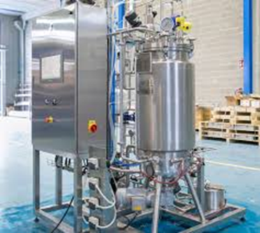
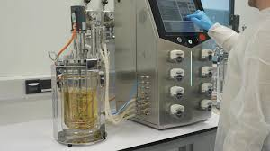
Enzymes used in food industry have
mainly microbial origin.
Advantages of microorganisms
as a source for enzyme production:
Easy and fast grow.
Take small space to cultivate.
Relatively cheep culture compounds.
Their use as an enzyme source is
not affected by seasonal changes
and climatic conditions and is, thus, more consistent.
Possibility for tight control of culture conditions.
Their use as sources of enzymes is not affected by various political and agricultural policies or decisions that regulate the slaughter of animals or felling of trees or plants.

Slide 5
Even though all classes of enzymes are expected to occur
in all or most microorganisms, in practice, the great majority
of industrial microbial enzymes are derived from only a very
few GRAS (generally recognized as safe) species.
The predominant microorganisms used for industrial production of enzymes for food purposes are:
Aspergillus species,
Bacillus species,
Kluyveromyces species.
Limited use is due to: co-production of harmful toxins.
There is a need for stringent evaluation for safety at high cost before they can be put to use for food production.

Slide 6
Selected examples for food enzymes and their application.

Slide 7
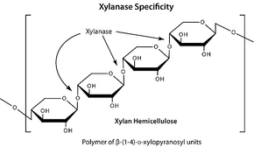
Use of enzymes in baked goods manufacturing
Baked goods are prepared from flours such as wheat flour, which
has starch as its main constituent.
Amylolytic enzymes break down flour starch into small dextrin pieces that become better substrates for yeast to act upon in the bread-making process.
Xylanase – preferred are those that act on the non-water soluble arabinoxylan fraction. It interferes with the formation of gluten network. Removal of not-extractable with water arabinoxylan fraction results in increase of high molecular weight solubilized in water arabinoxylans that in turns increase viscosity and dough stability; provide better crumb texture and increased loaf volume.

Slide 8
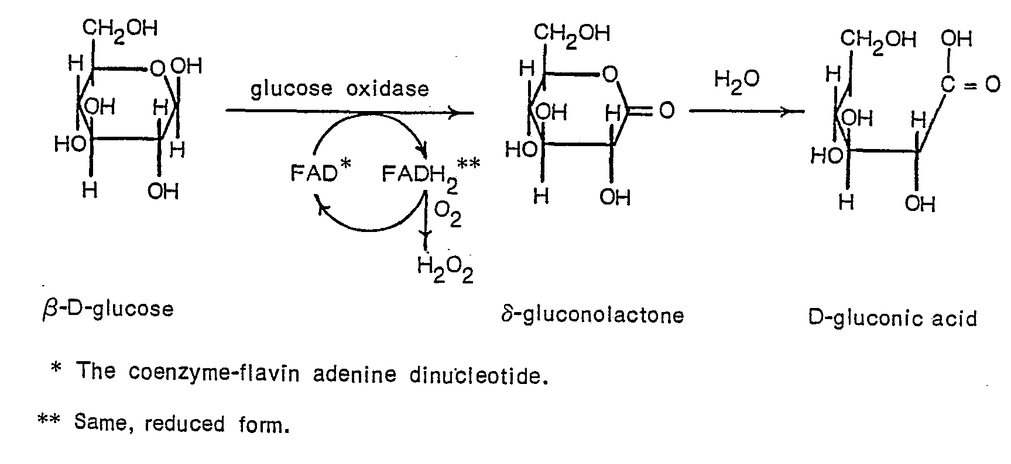
Broader application of enzymes in the baking industry is replacement of chemicals that are conventionally used in bread making.
For example, an enzyme like glucose oxidase (GOX) is used in baked goods to strengthen dough texture and enhance elasticity in place of chemicals such as potassium bromate (flour improver - E number E924).
Potassium bromate - 2B carcinogen (possibly carcinogenic to humans). Banned for use in EU; Allowed for use in the USA.

Slide 9
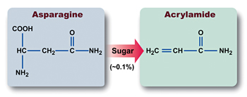
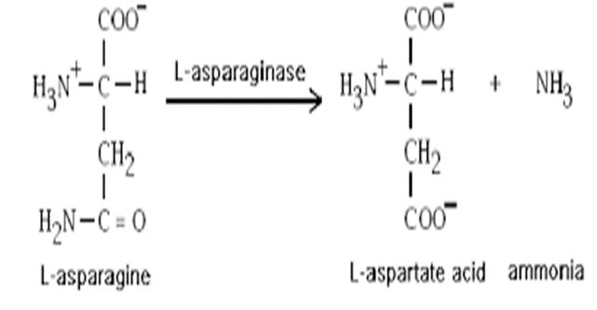
Proteases:
To break down protein molecules in the dough and improve dough
handling;
Enhance flavor development;
May be used to degrade gluten and protect individuals that are gluten intolerant.
Asparaginase breaks down asparagine in the flours to reduce its availability for reaction with reducing sugars to form acrylamide at high temperature.

Slide 10
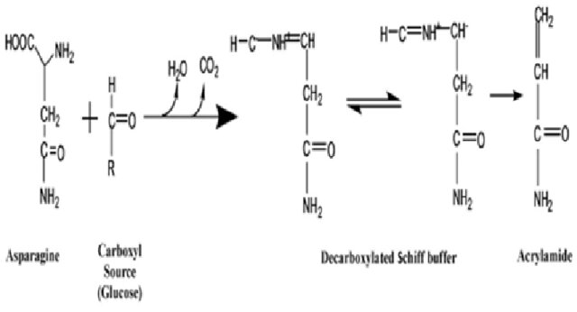
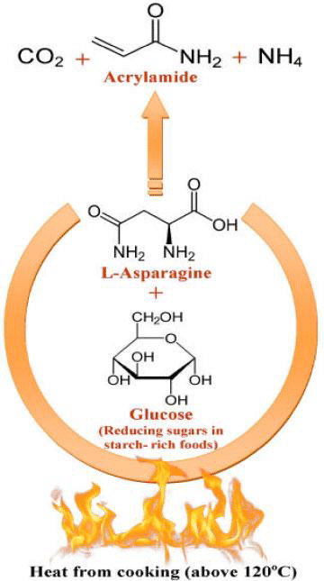
Mandeep Kataria

Slide 11
Horváthová et al. Biologia, Bratislava, 55/6: 605|615, 2000
Enzymes in starch modification
Biologia, Bratislava, 55/6: 605|615, 2000
Fig. 1. Action of starch-degrading enzymes. () Reducing -D-glucose residue; () non reducing -D-glucose residue. Arrows indicate the -1,6-branching points in the starch molecule.

Slide 12
Major steps of starch conversion

Slide 13
Enzymes in starch modification: Liquefaction
α-amylase: an endo-amylase which hydrolyses the α- 1,4-linkages in starch (amylose and amylopectin) almost at random. The breakdown products formed are mainly soluble dextrin and oligosaccharides. In a concentrated solution of starch, the hydrolysis results in a rapid viscosity reduction. In consequence the bacterial thermophilic α-amylase is often referred to as a 'liquefying amylase'. The process is called liquefaction.
Starch liquefaction results in formation of maltodextrin (Dextrose equivalent (DE) = 15-25 means partial hydrolysis.
Enzymes in food technology. 2002. Whitehurst R.J., Law B.A. (Eds.), Sheffield Academic Press Ltd., Sheffield, UK

Slide 14
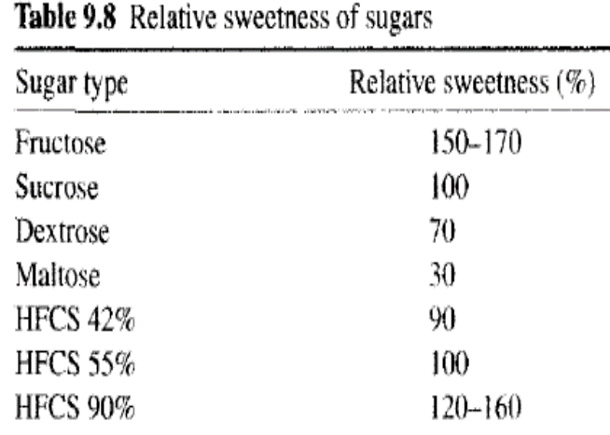
Saccharification of liquefied starch
Further degradation of maltodextrins is known as saccharification. Depending on the degree of hydrolysis and enzymes used numerous varietes of sweeteners can be produced which differ by their carbohydrate composition and rheological properties.
Dextrose equivalent (DE) = degree of hydrolysis. Expresses the reducing power (as glucose) as a percentage of pure dextrose, calculated to a dry weight basis.

Slide 15
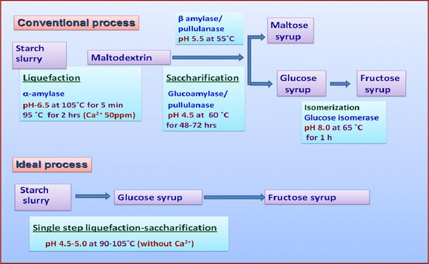
Nisha, M., Satyanarayana, T. Characteristics, protein engineering and applications of microbial thermostable pullulanases and pullulan hydrolases. Appl Microbiol Biotechnol 100, 5661–5679 (2016). https://doi.org/10.1007/s00253-016-7572-

Slide 16
Saccharification enzymes
Production of maltose syrup:
β-amylase is an exo-enzyme that degrades every second α-1,4 glycosidic bond starting from the non-reducing end of the maltodextrin which results in maltose production.
β-amylase is used for the production of maltose syrups.

Slide 17
Properties of maltose syrups:
Low glucose content and a high maltose content.
Because of the low glucose content, high maltose syrups show a low tendency to crystallize.
They are relatively non-hygroscopic.

Slide 18
Production of glucose syrup:
Glucoamylase hydrolyses every first α-1,4 glycosidic bond starting from the non-reducing end of the maltodextrin which results in glucose (as β-glucose) production.
Eventually, an almost complete conversion of starch into glucose can be obtained.
α-glucosidase can also be used but liberates α-glucose.

Slide 19
Glucose syrups (95-97% glucose) may be produced from most starch raw materials (corn, wheat, potatoes, tapioca, barley and rice).

Slide 20
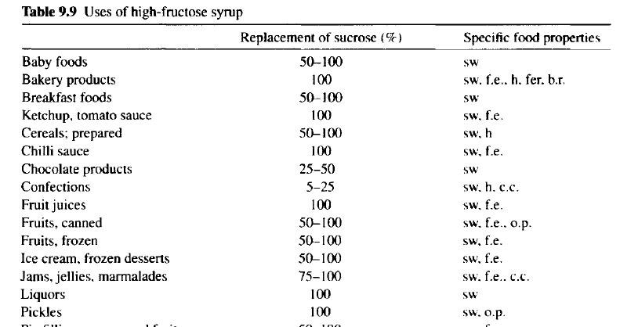
Fructose syrup
High-fructose corn syrup (HFCS): contain 42% or 90% fructose based on dry substance.
A sweetener alternative to white sugar (sucrose) produced from sugar cane or beets.

Slide 21
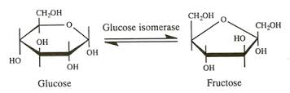
Produced by the use of the enzyme glucose isomerase.
Glucose can reversibly be isomerized to fructose. The equilibrium conversion for glucose to fructose is 50% under industrial conditions.
The isomerization reaction can only be economically efficient by using immobilized enzyme.

Slide 22
This is done by using an immobilized isomerase in a fixed-bed reactor process in a column through which glucose flows continuously.
The enzyme granules must be rigid enough to prevent compaction during the operation.
Sweetzyme IT (Novozymes A/S) is produced by a mutant of a selected Streptomyces murinus strain. The immobilization procedure consists of a disruption of a cell concentrate through with a homogenizer. The cells are then cross-linked with glutaraldehyde. The concentrated aggregate is extruded and finally fluid-bed dried and sieved.
Depending on parameters such as temperature, pH, feed purity, and so on, the operating lifetime of this isomerase will typically be 200–360 days.

Slide 23
De-branching enzymes
Isoamylase and pullulanase hydrolyse alpha-1,6-glycosidic bonds of starch, which has been partly hydrolyzed by alpha-amylase.
Generates linear amylose fragments as substrates for
saccharification enzymes.
Increase of product yield.

Slide 24
Saccharification products and their application

Slide 25
Use of enzymes in dairy products manufacturing
Proteases: To act on milk proteins to modify texture and solubility properties of milk and other dairy products; accelerate cheese ripening and improve flavor intensity.
Rennet is the stomach extract that contains the enzyme chymosin in a stabilized form that is usable for cheese making. It is a coagulant which degrade kapa-casein to produce cheese curds.
For the manufacture of traditional rennet, calves, lambs, or kids that are no more than about 2-weeks-old and fed only milk are used.

Slide 26
Genetic technology has been used for the commercial production
of a 100% pure chymosin product from microbes. This type
of chymosin is often called fermentation-produced chymosin.
The microbes used for the production of this type of rennet include nonpathogenic microorganisms
Escherichia coli K-12,
Kluyveromyces marxianus var. lactis
Aspergillus niger var. awamori.
Pro-chymosin genes obtained from young calves are transferred
through DNA plasmid intervention into microbial cells. Fermentation
follows to produce pro-chymosin, cell destruction, activation
of the prochymosin to chymosin (by cleavage of 42 amino acids), and harvesting/producing large yields of pure, 100% chymosin.

Slide 27
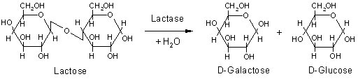
Lactase
Lactose is present in milk (about 4.7% (w/v)) and remains in the whey (supernatant) left after the coagulation stage of cheese-making. Lactose has low solubility resulting in crystal formation at concentrations above 11 %.
If lactase is added to milk or liquid whey (2000 U kg⁻¹) and left for about a day, about 50% of the lactose is hydrolyzed, giving a sweeter product which will not crystallise if condensed or frozen. Therefore, it can be used in the production of ice cream and sweetened flavored and condensed milks to prevent “sandy” taste.
Hydrolyzed lactose is 4 times sweeter than non-hydrolyzed lactose.
It also improves the 'scoopability' and creaminess of the product.

Slide 28
Use of lactase protect individuals that are lactose intolerant.
Of the Thai, Chinese and Black American populations, 97%, 90% and 73% respectively, are reported to be lactose intolerant.
Some individuals suffer from inborn metabolic lactose intolerance (lactase deficiency).
Severe tissue dehydration, diarrhea and even death may result from feeding lactose containing milk to lactose-intolerant children and adults.

Slide 29
Use of enzymes in meat and seafood products manufacturing
Proteases- heat-stable forms preferred, e.g., papain, ficin, and bromelain (mixture of enzymes found in pineapples)
To modify texture and induce tenderness in meats and squid,
To improve chewability and digestibility,
To reduce bitterness and improve flavor as well as nutritive value,
Produce hydrolysates from meat scraps, underutilized fish species, and fish processing discards;
Enhanced flavors in fermented herring (fish).

Slide 30
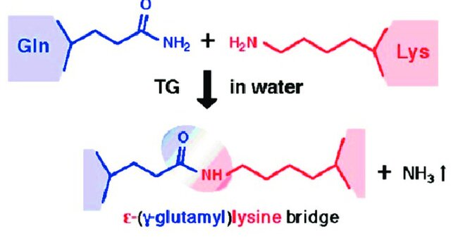
Transglutaminase: Function
El-Sayed El-Tanboly, 2021
Catalyze the formation of an isopeptide bond between γ-carboxamide groups of glutamine residue side chains and the ε-amino groups of lysine residue side chains with subsequent release of ammonia
Covalent cross-links between proteins as well as peptides and various primary amines.

Slide 31
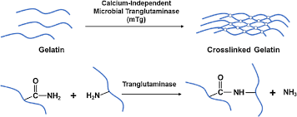
Crosslinking of polypeptides by transglutaminase

Slide 32
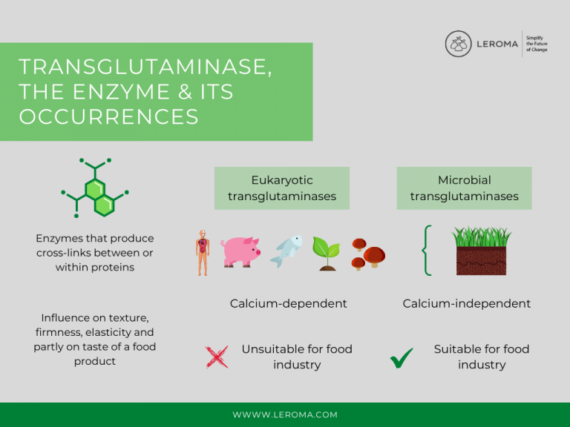

Slide 33
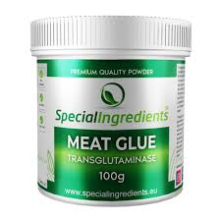
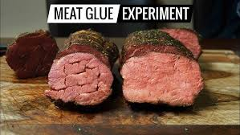
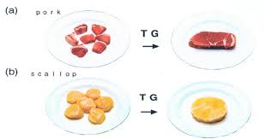
Transglutaminase:
To improve texture in meats and seafood products,
Form restructured meats from trimmings and surimi-type products,

Slide 34
Use of enzymes in fruit, vegetable and cereal processing
Pectolytic enzymes (pectinase): a collective name for several enzymes that degrade pectin;
Cellulolytic complex;
Hemicellulases.

Slide 35
Enzymatic mash treatment: why are exogenous enzymes needed?
Cell walls contain high-molecular weight compounds.
Protopectin is insoluble and inhibit the extraction of the juice
from the fruit and keep solid particles suspended in the juice.
In addition, polymers of xylose, galactose, and arabinose (hemicelluloses) form a link with cellulose. The entire system forms a gel that retains the juice in the mash.
The goal:
Enzymatic mash treatment (for example, in juice production) is performed to: improve the pressabiliy of the mash and, respectively juice yield.

Slide 36
Cellulases and hemicellulases
The use of cellulases and hemicellulases in fruit processing is not allowed in the EU.
They are, however, allowed without any legal restrictions for vegetable processing.

Slide 37
Enzymatic modification of food proteins:
Production of protein hydrolysates
Purpose: The hydrolysis of proteins with enzymes is an attractive way of modifying
functional properties – better solubility, foaming, and emulsifying capabilities
and nutritional properties – improved digestibility, decreased allergenicity
of food proteins of vegetable origin or by-products.
Whitehurst, R. J., & Van Oort, M. (Eds.). (2010). Enzymes in food technology (Vol. 388). Singapore: Wiley-Blackwell.

Slide 38
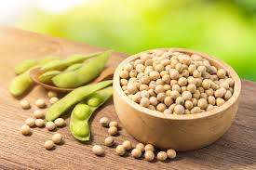
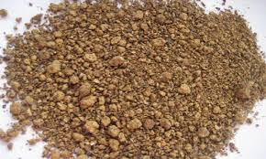
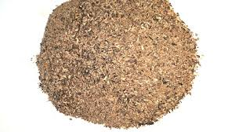
Production of protein hydrolyzates.
Raw materials:
Plant proteins (soybean)
By-products of animal (fish, meat) or plant origin (meals of oil producing industry)
Sunflower meal
Rapeseed meal

Slide 39
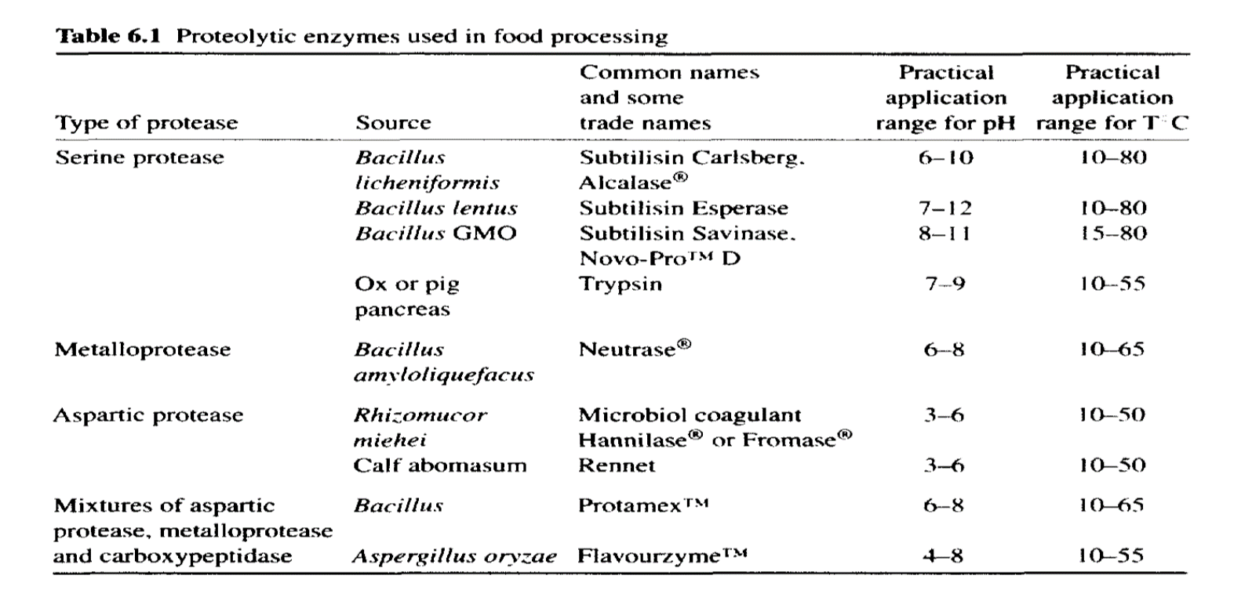
Enzymes used: proteases

Slide 40
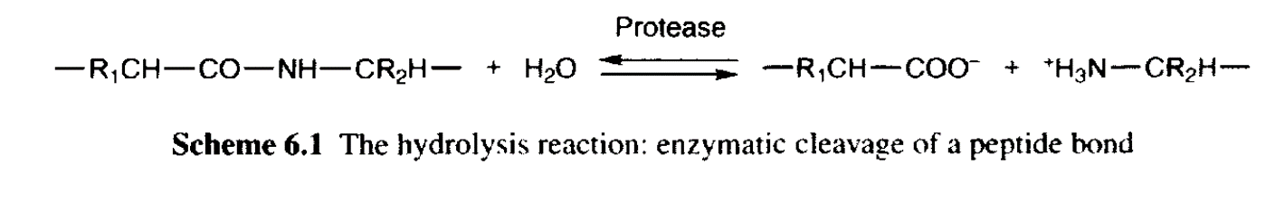
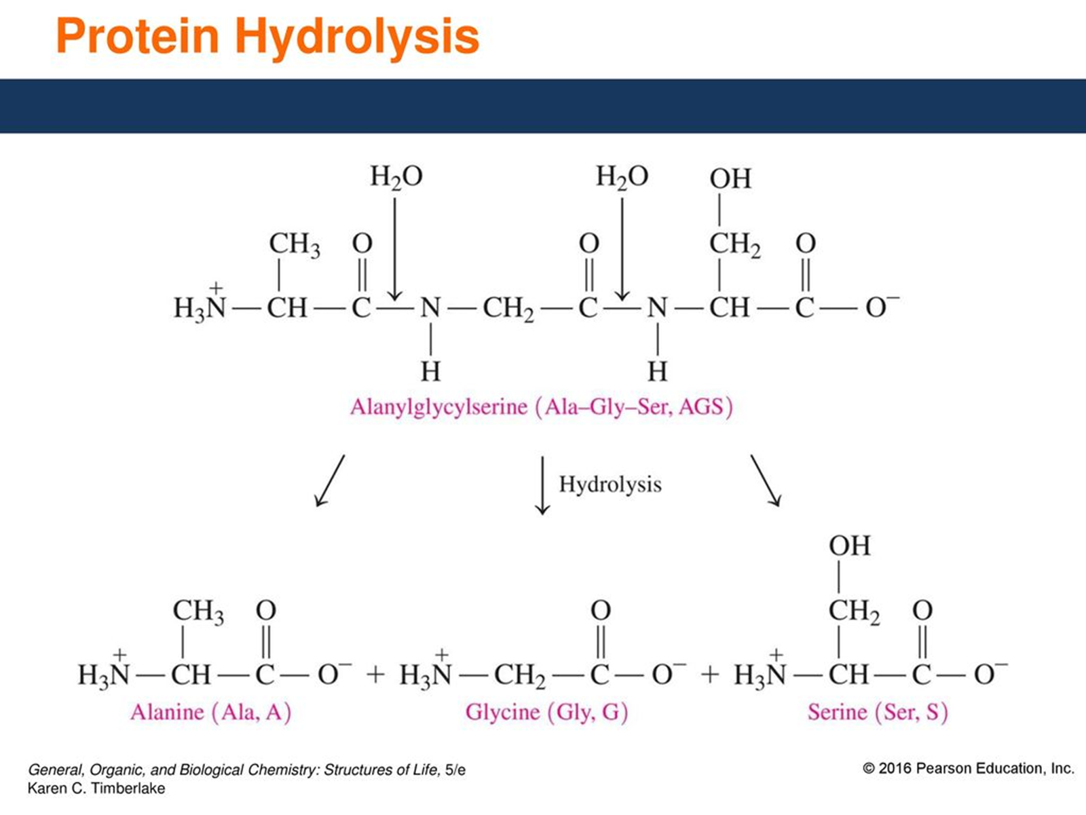

Slide 41
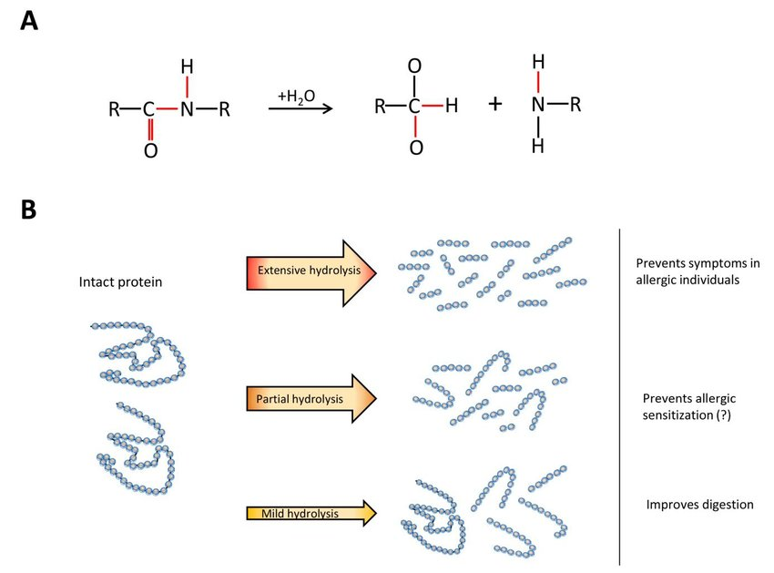
DH – Degree of hydrolyses
h- amount of α- amino group nitrogen
h_{tot} – amount of total nitrogen

Slide 42
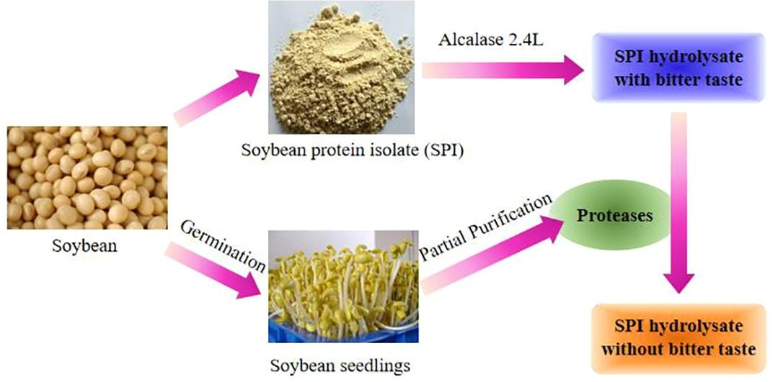
Example: preparation of soybean protein hydrolysate

Slide 43
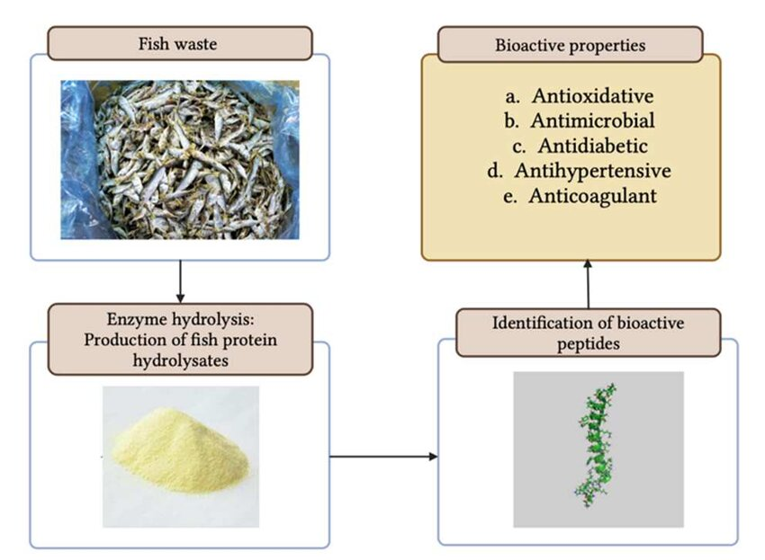
Example: preparation of fish waste protein hydrolysate

Slide 44




Thank you!!!

