Slide 1
Lecture 8.
Biochemical alteration of food during postharvest and storage.

Slide 2
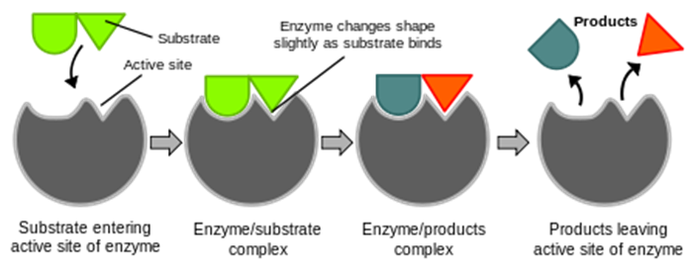
Proteins as enzymes
Enzymes are proteins with powerful catalytic function.
Initially, the enzyme binds to the substrate (the reactant undergoing chemical change) to form an enzyme-substrate complex. In this complex, the substrate is converted to a more reactive state and undergoes chemical transformation to a product of the reaction. The enzyme is released and can bind to a new substrate molecule.

Slide 3
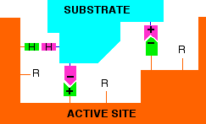
Interaction between the substrate and the active site of an enzyme. Functional groups such as –COOH, -OH, NH₂ , and –SH being a part of the amino acids side radicals might take a part in the formation of the active center of the enzyme.

Slide 4
Major characteristics of the enzymes. Advantages
Enzymes have a number of distinct advantages over conventional chemical catalysts:
High productivity and catalytic efficiency; Active in low concentrations;
They are more environmentally friendly and produce less residuals (or processing waste that must be disposed of at high costs) compared to traditional chemical catalysts.

Slide 5
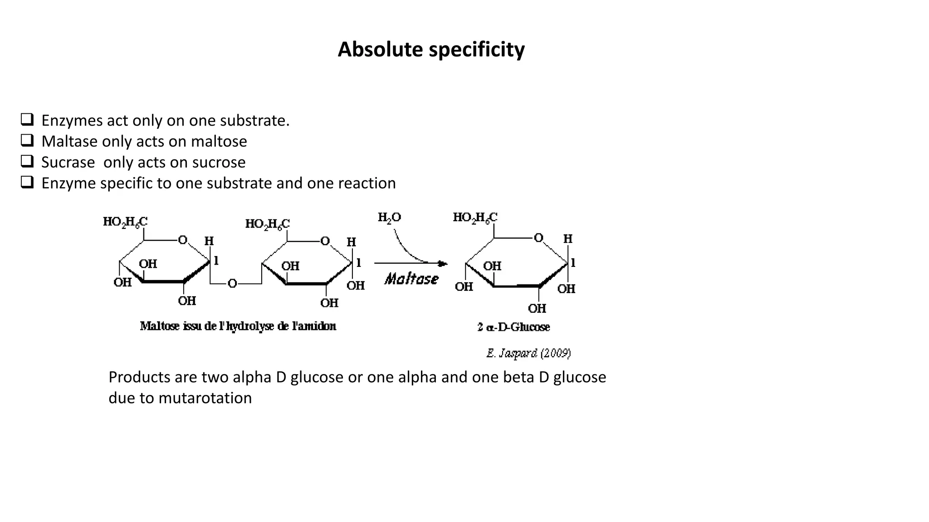
High specificity – able to discriminate between structurally similar molecules, for example-optical isomers (stereospecificity). Their action on food components other than their substrates are negligible, thus resulting in the formation of purer products with more consistent properties;

Slide 6
Advantages, Cont.
Work under mild conditions of temperature, pressure and pH. It helps to preserve the integrity of heat-labile essential nutrients.
Control of enzyme activity and reaction rate.
Most of them are quite heat labile and therefore can be readily inactivated by mild heat treatments after they have been used to achieve the desired transformation in foods;
They are natural and relatively innocuous components of agricultural materials that are considered “safe” for food and other nonfood uses;
Some disadvantages: High cost, Low stability.

Slide 7
Undesirable effects:
Enzymes like proteases, lipases, and carbohydrases break down biological molecules (proteins, fats, and carbohydrates, respectively) which, if not controlled, may adversely impact flavor, texture, overall product quality.
Decarboxylases and deaminases degrade biomolecules (e.g., free amino acids, peptides, and proteins) to form undesirable and/or toxic components, e.g., biogenic amines in foods.
Polyphenol oxidases (PPO) and lipoxygenases (LOX) promote oxidations and undesirable discolorations and/or color loss in fresh vegetables and fruits.
Ascorbic acid oxidase causes destruction of essential components (vit. C) in foods.

Slide 8
1. Indigenous Enzymes in Milk
General overview:
About 60 indigenous enzymes have been reported in normal bovine milk.
Physiological role of most of them unknown.
The indigenous enzymes are constituents of the milk as excreted.
Some of them are inactive due to lack of substrate or unsuitable environmental conditions such as pH.
Handbook of Food Enzymology. 2003. Whitaker J.R., Voragen A.G.J. , Wong D.W.S. (Eds.)

Slide 9
Why are indigenous milk enzymes technologically significant?
Deterioration (proteinase, lipase, acid phosphatase and xanthine oxidase) or preservation (lactoperoxidase, sulfhydryl oxidase, superoxide dismutase) of milk quality.
2. As indicators of the thermal treatment of milk; these include alkaline phosphatase, γ-glutamyl transpeptidase, lactoperoxidase, and perhaps others.
3. As indicators of mastitic infection; the concentration of several enzymes increases on mastitic infection, especially catalase, and acid phosphatase.
4. Antimicrobial activity, such as lysozyme and lactoperoxidase.
5. As commercial source of enzymes; these include ribonuclease and lactoperoxidase.

Slide 10
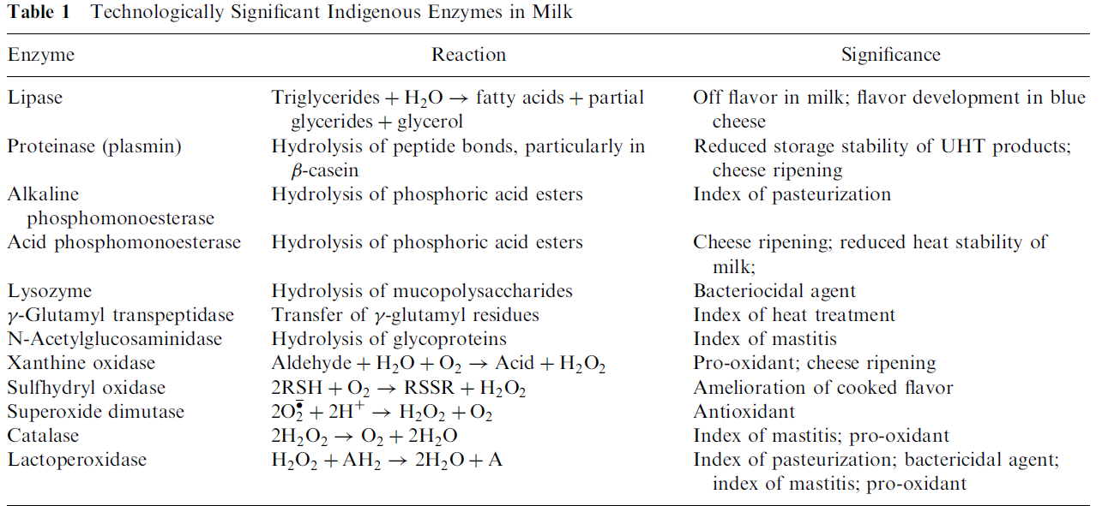
Handbook of Food Enzymology. 2003. Whitaker J.R., Voragen A.G.J. , Wong D.W.S. (Eds.)

Slide 11
With a few exceptions (e.g., lysozyme and lactoperoxidase), the indigenous milk enzymes do not have a beneficial effect on the nutritional or organoleptic attributes of milk, and hence their destruction by heat is one of the objectives of many dairy processes.

Slide 12
MILK DETERIORATION
1. PROTEASES
Plasmin (alkaline milk protease)

Slide 13
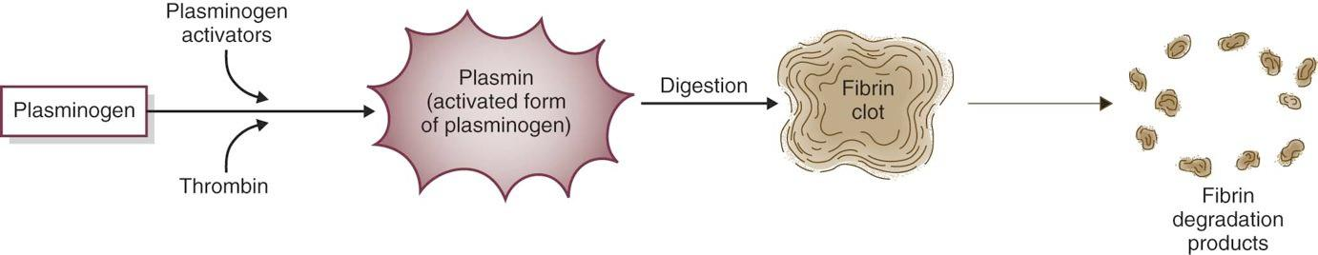
Plasmin (alkaline milk proteinase)
The physiological function of plasmin is to dissolve blood clots.
Plasmin is secreted as plasminogen which is the inactive plasmin precursor .
In milk, there is about four times as much plasminogen as plasmin.

Slide 14
Plasmin activity
Plasmin is a serine proteinase with a high specificity for peptide bonds to which lysine or arginine supplies the carboxyl group.
β-casein is the most susceptible milk protein to plasmin action.
α-casein in solution is also hydrolyzed very rapidly by plasmin.

Slide 15
κ-casein contains several Lys and Arg residues but it is quite resistant to plasmin, probably due to its secondary and tertiary structures.
Whey proteins are quite resistant to plasmin, probably due to their compact, globular structures.
In fact, β-lactoglobulin, especially when denatured, inhibits plasmin, presumably via sulfhydryl-disulfide interactions which rupture the structurally important elements.

Slide 16
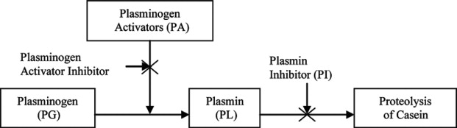
SIGNIFICANCE OF PLASMIN ACTIVITY IN MILK

Slide 17
Plasmin is thermostable.
Plasmin and plasminogen accompany the casein micelles on the chymosin coagulation of milk in cheese making.
Plasmin remains active even after milk cooking at high temperature.
Plasmin hydrolyzes of the caseins results in large polypeptides. This proteolysis alters three-dimensional protein network of the cheese to form a less firm and less elastic cheese.

Slide 18
SIGNIFICANCE OF PLASMIN ACTIVITY IN MILK Cont.
Plasmin is considered responsible for some undesirable changes in the rheological properties (flavor, texture) of cheese. The large polypeptides do not have a direct impact on flavor but do function as a substrate for the proteases associated with the starter and nonstarter bacteria. However, if the primary proteolysis is extensive, bitter peptides, with a high percentage of hydrophobic amino acids predominate.
Plasmin activity may contribute to the age gelation of ultra-high-temperature processed milk produced from high-quality raw milk (no bacterial activity involved).
Reduced yields of cheese and casein since resulted peptons from plasmin proteolytic activity are soluble at pH 4.6 and are not incorporated into acid- or chymosin-produced casein curd.

Slide 19
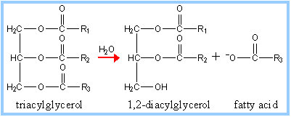
Lipase
Milk lipase is lipoprotein. It catalyzes the breakdown of lipids. The process is called lipolysis.
Lipase action produces free fatty acids but also diacylglycerol and monoacylglycerol.

Slide 20
Importance for dairy industry
Free fatty acids, especially short chain acids (i.e. butyric (C4), caproic (C6), caprylic (C8) have strong flavors and low flavor thresholds which lead to flavor defects – rancid (unpleasant smell or taste), astringent, „bitter‟.
But also may impart desirable flavors to some cheeses like parmesan.
Partial glycerides (and free fatty acids) are surface active - cause steam foaming problems in cappuccino coffee making.

Slide 21
Milk lipase
Originates from the blood.
Present in all raw milk.
Inactivated by pasteurization.
Therefore it causes no lipolysis in milk or dairy products after pasteurization.

Slide 22
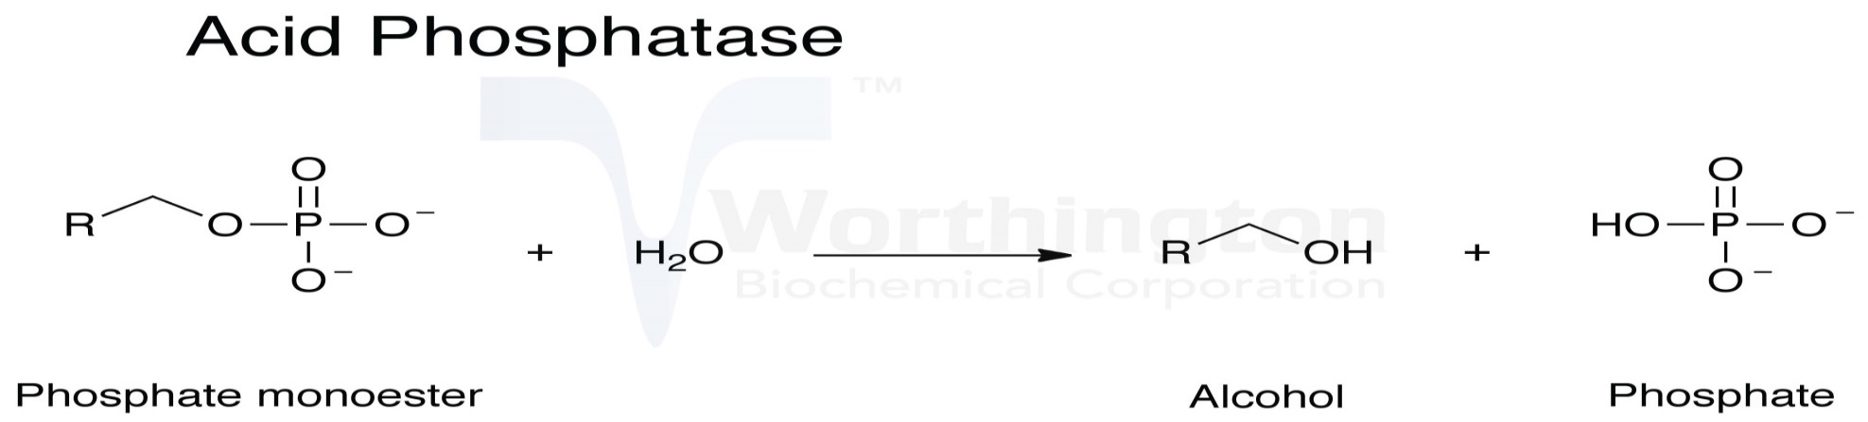
Acid phosphomonoesterase (phosphatase)
Acid phosphatase is found free in skim milk, in membrane material in skim milk and in the fat globule membrane.
Milk acid phosphatase has a pH optimum at 4.0.
Very heat stable. Low temperature, long time (LT) pasteurization (63°C, 30 min) causes only 10–20% inactivation. Full inactivation at 88°C, 30 min.
The level of acid phosphatase activity in milk is only 2% that of alkaline phosphatase.
It catalysis the hydrolysis of phosphoric acid esters.

Slide 23
Milk preservation
Lactoperoxidase (LPD)
Catalytic function: oxidation of inorganic and organic substrates by hydrogen peroxide as an oxidizing agent.
It is one of the most heat-stable enzymes in milk.
Its inactivation is used as an index of Super-High Temperature Short-Time pasteurization, e.g., temperatures > 76°C for 15 sec.

Slide 24
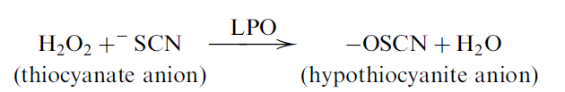
Bactericidal effect of Lactoperoxidase (LPD)
It is based on the peroxidation of ⁻SCN to products which are nontoxic to mammalian cells but which kill or inhibit the growth of many species of microorganisms.
⁻SCN occur naturally in milk , a product of the enzymatic hydrolysis of plant thio-glycosides.
Handbook of Food Enzymology. 2003. Whitaker J.R., Voragen A.G.J. , Wong D.W.S. (Eds.)

Slide 25
Microbial membranes are permeable for –OSCN.
⁻OSCN oxidizes sulfhydryl groups:
Any reaction involving a sulfhydryl group, e.g., thiol enzymes, will be inhibited by this oxidation.

Slide 26
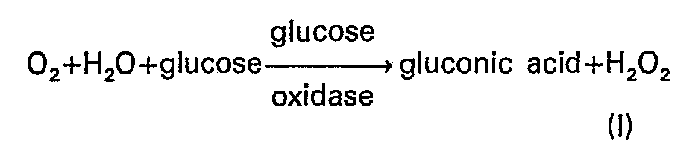
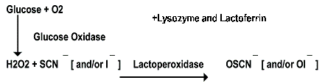
Milk does not contain indigenous H₂O₂ but can be generated metabolically by catalase-negative bacteria, or produced in situ through the action of exogenous glucose oxidase on glucose which may be added to milk.

Slide 27
2. Indigenous Enzymes in Meat

Slide 28
Proteolysis: Muscle Proteases
Proteases are characterized by their ability to degrade proteins (peptide bonds).
Endoproteases or proteinases,
when they are able to hydrolyze internal peptide bonds.
Exopeptidases, when they hydrolyze external peptide bonds, either at the amino termini or the carboxyl termini.

Slide 29
Some of the endogenous proteolytic enzymes cease their functions shortly after animal death.
Others remain active throughout the entire postmortem ageing process and contribute either to flavor (exopeptidases) or to tenderness
(endopeptidases) of meat.
Two well-studied enzyme systems that are implicated in meat tenderization are calpain and cathepsins.

Slide 30
Calpain
Calpain is a calcium-dependent protease located around the myofibrils.
Disrupt peripheral structure of the myofibrils but does not affect myosin and actin.
Cathepsins
A group of acidic proteases.
These proteases can degrade most of the same substrates affected by calpain.
In addition, they are active against collagen, myosin and actin (as shown in model systems).

Slide 31
3. Indigenous enzymes in fruit and vegetables.
Fresh Fruits/Vegetables are high value crops, with high consumer demand and high export potential.
Under postharvest and storage conditions fruit and vegetable quality may alter.
Enzymes are responsible for most of the reactions determining the quality of fresh fruit and vegetables.
Enzymes which are endogenous to plant tissues can exert undesirable or desirable consequences.

Slide 32
Major physiological processes that occur during handling and storage of fruit and vegetables
1. FRUIT RIPENING AND SOFTENING
Fruit ripening is a physiological event that results from a very complex and interrelated biochemical changes that occur in the fruits.
Food biochemistry and food processing. 2012. Simpson B.K. (Ed.) 2nd edition

Slide 33
Ethylene production
A key initiator of the ripening process is the gaseous plant hormone ethylene.
In general, all plant tissues produce a low, basal, level of ethylene.
Based on the pattern of ethylene production and responsiveness to externally added ethylene, fruits are generally categorized into climacteric and non-climacteric fruits.
During ripening, the climacteric fruits (apple, pear, banana, tomato, avocado, etc.) show a burst in ethylene production (30–500 ppm) and respiration (CO₂ production).
Non-climacteric fruits (orange, lemon, strawberry, pineapple, etc.) show a low level of ethylene production (0.1–0.5 ppm).

Slide 34
Ethylene biosynthesis.
A series of reactions.
The amino acid methionine used as a precursor.
Final step of ethylene production is catalyzed by an oxidase which requires an atmospheric oxygen.
Control of ethylene production: atmosphere with very low oxygen levels (1–3%) for long-term storage of fruits such as apples to reduce the production of ethylene.

Slide 35
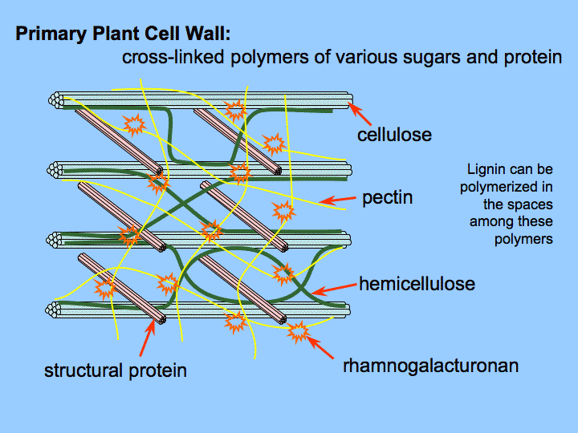
Cell Wall Degradation
Cell wall degradation is the major factor that causes softening of several fruits.
This involves the degradation of cellulose components, pectin components or both. Degradation of hemicelluloses (xyloglucans, glucomannans and galactoglucomannans) is also considered an important feature that leads to fruit softening.

Slide 36
Examples:
Both cellulase and pectinase activities have been observed to increase during ripening of avocado fruit (an example).
Polygalacturonase (pectin depolymerase) are major enzymes involved in softening of tomato (an example).

Slide 37
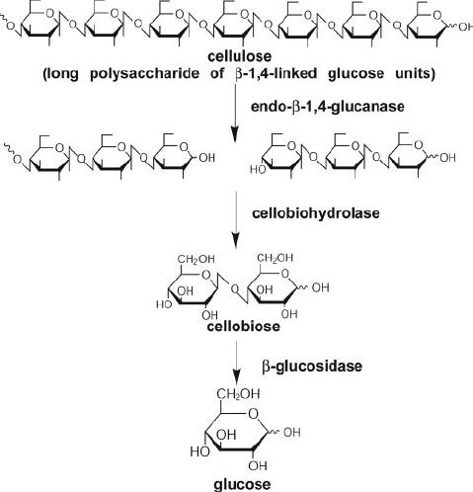
Cellulose is degraded by cellulolytic complex

Slide 38
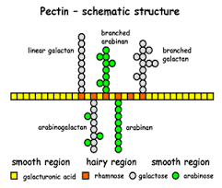
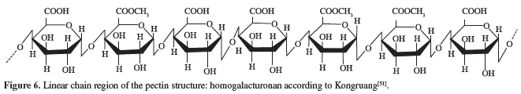
Pectins are complex branched heteropolysaccharides primarily containing an α-(1-4) polygalacturonic acid backbone which can be randomly acetylated and methylated.

Slide 39
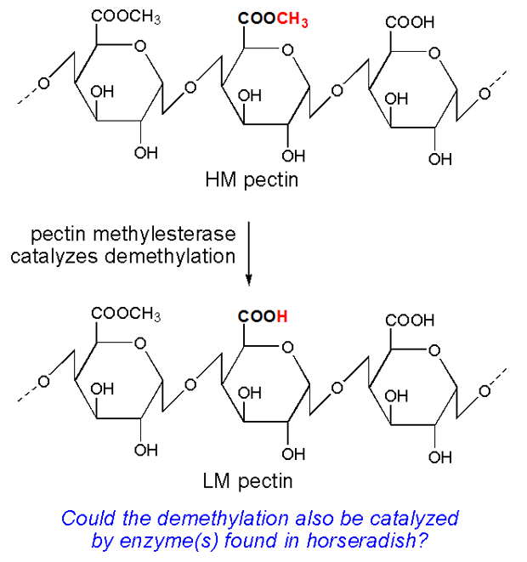
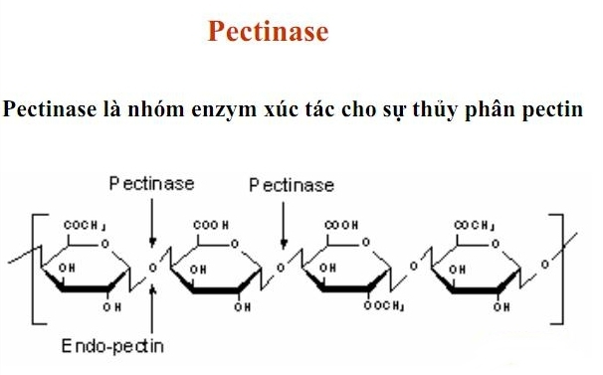
Partial pectin degradation involves the enzymes:
Pectin methylesterase
Pectinase

Slide 40
The degradation of cell wall can be reduced by the application of calcium as a spray.
Calcium binds and cross-links the free carboxylic groups of polygalacturonic acid components in pectin.
Calcium treatment, therefore, also enhances the firmness of the fruits.

Slide 41
Starch Degradation
Starch is the major storage form of carbohydrates.
During ripening, starch is catabolized into glucose and fructose, which enters the metabolic pool where they are used as respiratory substrates or further converted to other metabolites.
In fruits such as banana and mango the breakdown of starch into simple sugars is associated with fruit softening.

Slide 42
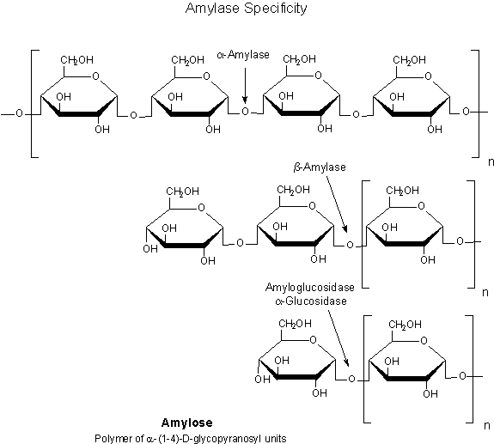
There are several enzymes involved in the catabolism of starch (amylolytic enzymes).
α-amylase hydrolyses amylose molecules by cleaving the α-1,4-linkages between sugars providing smaller chains of amylose termed dextrins.
β-amylase is another enzyme that acts upon the glucan chain
releasing maltose, which is a diglucoside.
The dextrins as well as maltose can be further catabolised to simple glucose units by the action of
gucoamylase.

Slide 43
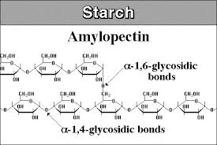
Degradation of amylopectin molecule is not only degraded in a similar manner to amylose but also involves the action of de-branching enzymes which cleaves the α-1,6-linkages in amylopectin and releases linear units of the glucan chain.

Slide 44
Proteolysis and Structure Breakdown in Chloroplasts
During senescence, the chloroplast structure is gradually disassembled with a decline in chlorophyll levels.
The degradation of chloroplasts and chlorophyll result in the unmasking of other colored pigments. Decrease in the intensity of green vegetables such as green bean, peas is not well accepted by customers.
Chlorophyll degradation is initiated by the enzyme chlorophyllase which splits chlorophyll into chlorophyllide and the phytol chain.

Slide 45
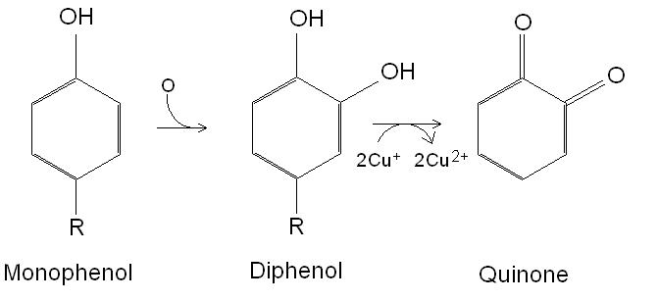
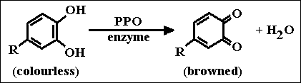
Polyphenol oxidase (PPO)
Polyphenol oxidase is responsible for oxidative browning, also called enzymatic browning. It is a bi-functional, copper-containing oxidase.
Two reactions catalyzed:
Hydroxylation of a monophenol to a diphenol.
Oxidation of a diphenol to a quinone.

Slide 46
PPO is normally compartmentalized in tissue such that oxygen is unavailable.
Injury or cutting of plant material, especially apples, bananas, pears and lettuce, results in decompartmentalization, making O2 available for the reaction.
The action of PPO can be desirable in various food products, such as raisins, prunes, dates, cider and tea.
Or undesired for salads, potatoes etc.

Slide 47
Control of enzymatic browning.
The most widespread anti-browning treatment used by the food
industry was the addition of sulfiting agents (sulfur dioxide, sodium sulfate, sodium and potassium bisulfites, and metabisulfites); however, due to safety concerns (e.g. allergenic-type reactions), other methods have been developed, including the use of other reducing agents (ascorbic acid and analogues, Cys, glutathione).
Chelating agents (phosphates, EDTA) – interact with Cu –ions of the active site of the enzyme.
Acidulants (citric acid, phosphoric acid) – pH < 4.5 sharply reduce the activity of PPO.
Enzyme inhibitors (sodium benzoate) – compete with the substrate for the active site of PPO.
Application of these PPO activity inhibitors is strictly regulated in different countries.

Slide 48
4. Indigenous Enzymes in Cereal Seeds
During dormancy the proteins, and other components, e.g., lipids and starch, in the cereal seeds are not mobilized from the protein bodies because:
presence of a low amount of water,
the cellular section separation
presence of different enzyme inhibitors.
During germination the enzymatic machinery starts to work and the protein composition of the seed changes.
Proteins in food processing. 2004. Yada R. Y. (Ed.)

Slide 49
The enzymes present in the cereal kernel are necessary for seed development, but also play a role in the processing or are responsible for reactions correlated with the quality of cereal products.
α- and β-amylases are present in all cereals. Associated with starch degradation.
Unfavorable harvest conditions favor sprouting; the amount of
α- amylase rises and the quality of the wheat decreases. Higher amounts of this enzyme determine an extensive starch degradation during baking that produces a sticky and poor development of the baked goods.
Both α- and β-amylases are heat labile.

Slide 50
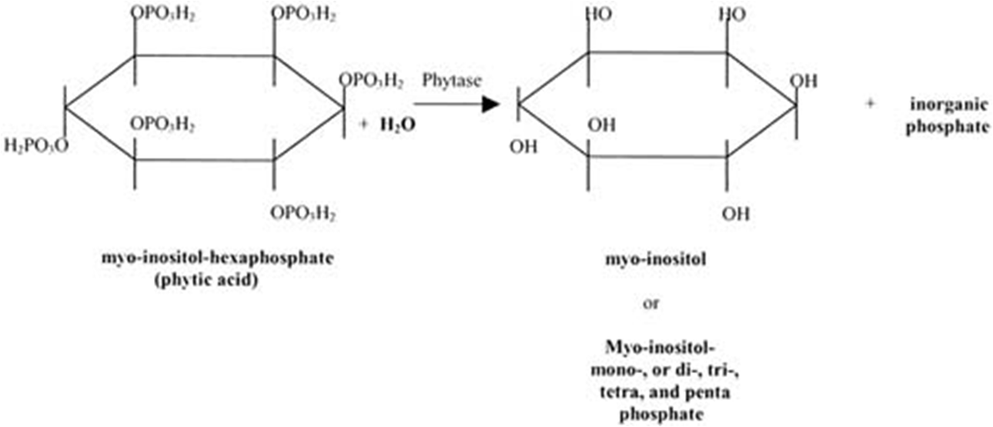
Phytase
About 70% of phosphorus in wheat is bound to phytate (Ca/Mg salts of phytic acid).
This reaction is nutritionally desirable since phytate inhibits the intestinal absorption of iron and calcium ions.

Slide 51
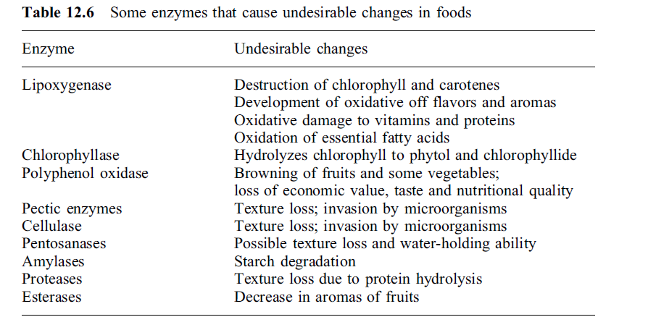
Summary
Proteins in food processing. 2004. Yada R. Y. (Ed.)

Slide 52


