Slide 1
Lecture 5.
Food proteins. Nutritive function of proteins.
Quality evaluation.

Slide 2
Food proteins: General overview.
Proteins: a major food macro-component.
Food is the major source providing proteins to human body:
food with animal origin
food with vegetable origin

Slide 3
Why do we need proteins?
Food proteins
Digestion
Amino acid mixture
New proteins
Glycogen
Lipids
(re-synthesis)
Biologically
Active
Compounds
Hormones: insulin,
serotonin and melatonin
(tryptophan derived)
Energy
(May provide up to 10-15% of body’s energy need. )

Slide 4
The amount of protein needed depends on:
Individual physiological features:
Sex
Age
Physical activity
Health status
Protein quality:
Amino acid composition/ratio
Protein digestibility

Slide 5
Protein quality: Amino acid composition
20 common amino acids composing proteins.
Non-essential amino acids (NE): body can synthesize them.
Essential amino acids (E): body can not synthesize them. Must be supplied by diet.
      Valine Methionine
      Phenylalanine Lysine
      Threonine Leucine
      Tryptophan Isoleucine
The quality of a dietary protein is a measure of its ability to provide the essential amino acids to cells in adequate amounts.

Slide 6
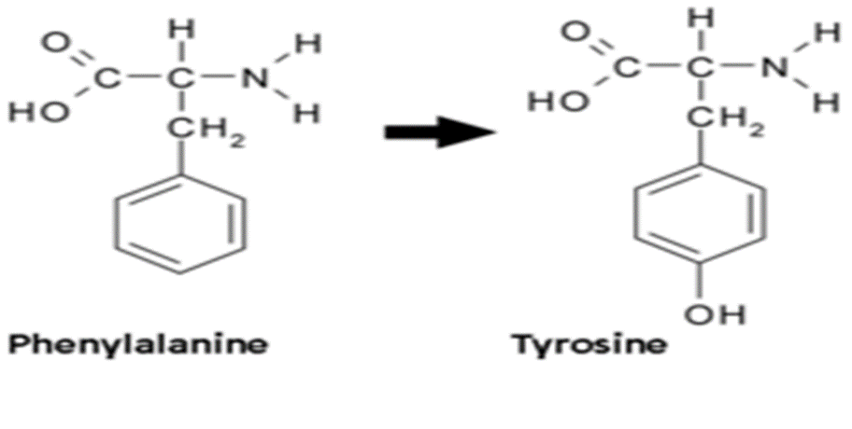
Conditionally essential amino acids: nonessential amino acids that become essential under certain conditions. For example Tyr (NE) is synthesized by Phe (E). If diet is low in Phe then Tyr becomes conditionally essential.

Slide 7
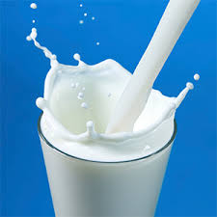
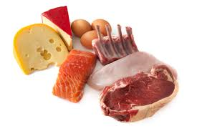
Complete proteins: contain an adequate proportion of all the essential amino acids that should be incorporated into a diet.
Proteins from animal sources (meat, poultry, milk, and fish) have a high quality because they contain all the essential amino acids in proportions similar to those required for synthesis of human tissue proteins
[Note: Gelatin prepared from animal collagen is an exception; it has a low biological value as a result of deficiencies in several essential amino acids.]

Slide 8
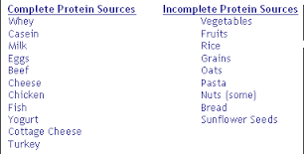
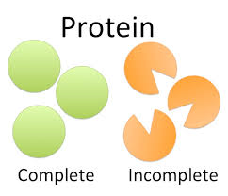
Incomplete proteins: lack one or more essential amino acids or contain them in inadequate proportions necessary for human metabolism.
Proteins from plant sources (wheat, corn, rice, and beans) have a lower quality (except soy protein) than do animal proteins. They are considered incomplete.

Slide 9
Complementary proteins
Incomplete proteins from different plant sources may be combined in such a way that the result is equivalent in nutritional value to animal protein.
Ile, Leu Lys Met Trp
Legumes x x
Cereals x x
Combined

Slide 10
Methods for evaluation of protein quality
Chemical methods
Amino Acid Scoring (AAS)
Amino acid scoring provides a way to predict how efficiently protein will meet a person’s amino acid needs.
This concept assumes that tissue protein synthesis is limited unless all required amino acids are available at the same time and in appropriate amounts at the site of tissue protein synthesis.

Slide 11
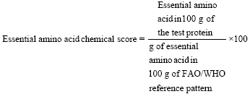
Amino acid score calculation
Ration of the amount of each essential amino acid (g/100g protein) in a test protein and the amount of the respective essential amino acid (g/100g protein) in an “ideal protein” as defined by FAO/WHO.
Proposed “ideal protein” :
Whole egg protein
Milk protein
For example, if the lysine content of a whole-wheat flour protein is 2.6% and the value for lysine in an “ideal protein” is 5.1%, AAS is calculated as 2.6/5.1x100=51.
The essential amino acid with the lowest AAS for certain protein is called limiting amino acid.

Slide 13
Drawbacks
AAS is determined after acid hydrolyses of proteins which results in total amino acid content.
Some of the amino acids in the total pool are not bioavailable.
The degree of error varies depending on food:
  highly processed food has impaired digestibility
  proteins with plant origin have lower digestibility

Slide 14
Protein digestibility-corrected amino acid score (PDCAAS)
Amino acid scoring does not take protein digestibility into account. It is useful for comparing animal products and refined foods that are not excessively heated.
Plant foods are not completely digested, it is necessary to make a correction to the calculation of AAS.
PDCAAS = Protein digestibility x Amino acid score
J. Nutr. 2000, vol. 130 no. 7 1865S-1867S

Slide 15
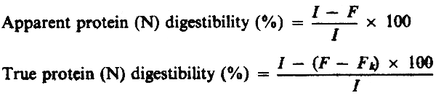
Protein digestibility
A measure of efficient utilization of a protein
Calculations:
where | I = nitrogen intake
 | F = fecal nitrogen output on the test diet
 | F_{k} = fecal nitrogen output on a non-protein diet.

Slide 16
Factors affecting protein digestibility
Indigenous anti-nutritional factors:
Glucosinolates (mustard and rapeseed)
Trypsin inhibitors and hemagglutinins (legumes)
Tannins (legumes and cereals)
Phytates (cereals and oilseeds)
Gossypol (cottonseed protein products.)
Effects of antinutritional factors on protein digestibility and amino acid availability in foods J AOAC Int. 2005 May-Jun;88(3):967-87.

Slide 17
Anti-nutritional factors formed during heat/alkaline processing of protein containing food.
Oxidized forms of sulfur amino acids,
D-amino acids,
Lysinoalanine (LAL – cross-linkage between polypeptides).
Maillard compounds,

Slide 18
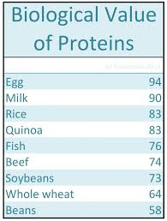
Biological methods: Animal assays
Biological Value (BV)
Biological Value (BV) is a measure of the proportion of the absorbed protein from food which becomes incorporated into the proteins of the organism's body.
B.V. = (N retained/N-absorbed) x 100
Egg and human milk have BV = 90-100; Meat and fish have BV = 75–80;
Wheat protein - 50;

Slide 19

Apparent Net Protein Utilization (NPU)
Defined as the percentage of ingested protein which is deposited as tissue protein
Pb - the total body protein at the end of the feeding trial,
Pa - the total body protein at the beginning of the feeding trial,
Pi - the amount of protein consumed over the feeding trial.
In this calculation no allowance is made for endogenous protein losses.
Representative sample of animals should be sacrificed at the beginning and end of the feeding trial for carcass protein analysis.

Slide 20
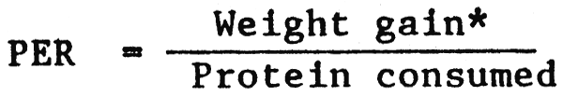
Protein Efficiency Ratio (PER)
Protein Efficiency Ratio (PER) is the gain in weight of growing animals per gram of protein eaten.
With this method no allowance is made for maintenance: ie. method assumes that all protein is used for growth

Slide 21
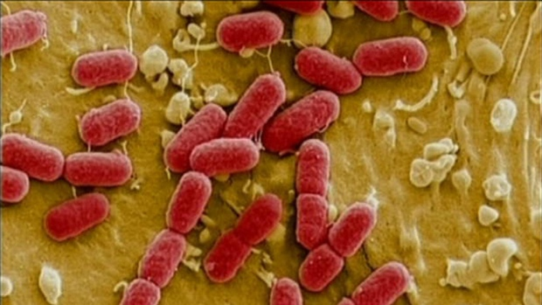
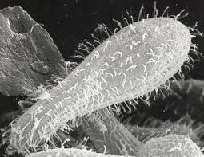
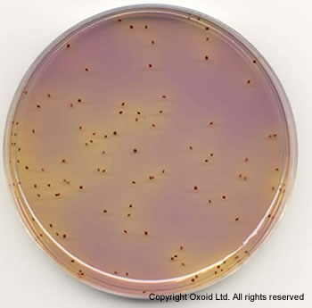
Biological methods: Microbial assays
For determination of:
Total amino acids (after chemical hydrolysis)
Bioavailable amino acids
Microorganisms used:
Escherichia coli
Tetrahymena pyriformis
Streptococcus zymogenes

Slide 22
Streptococcus zymogenes:
It does not require lysine and therefore, this amino acid (neither total nor bioavailable) can not be determined.
Can hydrolyze protein with own enzymes but slowly. Protein could be pre-treated with enzymes.
Tetrahymena pyriformis
It requires all essential amino acids for growth
Own extracellular enzymes to hydrolyze proteins
Assay takes 2-3 days
Escherichia coli
Auxotrophs for specific amino acids are used
Use own extracellular enzymes to digest food ingredients
Assay can be completed in 6 to 8 hours

Slide 23
Advantages of microbial assays
Compared to animal assays:
Simple
Fast
Cheaper
Do not require elaborate equipment
Do not require vast working space
Overall cost effective

Slide 24


