Slide 1
ART
INTRODUCTION

Slide 2
CAN WE DEFINE ART?
Something that is created with imagination and skill and that is beautiful or that expresses important ideas or feelings
https://www.britannica.com/dictionary/art
Art is a diverse range of human activity and its resulting product that involves creative or
imaginative talent, generally expressive of technical proficiency, beauty, emotional power, or conceptual ideas.
https://en.wikipedia.org/wiki/Art

Slide 3
What is art?
https://www.youtube.com/watch?v=yMiK7dj33S8
When does something become art?
Is appreciation that determines what is art?
Does the material determine whether something is art or not?
What is the role of the public?

Slide 4
Quotes by famous artists
The purpose of art is to lay bare the questions that have been concealed by the answers.
James Baldwin
All art is but imitation of nature.
Seneca

Slide 5
Quotes by famous artists
Art is the unceasing effort to compete with the beauty of flowers and never succeeding.
Marc Chagall
Art does not reproduce the visible; rather, it makes visible.
Paul Klee

Slide 6
Art is not a mirror held up to reality, but a hammer with which to shape it.
Bertolt Brecht

Slide 7
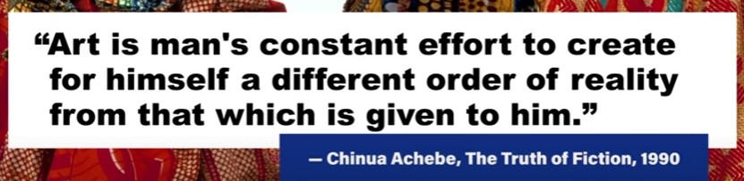
Quotes by famous artists

Slide 8
What is art?
Who decides what is art and what is not?
https://www.youtube.com/watch?v=4ha9nY1HLOU
How does the ordinary becomes art?

Slide 9

Lessons learned…

Slide 10
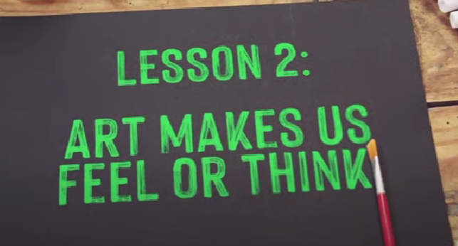
Lessons learned…

Slide 11

Lessons learned…

Slide 12
Does Art have to be beautiful?
Before you answer… we will have a tour of the Museum of Bad Art (Massachusetts)
https://www.youtube.com/watch?v=p6ATZYv61IY

Slide 13
So, who decides what is art?
Artists themselves
Art teachers
Art critics
Gallery owners
Collectors
Directors of institutions
Art lovers

Slide 14
What is the purpose of art?
Art is most often functional in its ability to evoke an emotional or intellectual reaction in its audience.
Source: https://www.thecoolist.com/art/
Does art need to have a purpose?
https://www.youtube.com/watch?v=Euk7wQMuLQY

Slide 15
What are the motivations behind art?
The motivations behind art are diverse and multifaceted, and often driven by the artist’s desire to express emotions, convey ideas, or respond to social, political, and cultural contexts

Slide 16
So , what are the motives of an artist?
1. Communication in art
The most fundamental motivation for creating art is to communicate ideas.
Pablo Picasso’s “Guernica” is one of the most prominent examples of transcendent political messaging through visual art. Picasso painted the piece in reaction to the horrors of the Spanish Civil War, specifically the fascist bombing of the Basque village of Guernica.

Slide 17
So , what are the motives of an artist?
2. Entertainment as art
Entertainment is a nearly ubiquitous motivation of art due to the massive demand for enjoyable diversion from the stresses of everyday life.
Entertainers who view their work as art seek not only to achieve commercial success and fame but also to provoke emotional and intellectual responses from their audiences.

Slide 18
So , what are the motives of an artist?
3. Need for expression
The human need for expression is primal, and art is a natural byproduct of that urge.
Art offers a means to distill one’s own complex thoughts, feelings, and values into a medium that is digestible to a diverse audience.

Slide 19
So , what are the motives of an artist?
4. Social inquiry
Art is a natural medium through which to
conduct social inquiry, and the evolution of the two is deeply intertwined.

Slide 20
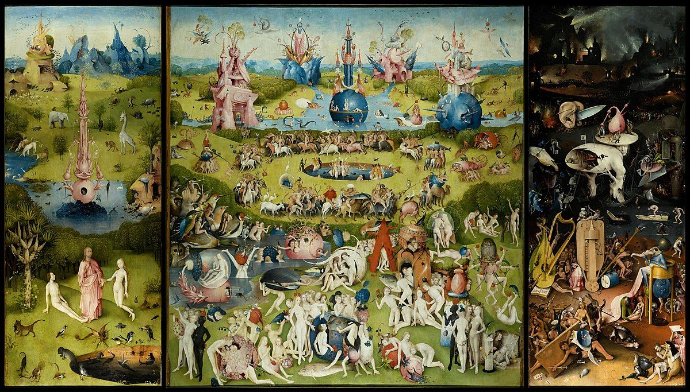
So , what are the motives of an artist?
4. Social inquiry
A prime example is Hieronymus Bosch’s “Garden of
Earthly Delights”, which invites the viewer to consider the
ethical implications of human behavior through
contrasting depictions of purity, hedonism, and decay.

Slide 21
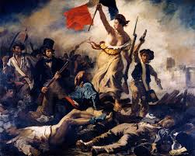
So , what are the motives of an artist?
5. Social causes
Social causes provide ample motivation for the
creation of art.
Eugène Delacroix’s 1830 painting “Liberty Leading the People” is a salient example of how art can represent revolutionary ideals.

Slide 22
So , what are the motives of an artist?
6. Commercialism
Τhere is a strong incentive for artists to make their work commercially sustainable. Similarly, commercial entities are interested in art for branding, sales, and marketing purposes. The two forces often converge to create compelling commercial art.
Andy Warhol is an iconic artist who blurred the lines between commercialism and art.
https://www.youtube.com/watch?v=r_FGcnR6EUY

Slide 23
So , what are the motives of an artist?
7. Psychological health
Art is a useful medium for fostering psychological health.
Art therapy helps patients understand, manage, and express their emotions and conflicts through the process of art-making and guided reflection on the resultant work.

Slide 24
So , what are the motives of an artist?
8. Propaganda
Propaganda has been a significant motivation for art throughout history, used by governments, organizations, and individuals to promote specific political, social, or cultural agendas.

Slide 25
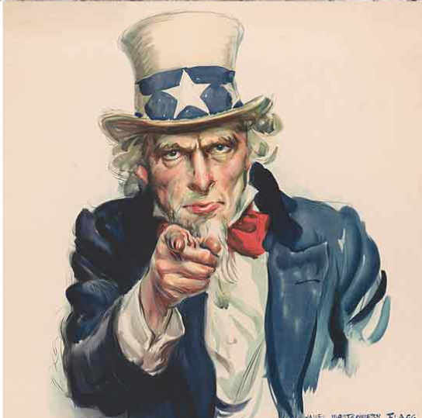
So , what are the motives of an artist?
20th-century wartime propaganda was significantly more explicit in its attempt to persuade the public to action. James Montgomery Flagg’s 1917 “I Want YOU for U.S. Army” poster is one of the most iconic and effective examples of artistic propaganda.

Slide 26
What makes something art?
“The intention behind a work’s creation is ultimately what makes something art.”
There are two fundamental qualities that something must have to qualify as art.
Human expression: It manifests the artist’s creativity, emotions, ideas, or worldview.
Creative process: An artist manipulates the its intended audience, medium, and technique in order to elevate the novelty and message of the artwork.

Slide 27
What is considered Art?
The question “What is considered art?” recognizes that the definition of art is not just a matter of inherent qualities but is also shaped by social, cultural, and historical contexts.
In some societies, art is closely linked to religious or ceremonial functions, while in others, it’s seen primarily as a form of authentic personal expression or social commentary.

Slide 28
What is considered Art?
A piece that might be overlooked or dismissed in one era might be celebrated as groundbreaking or visionary in another, often due to changes in artistic trends, societal values, or critical perspectives.
For example, Vincent van Gogh’s work was largely unappreciated in his time, and the artist lived and died in poverty and relative obscurity. It wasn’t until influential art dealers like Ambroise Vollard created a market for van Gogh’s avant-garde art that his work became widely accepted as having high artistic merit.

Slide 29
What is not considered Art?
Determining what is not considered art can be as complex and subjective as defining what is considered art.
- Purely functional items created solely for utilitarian purposes without any expressive or aesthetic intent are usually not considered art.
- Mundane tasks do not usually constitute an artistic performance.
- Works of plagiarism or forgery are commonly rejected as art,

Slide 30
Questions
- What are the characteristics an artist has too have?
Can somebody be taught how to be an artist?
What are the main forms of art?
Do you consider folk art an art?

Slide 31
Questions about you!
What are your expectations from this School of art?
What are your goals after finishing the school?

Slide 32
what is art?
Related articles
https://www.guarcholga.es/who-determines-what-a-work-of-art-is/
https://www.thecoolist.com/art/

