Slide 1
Case Study on the Development of Tech Solutions in the Public and Private Sector in Brazil
17/01/2023

Slide 2
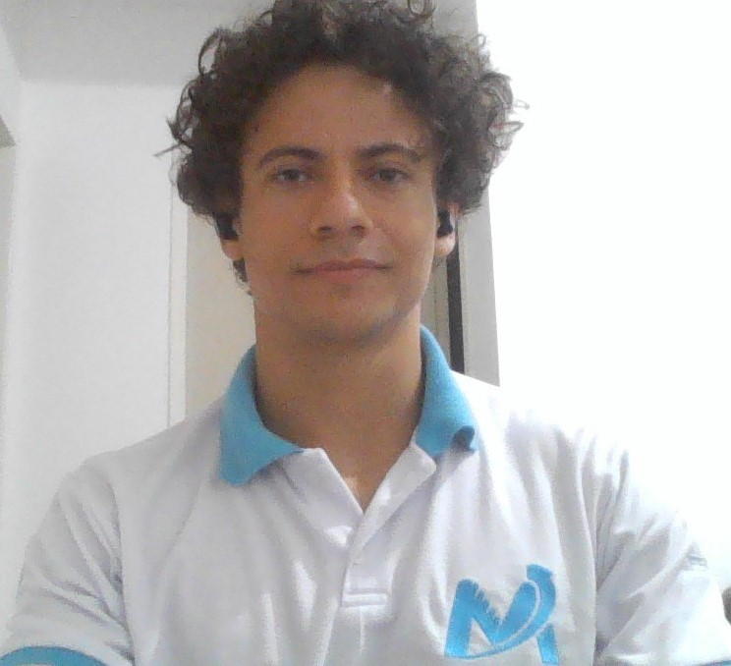
Who am I?
Luis Otavio M Soares
Computer Scientist and Mathematician
Worked in the Mayors Office as an Intern for a few months
Former President (Management Director) of Metrus Jr.
Director of Expansion for the North of Minas Gerais
Tech Entrepreneur (and often freelancer)
and Civil Engineering Student at the University of the North of Minas Gerais (UNIMONTES)

Slide 3
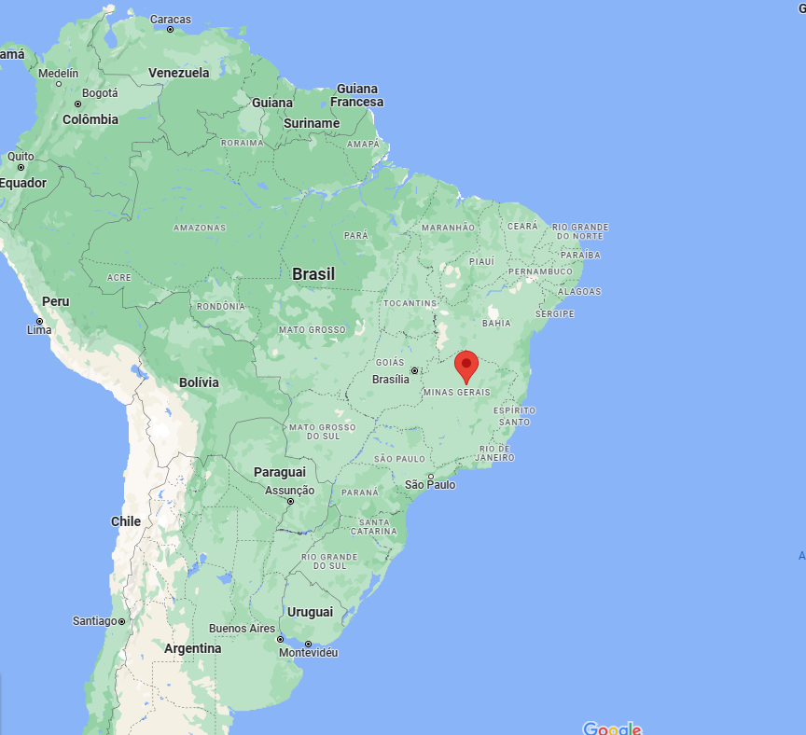
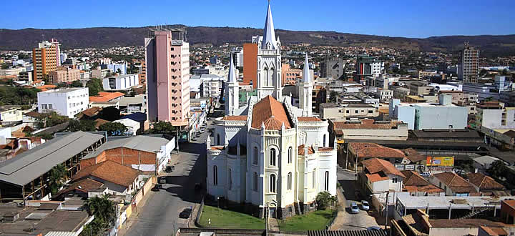
Where is Montes Claros?

Slide 4
A Few Definitions First
What is a Junior Company?
What do I mean when I say I was hired to help optimize the processes in the Mayor’s Office Public Services Sector?
What do I mean when I say I am a computer science and mathematician (problem solver)? And what about machine learning and AI?

Slide 5
The Mayor’s Office
Been first approached with the with the job proposal to help develop a new optimization strategy for the garbage collector sector of the city. I was supposed to work in a research project for that with a professor.
I was supposed to go to the Public Services sector, which handles all that is paid and done for the population of the city, as is the garbage collection.

Slide 6
The Mayor’s Office
REALITY CHECK: They needed so much more
The Garbage Collection sector of the Public Services is more important than most people realize. It can spend up to R$600k (108k euros) a month with its services, and with the cost of operations it can go up to R$1mi (200k euros), so optimizing it means a lot for the money of the city.

Slide 7
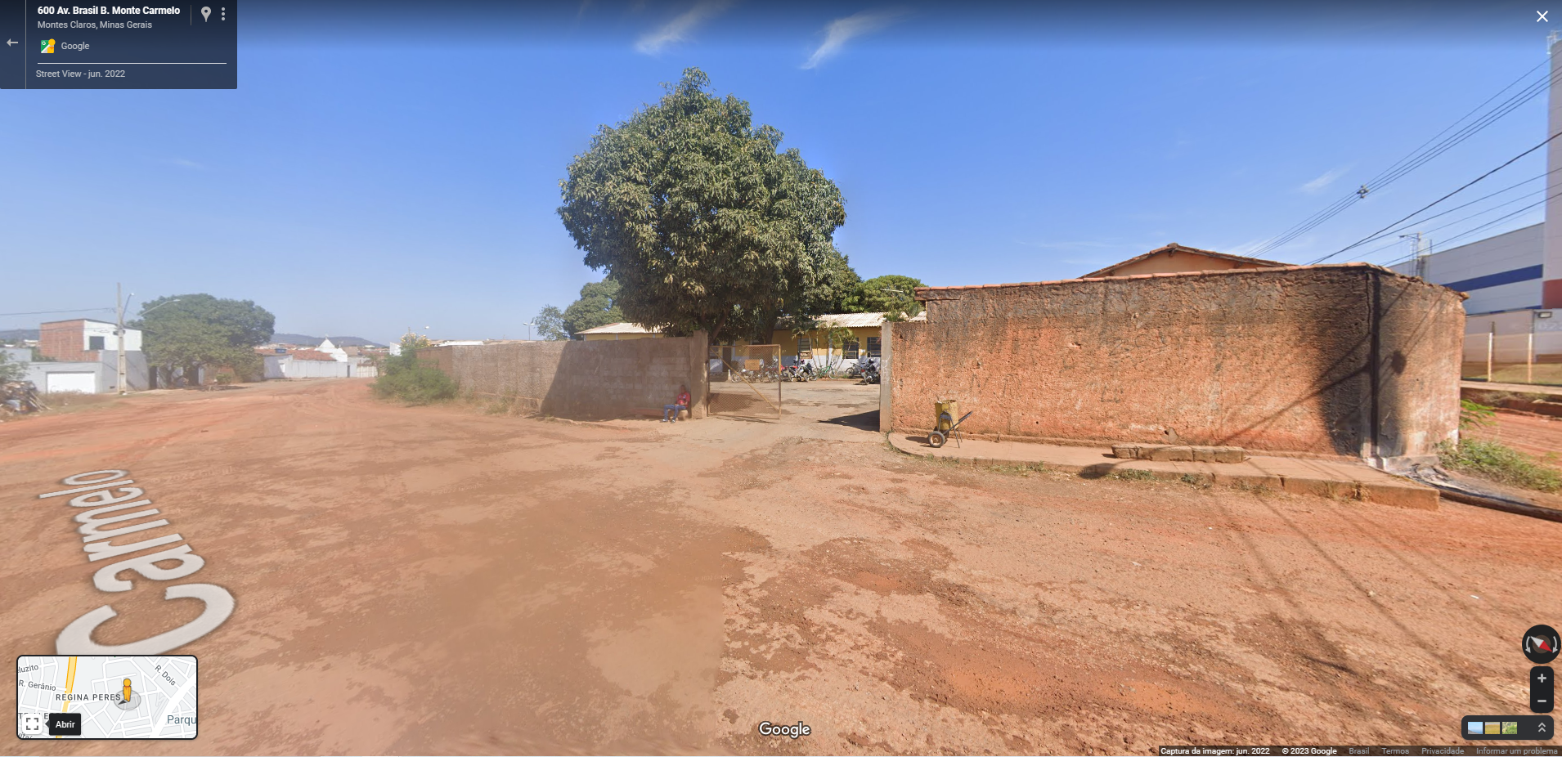
The Mayor’s Office

Slide 8
The Mayor’s Office
Been a Coder and an Intern, what could I do to optimize and improve the services there?

Slide 9
The Mayor’s Office
Let’s try and do as much as I can
2
Plan
1
Identify
3
Solve

Slide 10
The Mayor’s Office
Things I tried to solve (in the next slide as I really got excited about that when I was there):

Slide 11
Routing
Optimize the routes of each truck at each day
Communication
Different sectors in the garbage collection sector needed to communicate better, e.g.: management and the garage.
Work Schedule
Paying extra hours and night hours is a big deal there, so organizing it so no money will be spent unnecessarily was important
Financial Planning
Dealing with overweight in the trucks
Data Visualization
Making graphs and dashboards to follow the day-to-day activities
Image Analysis
Using AI to identify and mark the working time of the workers and “read” text documents to convert to digital.

Slide 12
The Mayor’s Office
With all that, is it even possible for one person to do it all? Short answer: no.
How the management of the public service in Brazil interfered? And as a reminder: I am not trying to advocate for public vs private.

Slide 13
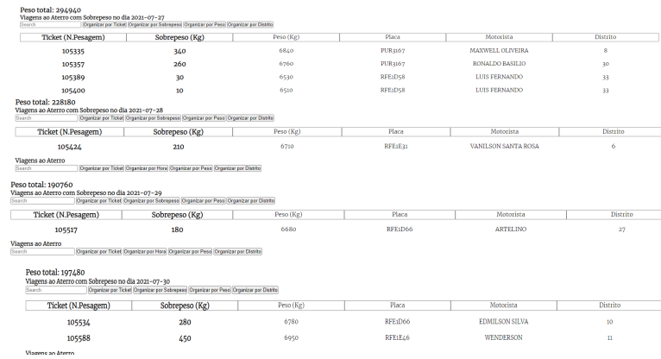
The Mayor’s Office
Overweight trucks reports

Slide 14
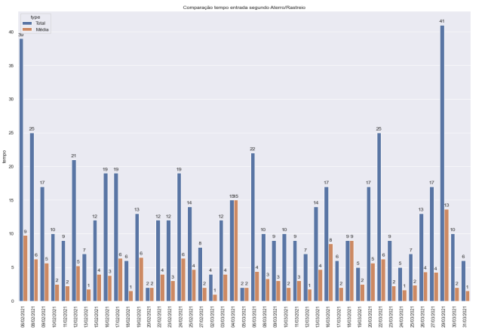
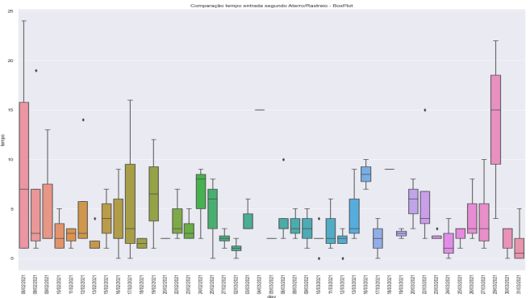
The Mayor’s Office
Analysing time each truck spent at the landfill

Slide 15
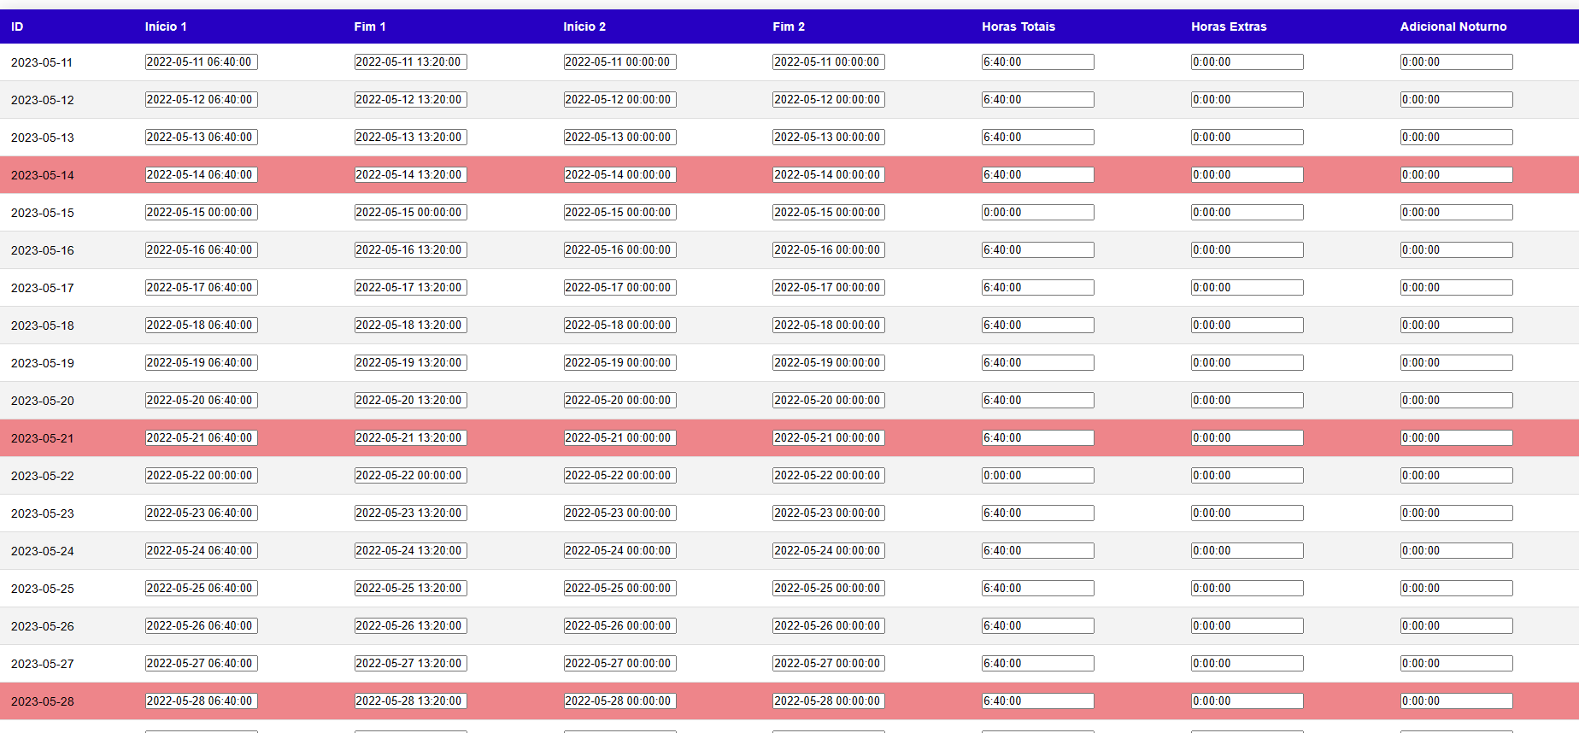
Mayor’s Office
What remained

Slide 16
Mayor’s Office
And why did it remain?

Slide 17
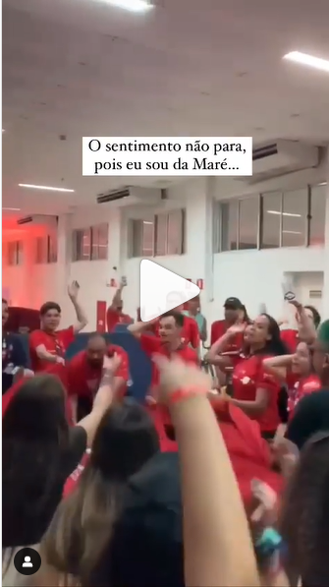
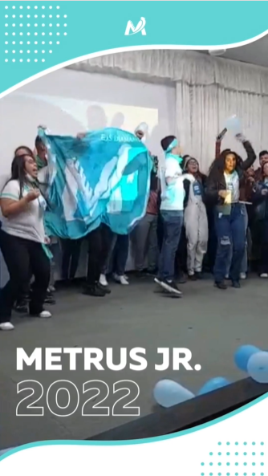
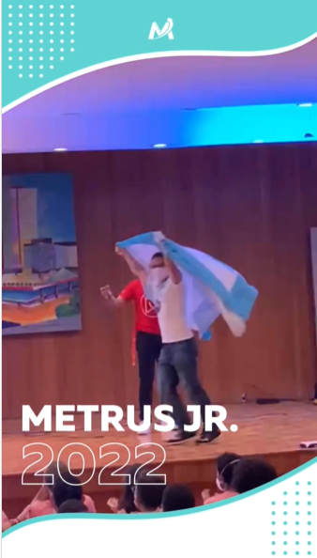
Metrus Jr.
Using what I learned from the “Movimento das Empresas Juniores” - MEJ

Slide 18
Metrus Jr.
Culture & Values
Working the values and the culture of a company, even if small, will determine a lot of its future results.
Management
Been a leader does not mean been the best and doing it all. Means guiding & managing.
Goals
Set up goals and a schedule for them. A routine can be a great difference maker.

Slide 19
Management Strategies
Agile
5W2H, SWOT (Strengths, Weaknesses, Opportunities, and Threads) - Action Plan
Lean

Slide 20
Management Strategies
I am not a Scrum Master
Been a developer and computer scientist is a huge advantage in these strategies
Sprints.

Slide 21
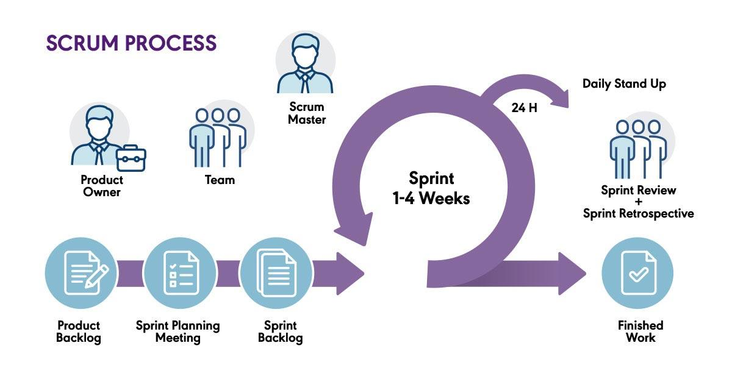
Management Strategies
SCRUM
Just a quick summary

Slide 22
Management Strategies
TRELLO - Just a tool

Slide 23
Management Strategies
The Scrum and Sprint strategy that I use are very important for each specific step in each project. But looking at a more “macro” picture can have some different tools.

Slide 24
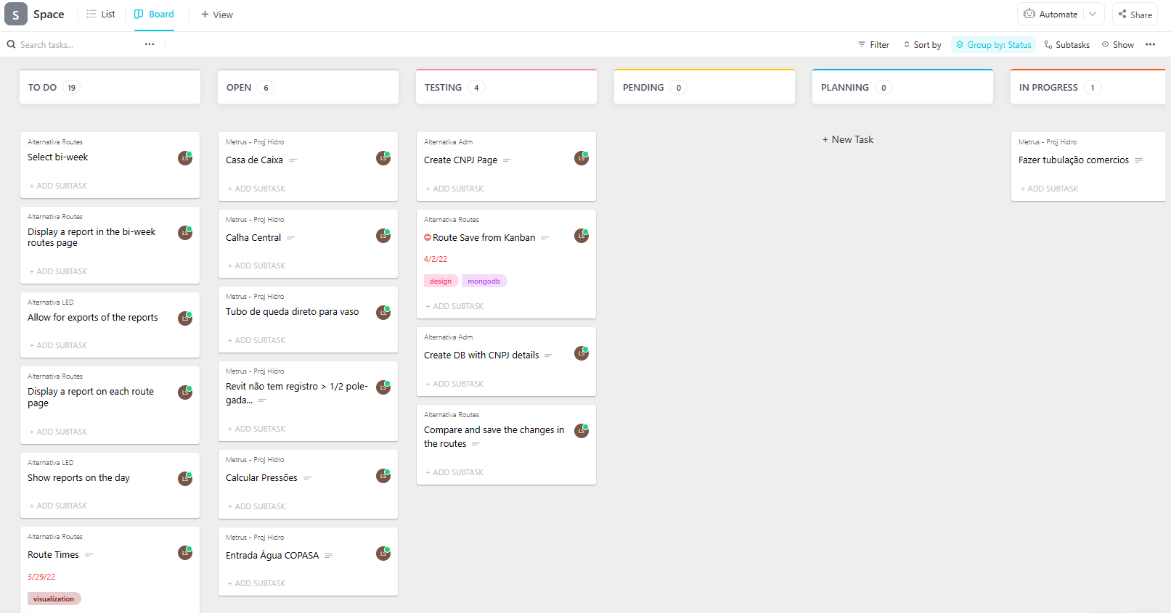
Management Strategies
CLICK UP

Slide 25
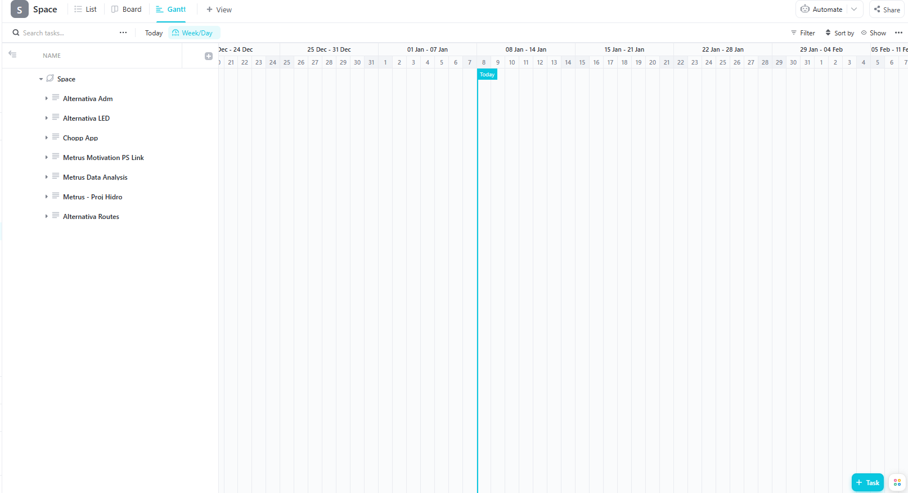
Management Strategies
CLICK UP

Slide 26
Use what you learn
Learning is a continuous process.

Slide 27
Explain better the process
Understanding the process is more important than just seen the results.

Slide 28
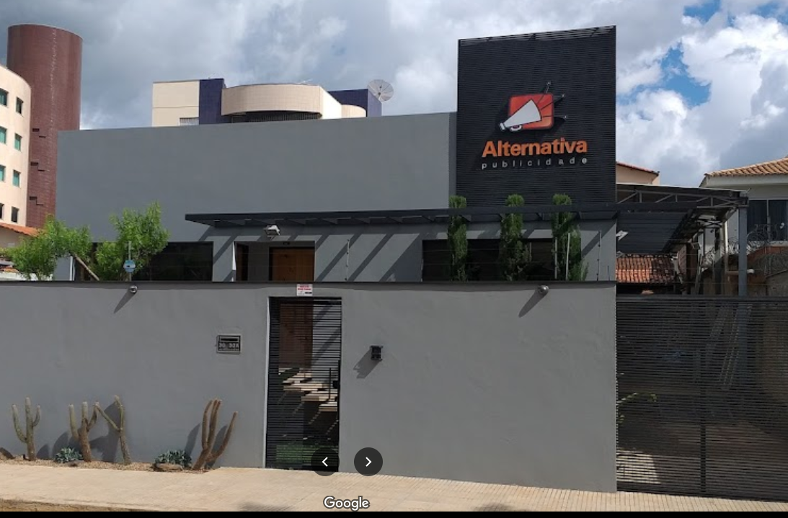
Alternativa Publicidade

Slide 29
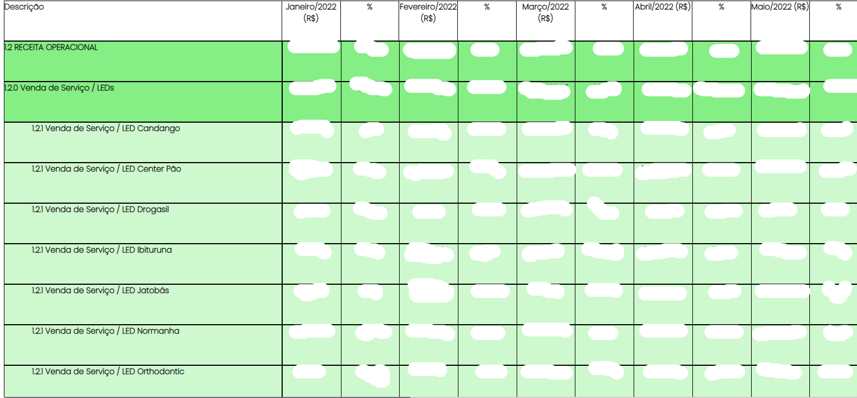
Alternativa Publicidade
Financial Processes (e.g.: DRE)

Slide 30
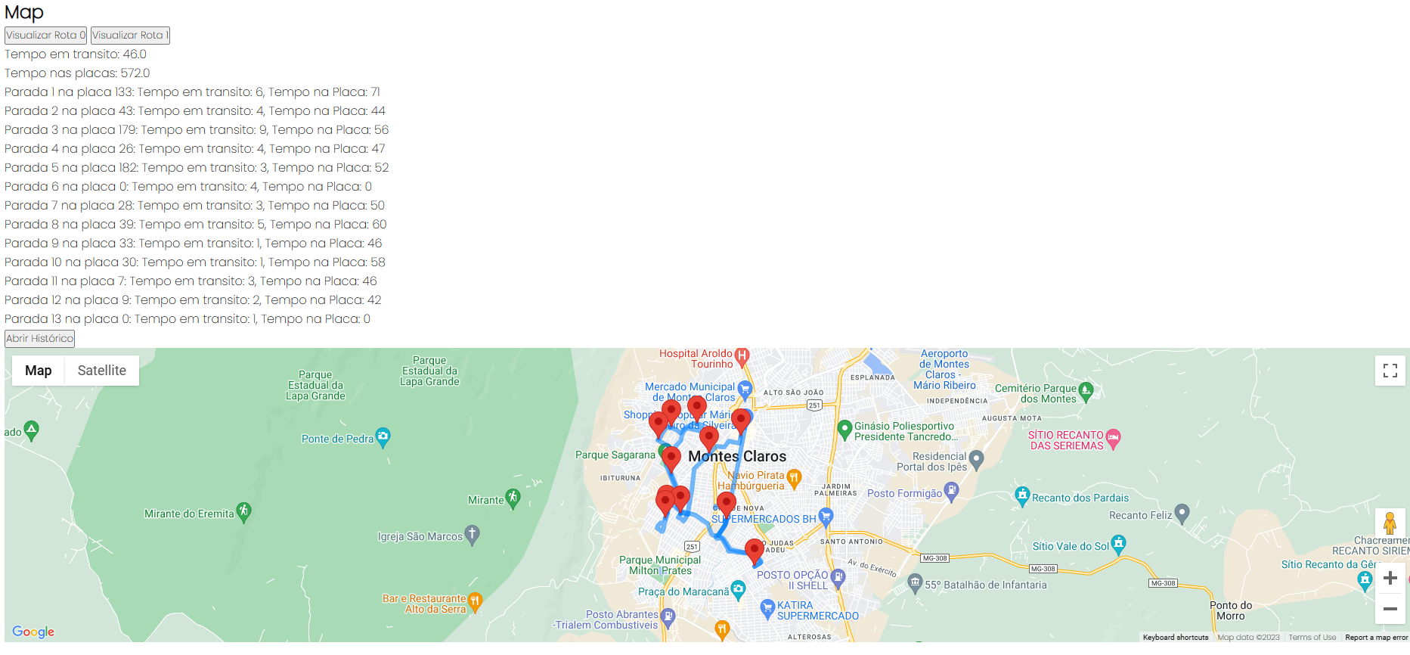
Alternativa Publicidade
Route Optimization (Done Right)

Slide 31
Alternativa Publicidade
Route Optimization (Done Right)
Now this was not just an optimization problem. We created a solution for the company, and a solution that could also be marketable.
All the project was planned from the idea to how it would fit in practice.
Testing was done in all steps of the process
There was a close follow-up of the results with the operations team
Communication was key

Slide 32
Alternativa Publicidade
Route Optimization (Done Right)
But why was it done right?
Working with the team; Understanding the situation; Creating and working the culture of the company or the project; Having a well established leadership (“not a boss”)

Slide 33
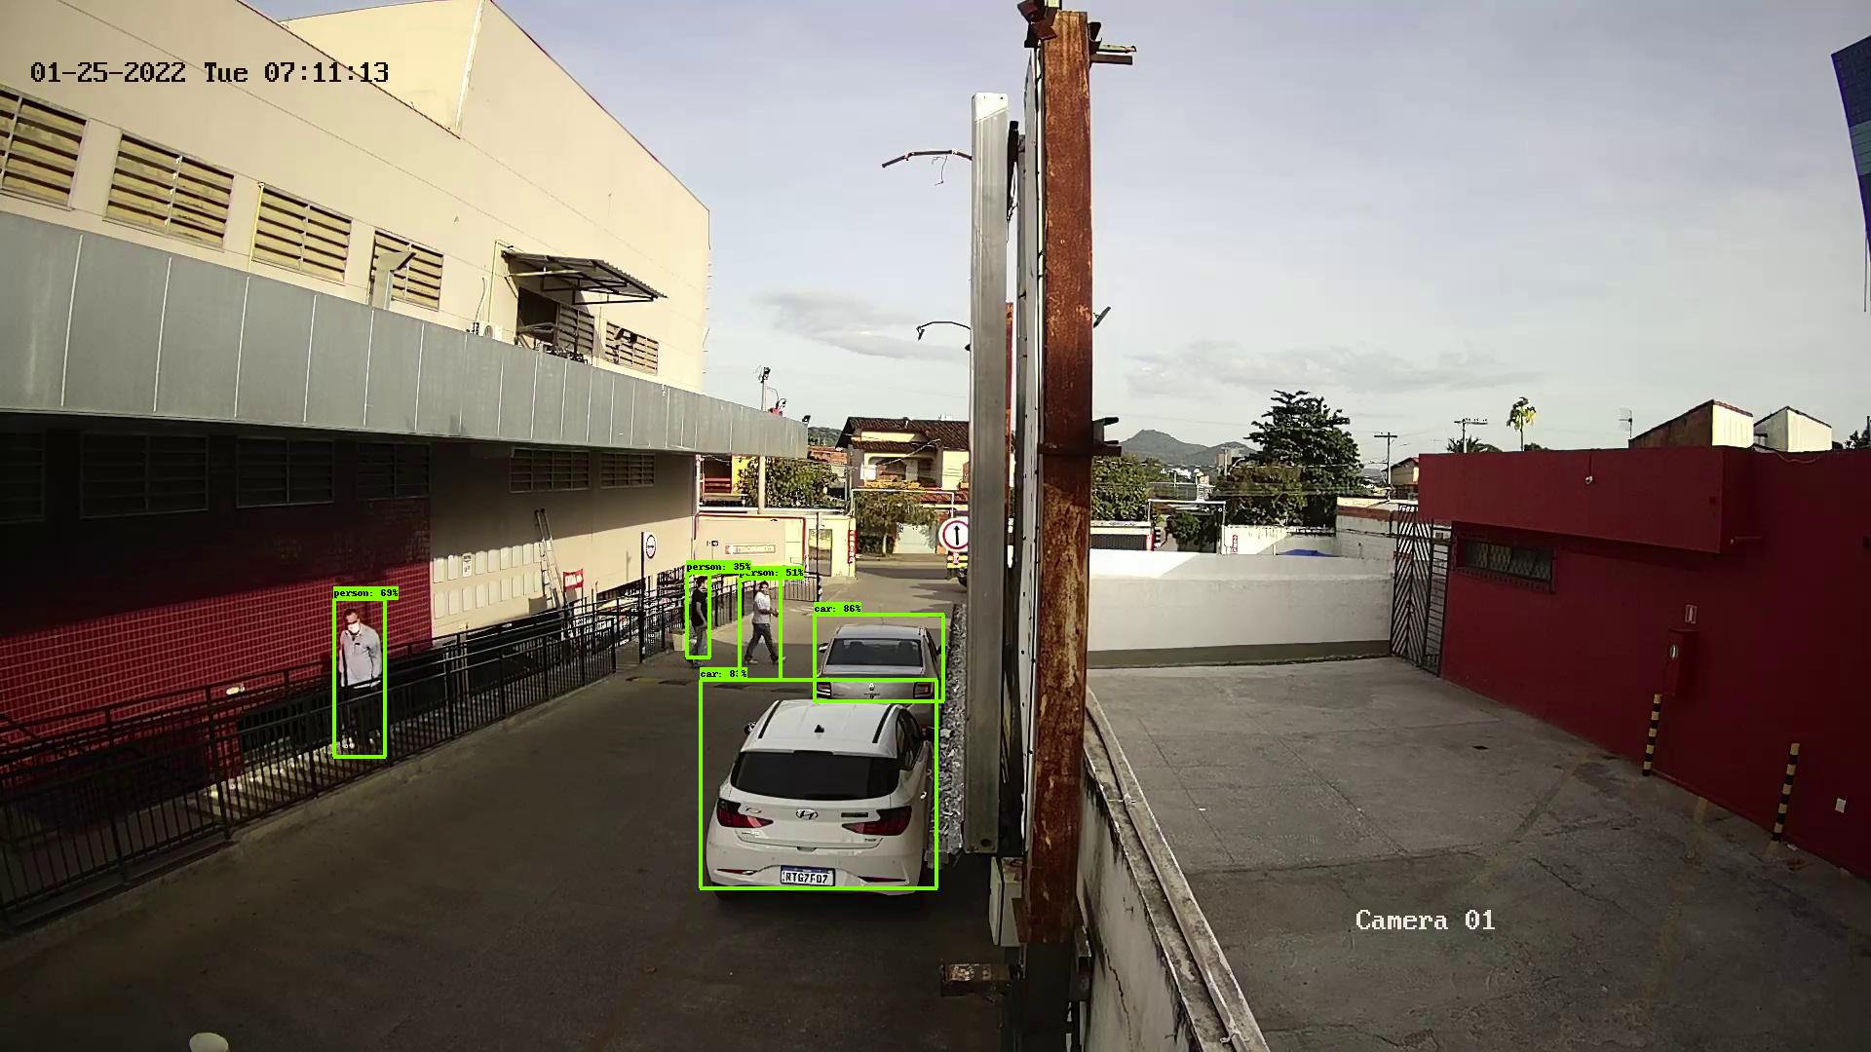
Alternativa Publicidade
Image Analysis

Slide 34
Organizing and Adapting
When the processes are well structured any project or company can work at scale.

Slide 35
Ευχαριστώ πολύ!
www.linkedin.com/in/luis-otavio-soares-7363a61b2
+55 38 99245-1674
@lomsoares
@metrusjr
lotmsoares@gmail.com

